Slide 1
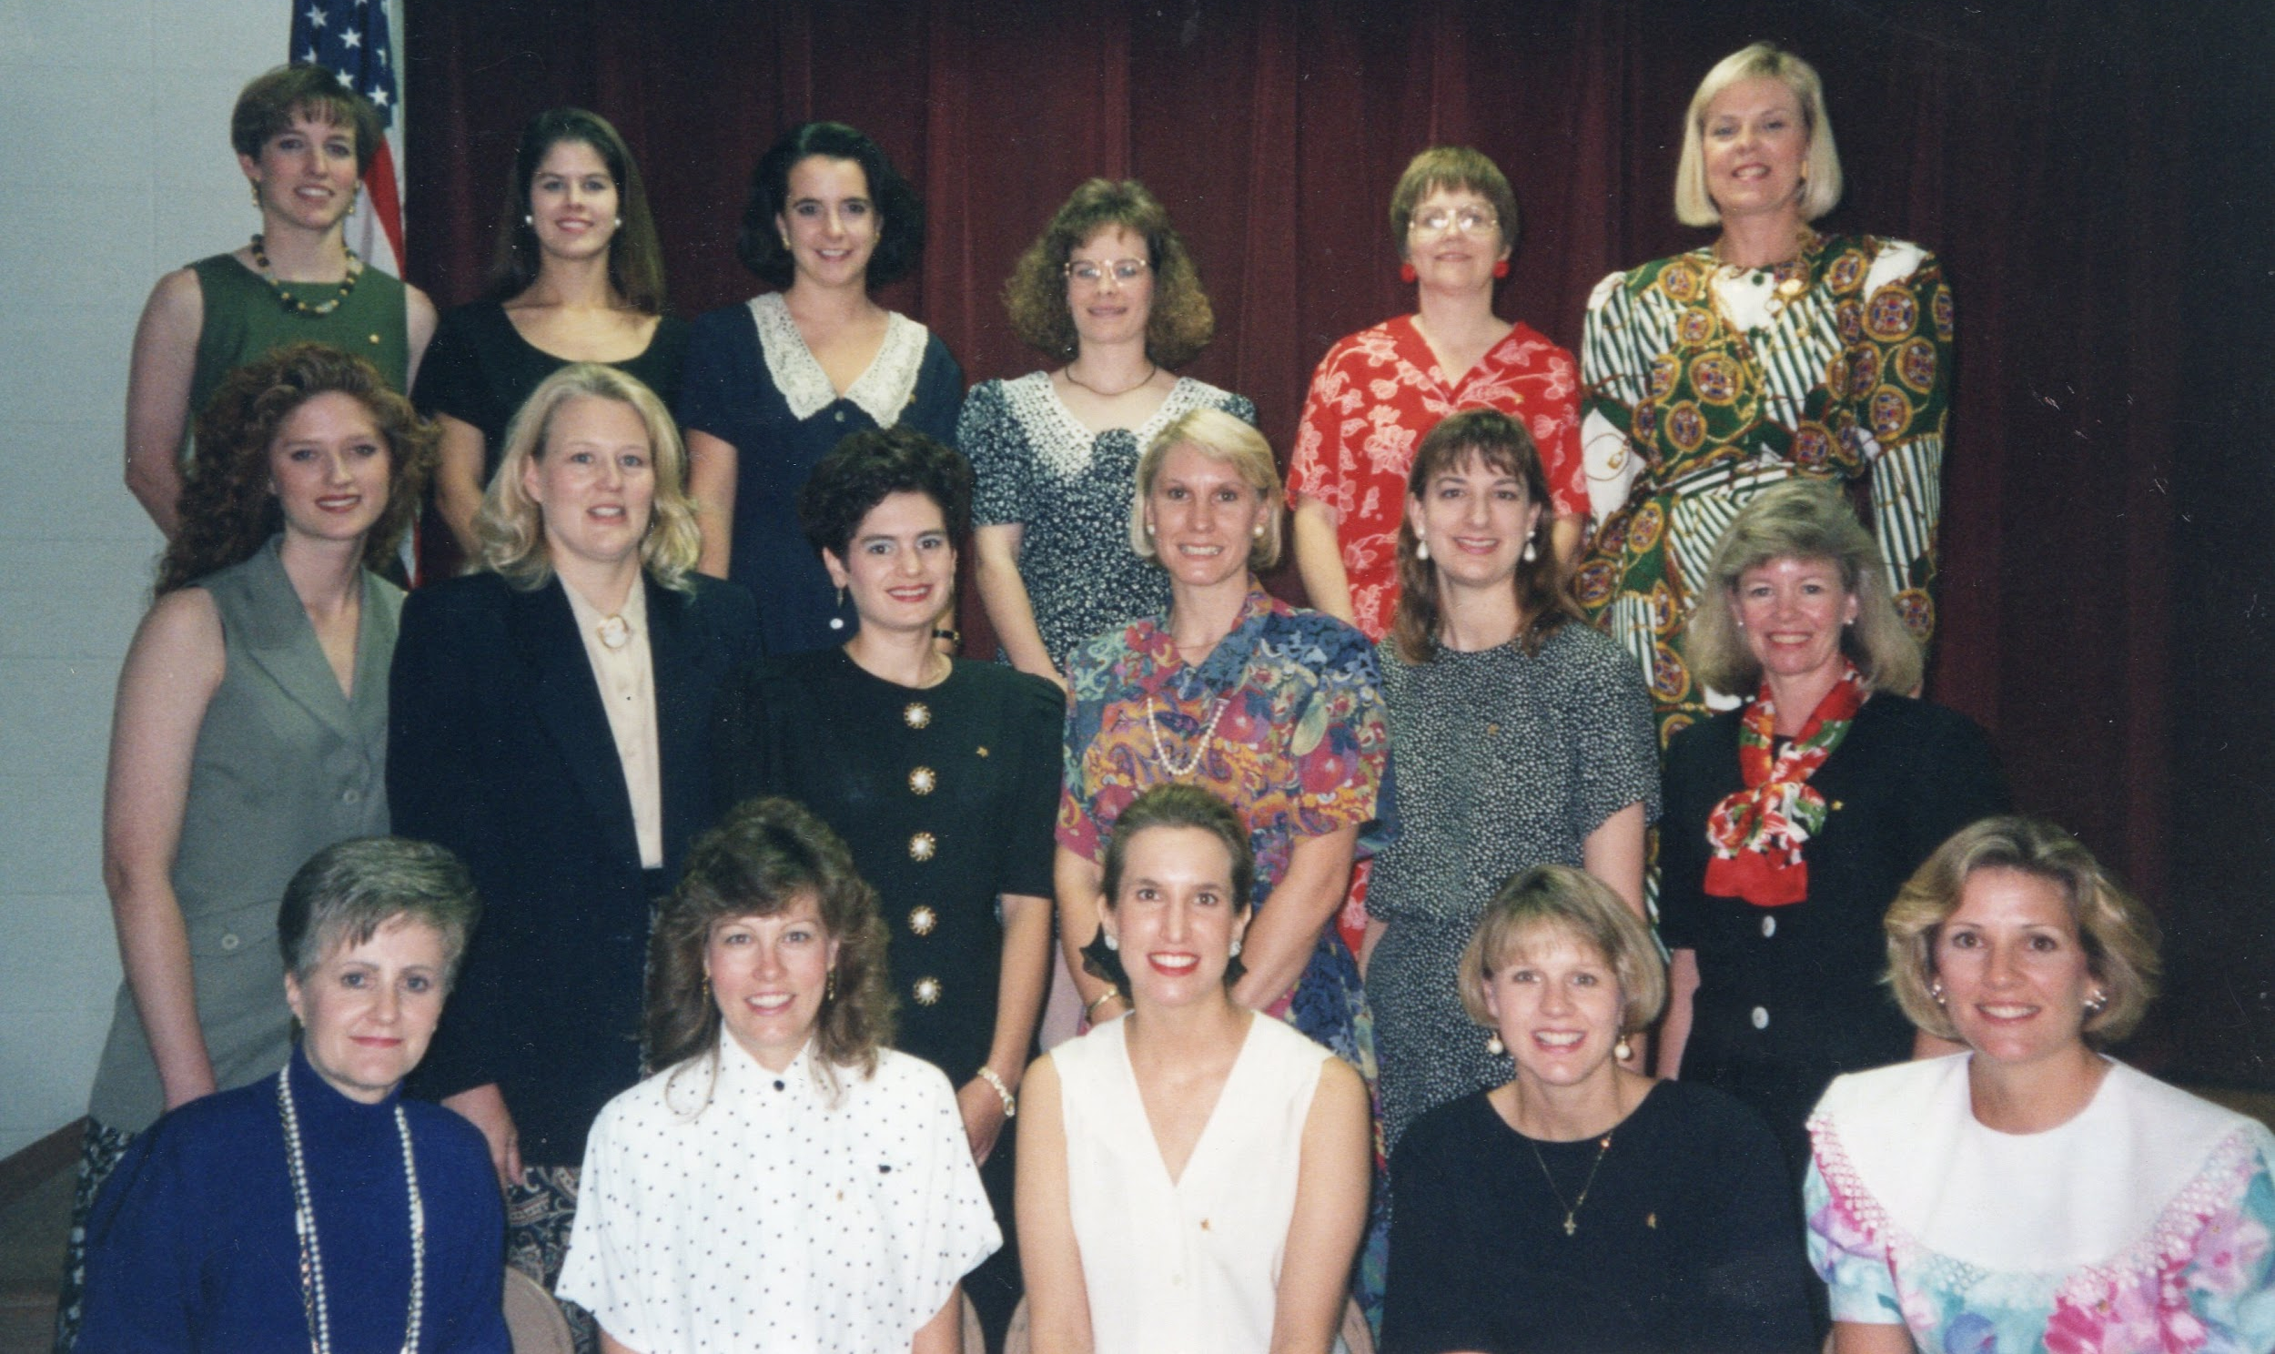
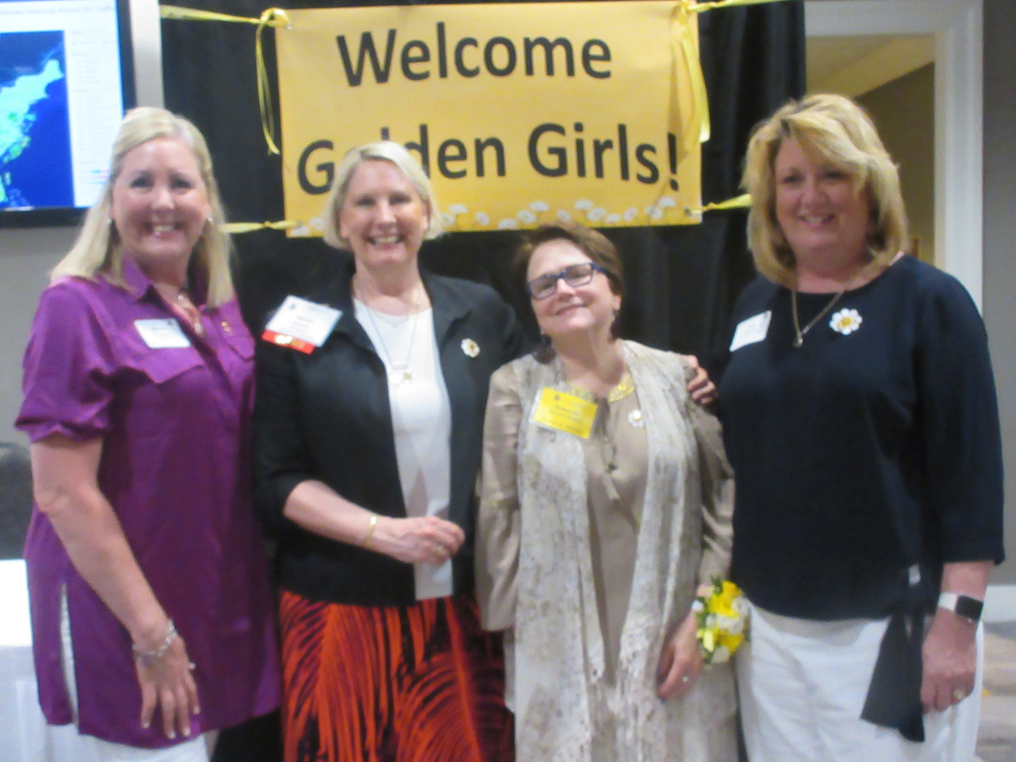
Online Chapter Scrapbooks:
Archiving Your
Star Sisters
Chapter JF - Shawnee Mission, KS
Notes:
Begin with introductory skit!

Slide 2
What is it?
An online scrapbook is a digital collection of memories, ideas, or inspirations—like a traditional scrapbook, but stored and accessed online. Some are private and personal, while others are shared publicly as a way to tell a story or document experiences.

Slide 3
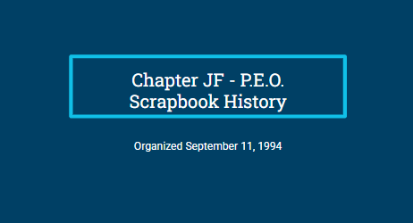
Chapter History
Getting to Know
our Sisters
All about our chapter, past and present.
Each sister gets a page!
Notes:
Our chapter has 2 online scrapbooks: Chapter History and Getting to Know our Sisters.
We will be demoing how to make one.
Next slide: examples!

Slide 4
Chapter JF - P.E.O.
Scrapbook History
Organized September 11, 1994

Slide 5
Table of Contents
Table of Contents
Chapter JF - Our Story
Organization - September 11, 1994
Joyously Fertile - Baby Additions
Sisters Who Have Gone Beyond Local Chapter Level
Family Initiations
Breast Cancer Survivors
Family Members in Chapter JF
Hostess Chapter Duties
Our Founders & Founders Day Programs
P.E.O. Project Recipients
Fun Social Events
Fundraising Auctions & Events
Fun with B.I.L.s
Golden Girls
Chapter Eternal

Slide 6

Chapter JF
Our Story
We organized Chapter JF on Sept. 11, 1994. Back then, 911 had not occurred yet. It happened on Sept. 11, 2001.We had no way of predicting that September 11th would have such significance due to the horrible tragedy that happened in our country’s history.
On February 9, 1994, several of us were invited to a meeting at Sue Hunt’s (Chapter HJ) home. Sue was in charge of the Unaffiliate List for Johnson County Reciprocity and all of our names were on her list. A lot of us had been previously initiated into our mothers’ out of town chapters, but had not been able to attend those chapter meetings due to moving to Kansas City.
At Sue Hunt’s meeting, it was suggested that a new chapter could be organized which would provide the opportunity for several of us to become affiliated & be in the same chapter. Two of the charter members of the chapter: Anne (Cleland) Hannon and Allynelizabeth(Sunny) (Cleland) (Coens) Murphy were sisters and the daughters of Betty Cleland, who was on the Board of Kansas State Chapter at the time. This was an excellent coincidence and Betty and the Kansas State Chapter Board were very helpful in guiding us through the process of organizing a new chapter. Betty was 2nd Vice President on the Board and Joyce Lutz was Organizer on the Board. They were both excellent advisors. In addition to these two women, Karen Slater from Chapter HF, was also very instrumental in our journey to organization.
Anne (Cleland) Hannon led us through the process, but it was the hard work accomplished by all 15 charter members that enabled Chapter JF to be organized in just a short 7 month period of time. There was a tremendous bonding and closeness that took place during the journey; much like what our 7 founders must have experienced when they started P.E.O. back in 1869.
On Sept. 11, 1994, we all celebrated the big day with 15 charter members and one new initiate: Kelley Pryor Amrein, Anne (Cleland) Hannon, Allynelizabeth(Sunny) (Cleland) (Coens) Murphy , Cathy (Cofer) Smith, Jill Fazio, Kari S. Goheen (Stubbs), Debi Hensley, Janet Jehle, Joann Lavery, Debbi Maddy, MarLynne Morrison, Susan (Ramsey) Adkins, Claudia (Snyder) Mills, Laura Sullivan, & Carolyn Young. Rachel (Werner) LaHue was our first initiate.

Slide 7
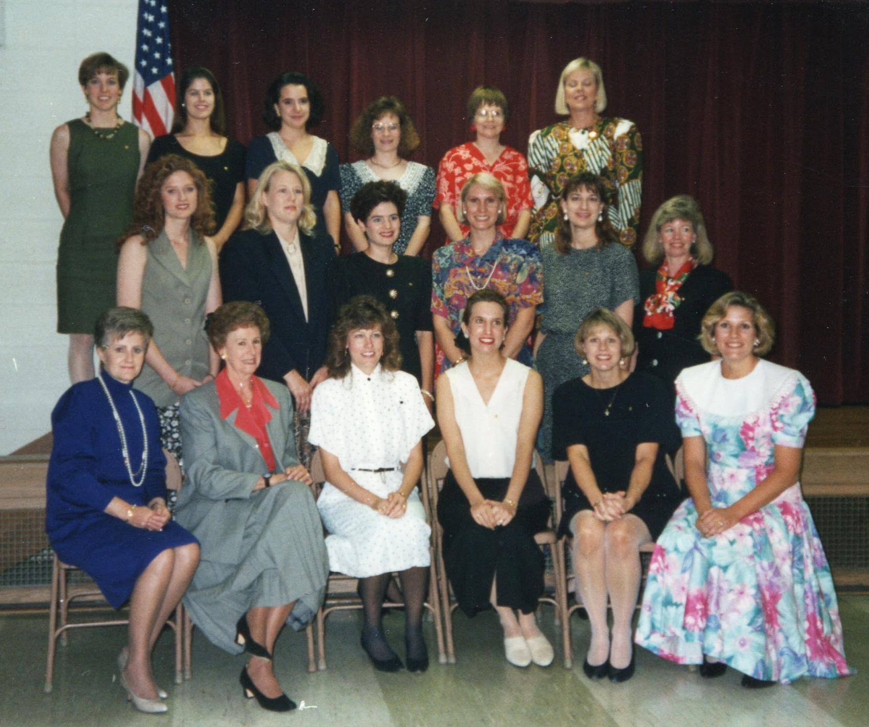
Organization
September 11, 1994
Front row: Joyce Lutz, Organizer, Kansas State Chapter, Joann Lavery, Jill Fazio, Allynelizabeth (Sunny) Cleland Coens Murphy, Janet Jehle. Middle Row: Rachel (Werner) LaHue, Carolyn Young, Kelley Amrein, Anne (Cleland) Hannon, Claudia (Snyder) Mills, MarLynne Morrison. Back Row: Laura Sullivan, Kari Stubbs, Susan (Ramsey) Adkins, Cathy (Cofer) Smith, Debbi Maddy and Debi Hensley.
You are cordially invited
to celebrate the
Organization
Of
Chapter JF, P.E.O.
Shawnee Mission, KS
Sunday, September 11, 1994
2:00 P.M.
Trinity United Methodist Church
5010 Parallel Parkway
Kansas City, Kansas
Regrets Only
Anne Cleland, President Reception to Follow
(913) 262-1148
Front Row: Joyce Lutz, Organizer, Kansas State Chapter, Betty Cleland, 2nd Vice President, Kansas State Chapter, Joann Lavery, Jill Fazio, Allynelizabeth (Sunny) Cleland Coens Murphy, Janet Jehle. Middle Row: Rachel (Werner) LaHue, Carolyn Young, Kelley Amrein, Anne (Cleland) Hannon, Claudia (Snyder) Mills, MarLynne Morrison. Back Row: Laura Sullivan, Kari Stubbs, Susan (Ramsey) Adkins, Cathy (Cofer) Smith, Debbi Maddy & Debi Hensley.

Slide 8
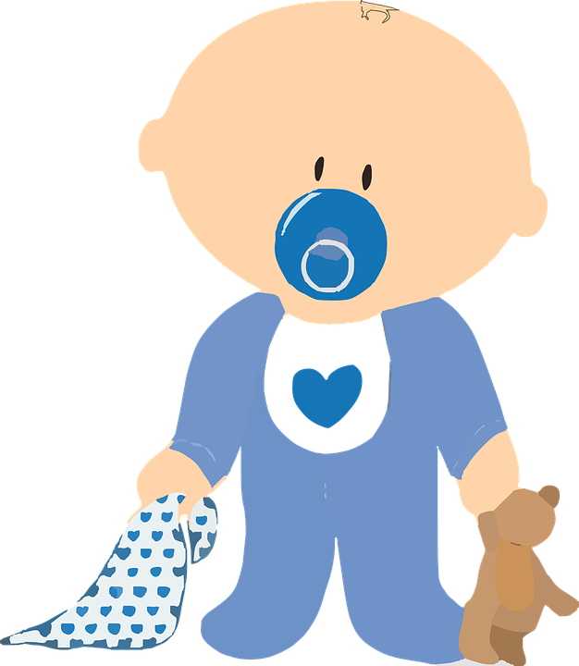
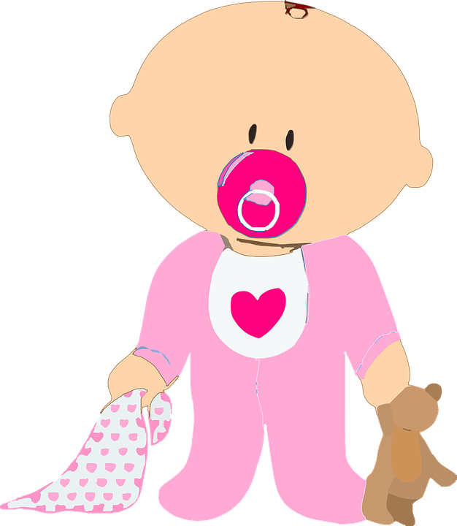
In the early days of the chapter, we had so many young members, we joked that Chapter JF stood for
“JOYOUSLY FERTILE”
So many babies have been born
into
Chapter JF…
Mom’s Name Baby’s Name Baby’s
Birthdate
Susan (Ramsey) Adkins | Trent Ramsey Adkins | Nov. 11, 2000
 | Ty Michael Adkins | Sept. 10, 2004
Rebecca Armacost | Jackson Henry Armacost | Born Sept. 6, 2013 Placed in her arms Dec. 20, 2013
Notes:
Grey boxes used to hide “sensitive information”.
A LOT of our sisters were expecting when our chapter was founded.

Slide 9


Courtney Bauer
Emily (Bean) Clark ( Parish) | Ella Michelle Clark | Oct. 10, 2004
Katie (Brown) Blake | William Hunter Blake | Jan. 23, 2011
 | Brady Austin Blake | Dec. 17, 2013
 | Riley Ann Blake | Dec. 14, 2015
Stephanie Burns | Ellie Meredith Burns | April 21, 2003
 | Brooklyn Emily Burns | Nov. 20, 2004
 | Hadley Ann Burns | March 4, 2008

Slide 10
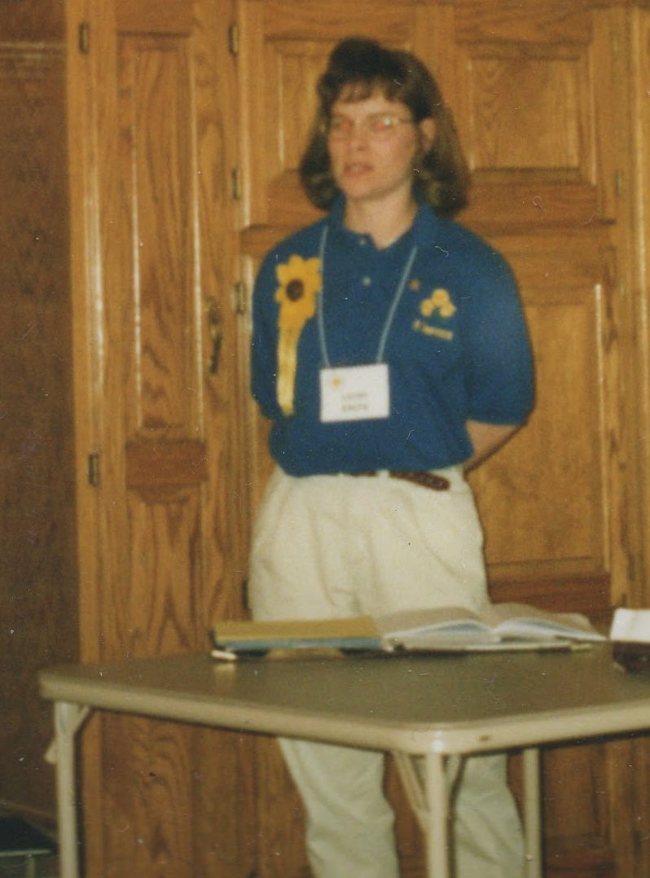
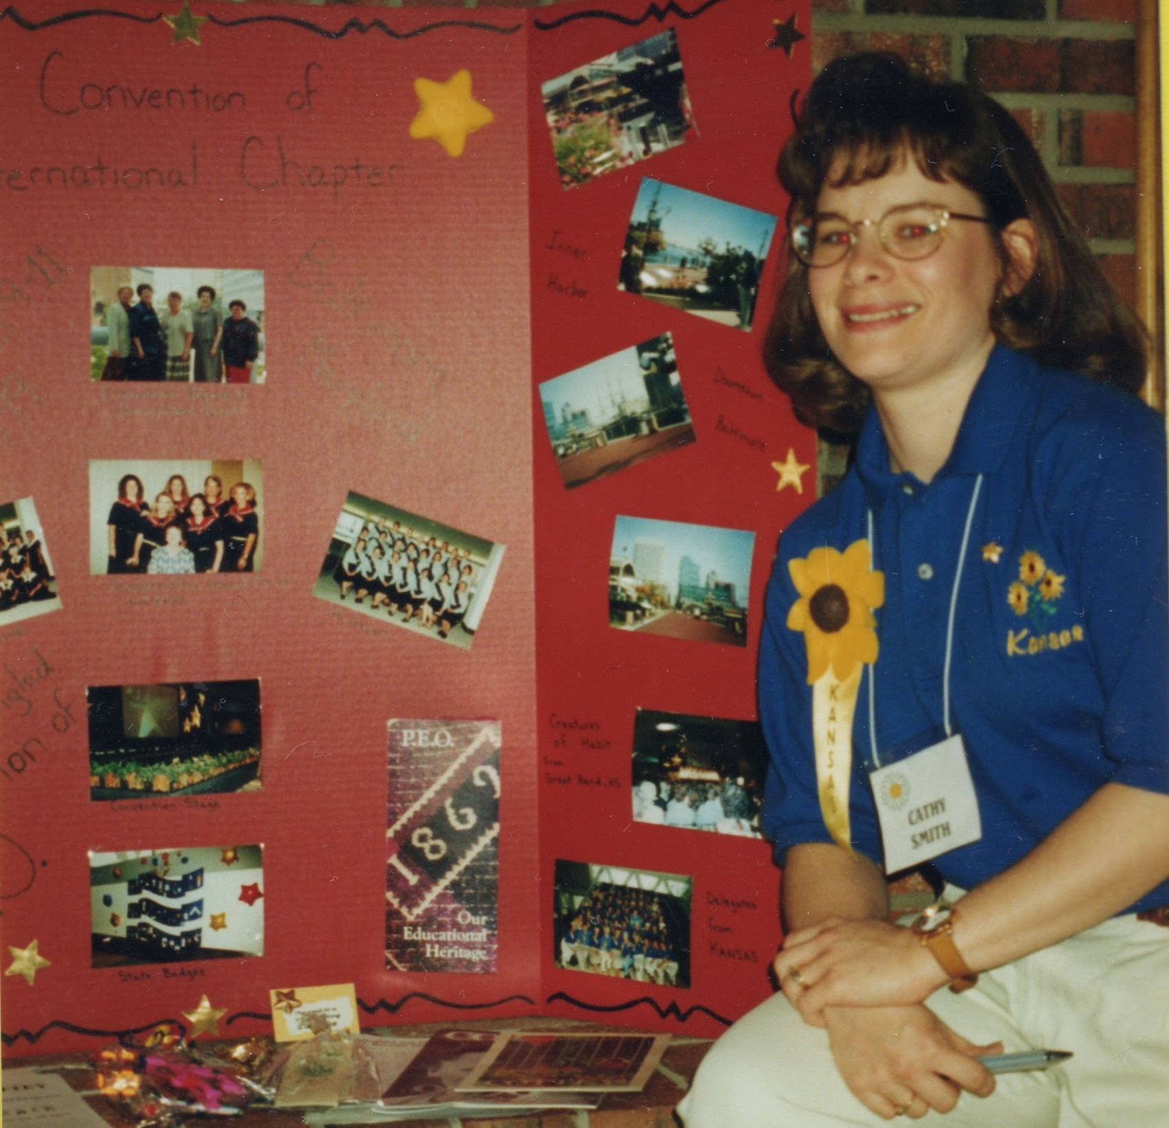
Sisters Who Have Gone Beyond The
Local Chapter Level for the Sisterhood
Cathy Smith gives her
International
Convention Report
Cathy served as International Delegate with the
Kansas Delegation to Convention of International Chapter in Baltimore, Maryland in 1999

Slide 11
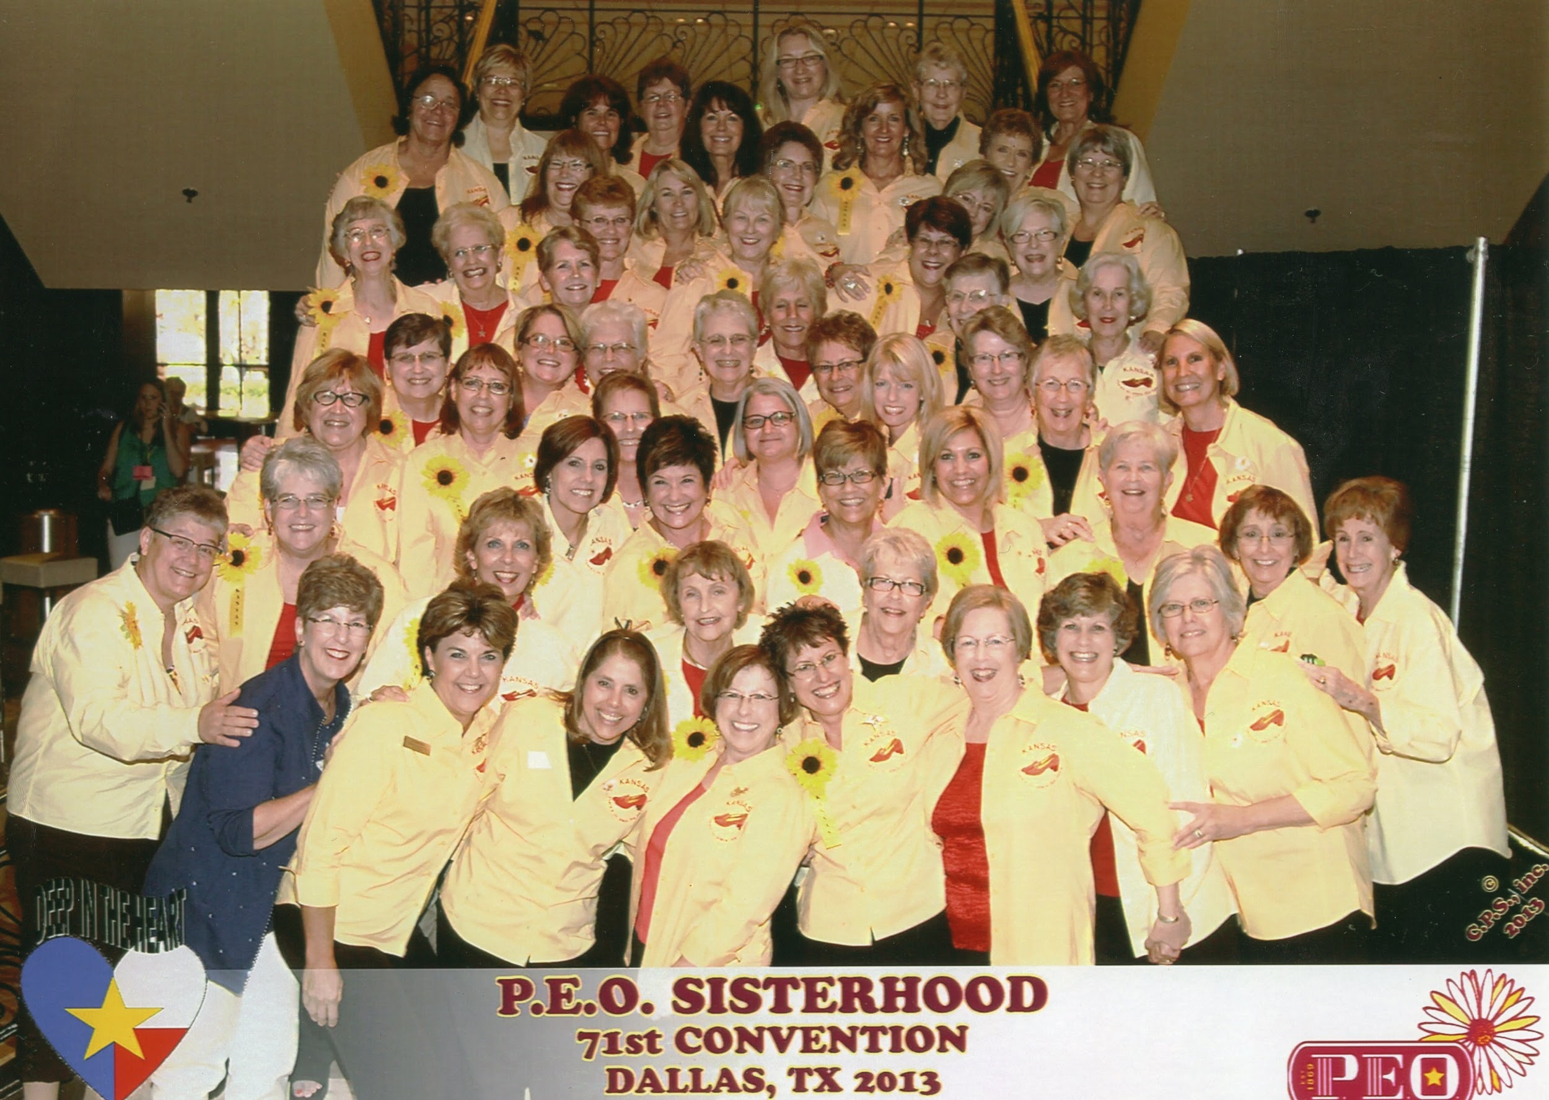
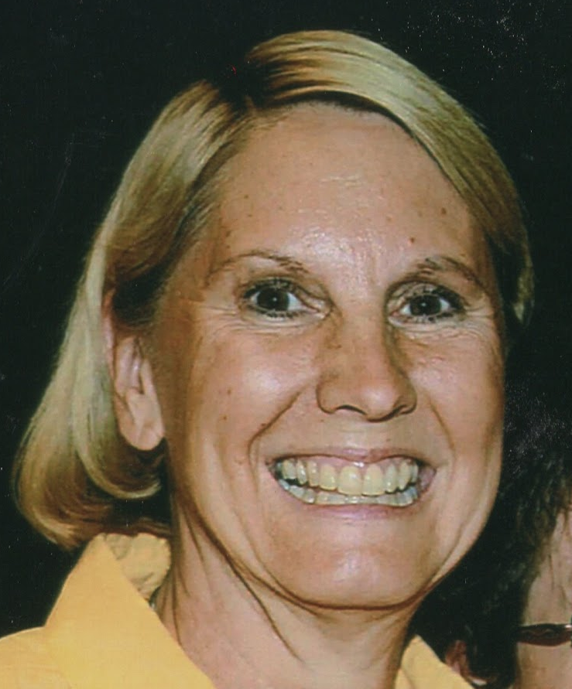
Anne Hannon served as International Delegate with the Kansas Delegation to Convention of International Chapter in Dallas, Texas in 2013.
She also served in the appointed position as Investment Consultant for Kansas State Chapter in 2000-2001.
Also 3 year term serving on Leadership Team - Unaffiliate Committee 2025 - 2028

Slide 12
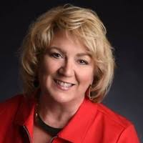
Jan has held many positions beyond the local chapter level:
She was Convention Chairman for Kansas State Convention 1999
She served on Kansas State Convention Advisory Comm 1997-2002
She served on Kansas State Finance Committee 2002-2003
She served on KSC Convention Credential Committee 2014
She served on KSC Nominating Committee 2014-2018
She served on Kansas State Nominating Committee 2014-2018
She served as Tennessee State Area Cottey College Chair 2011-2012
She was a delegate to International Convention in Baltimore 1999
Nominated as KSC Secretary 2021-2022
Nominated as KSC Treasurer 2022-2023
Nominated as KSC Organizer 2023-2024
Nominated as KSC Vice President 2024-2025
Nominated as KSC President 2025-2026
Jan Guevel

Slide 13

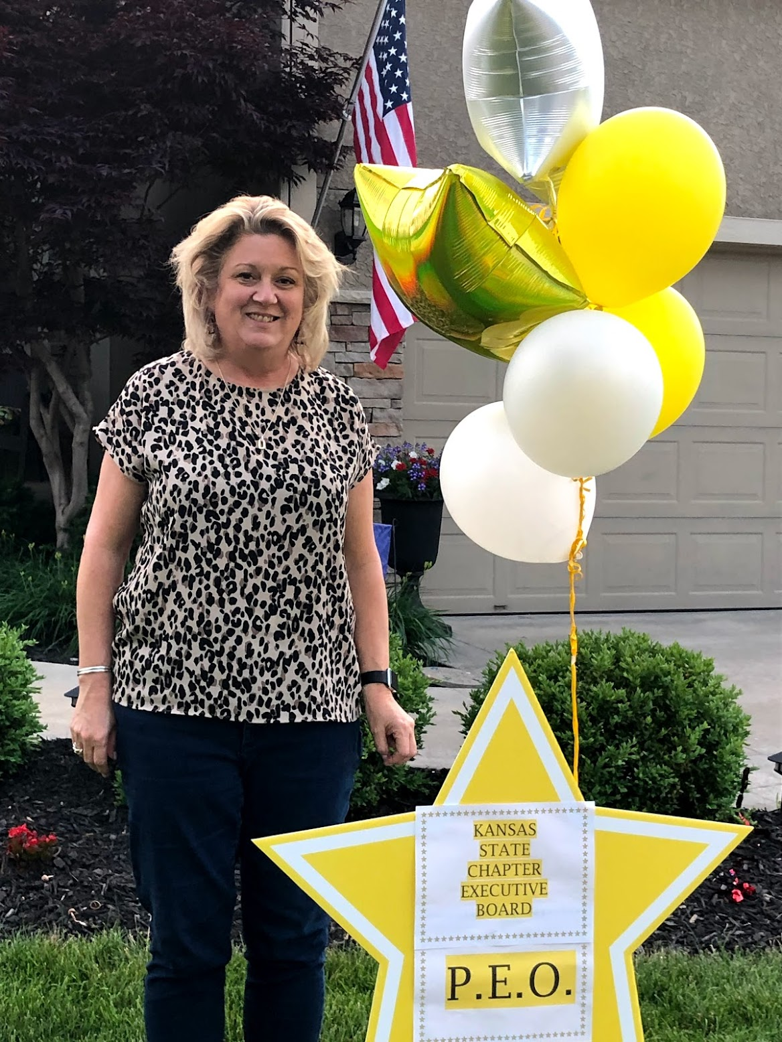
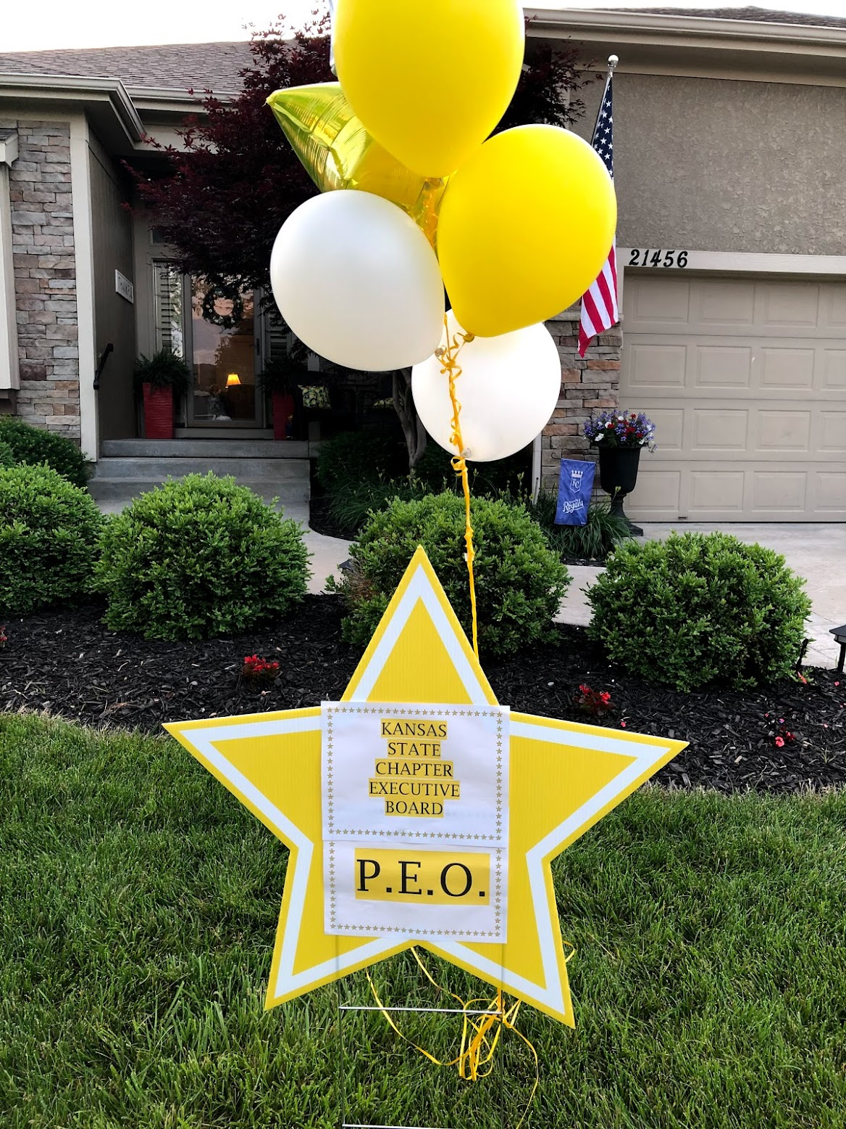
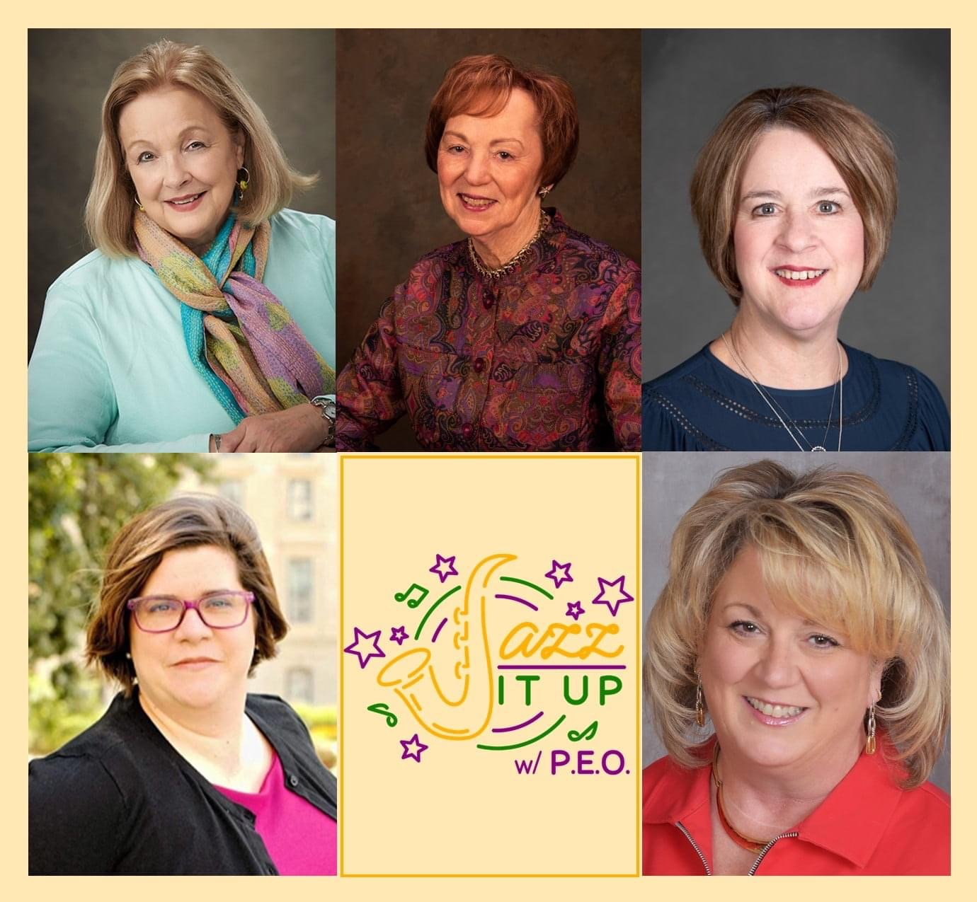
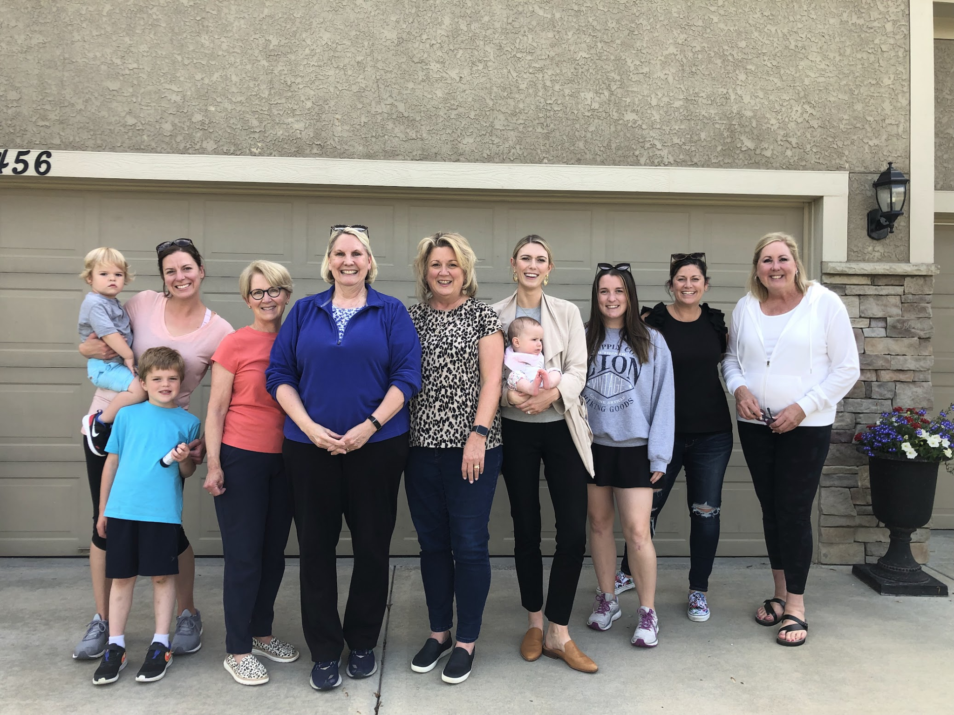
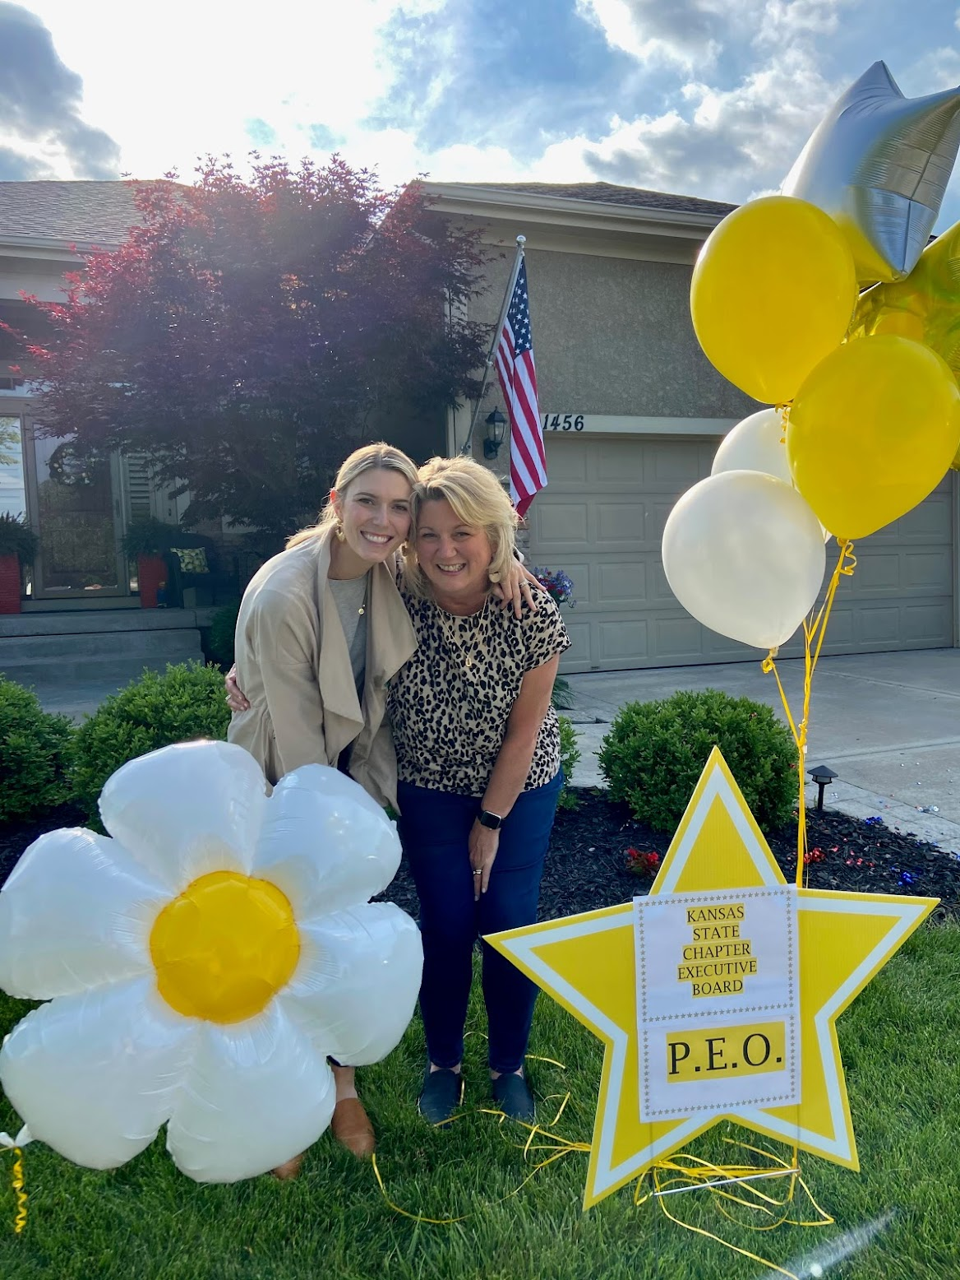
Kansas State Chapter
Executive Board Officer!
2021-The journey begins!
JF Sisters Celebrating
A Fabulous Sister!!!
Jan and her daughter, Jennifer-also a P.E.O.
Jan Guevel

Slide 14
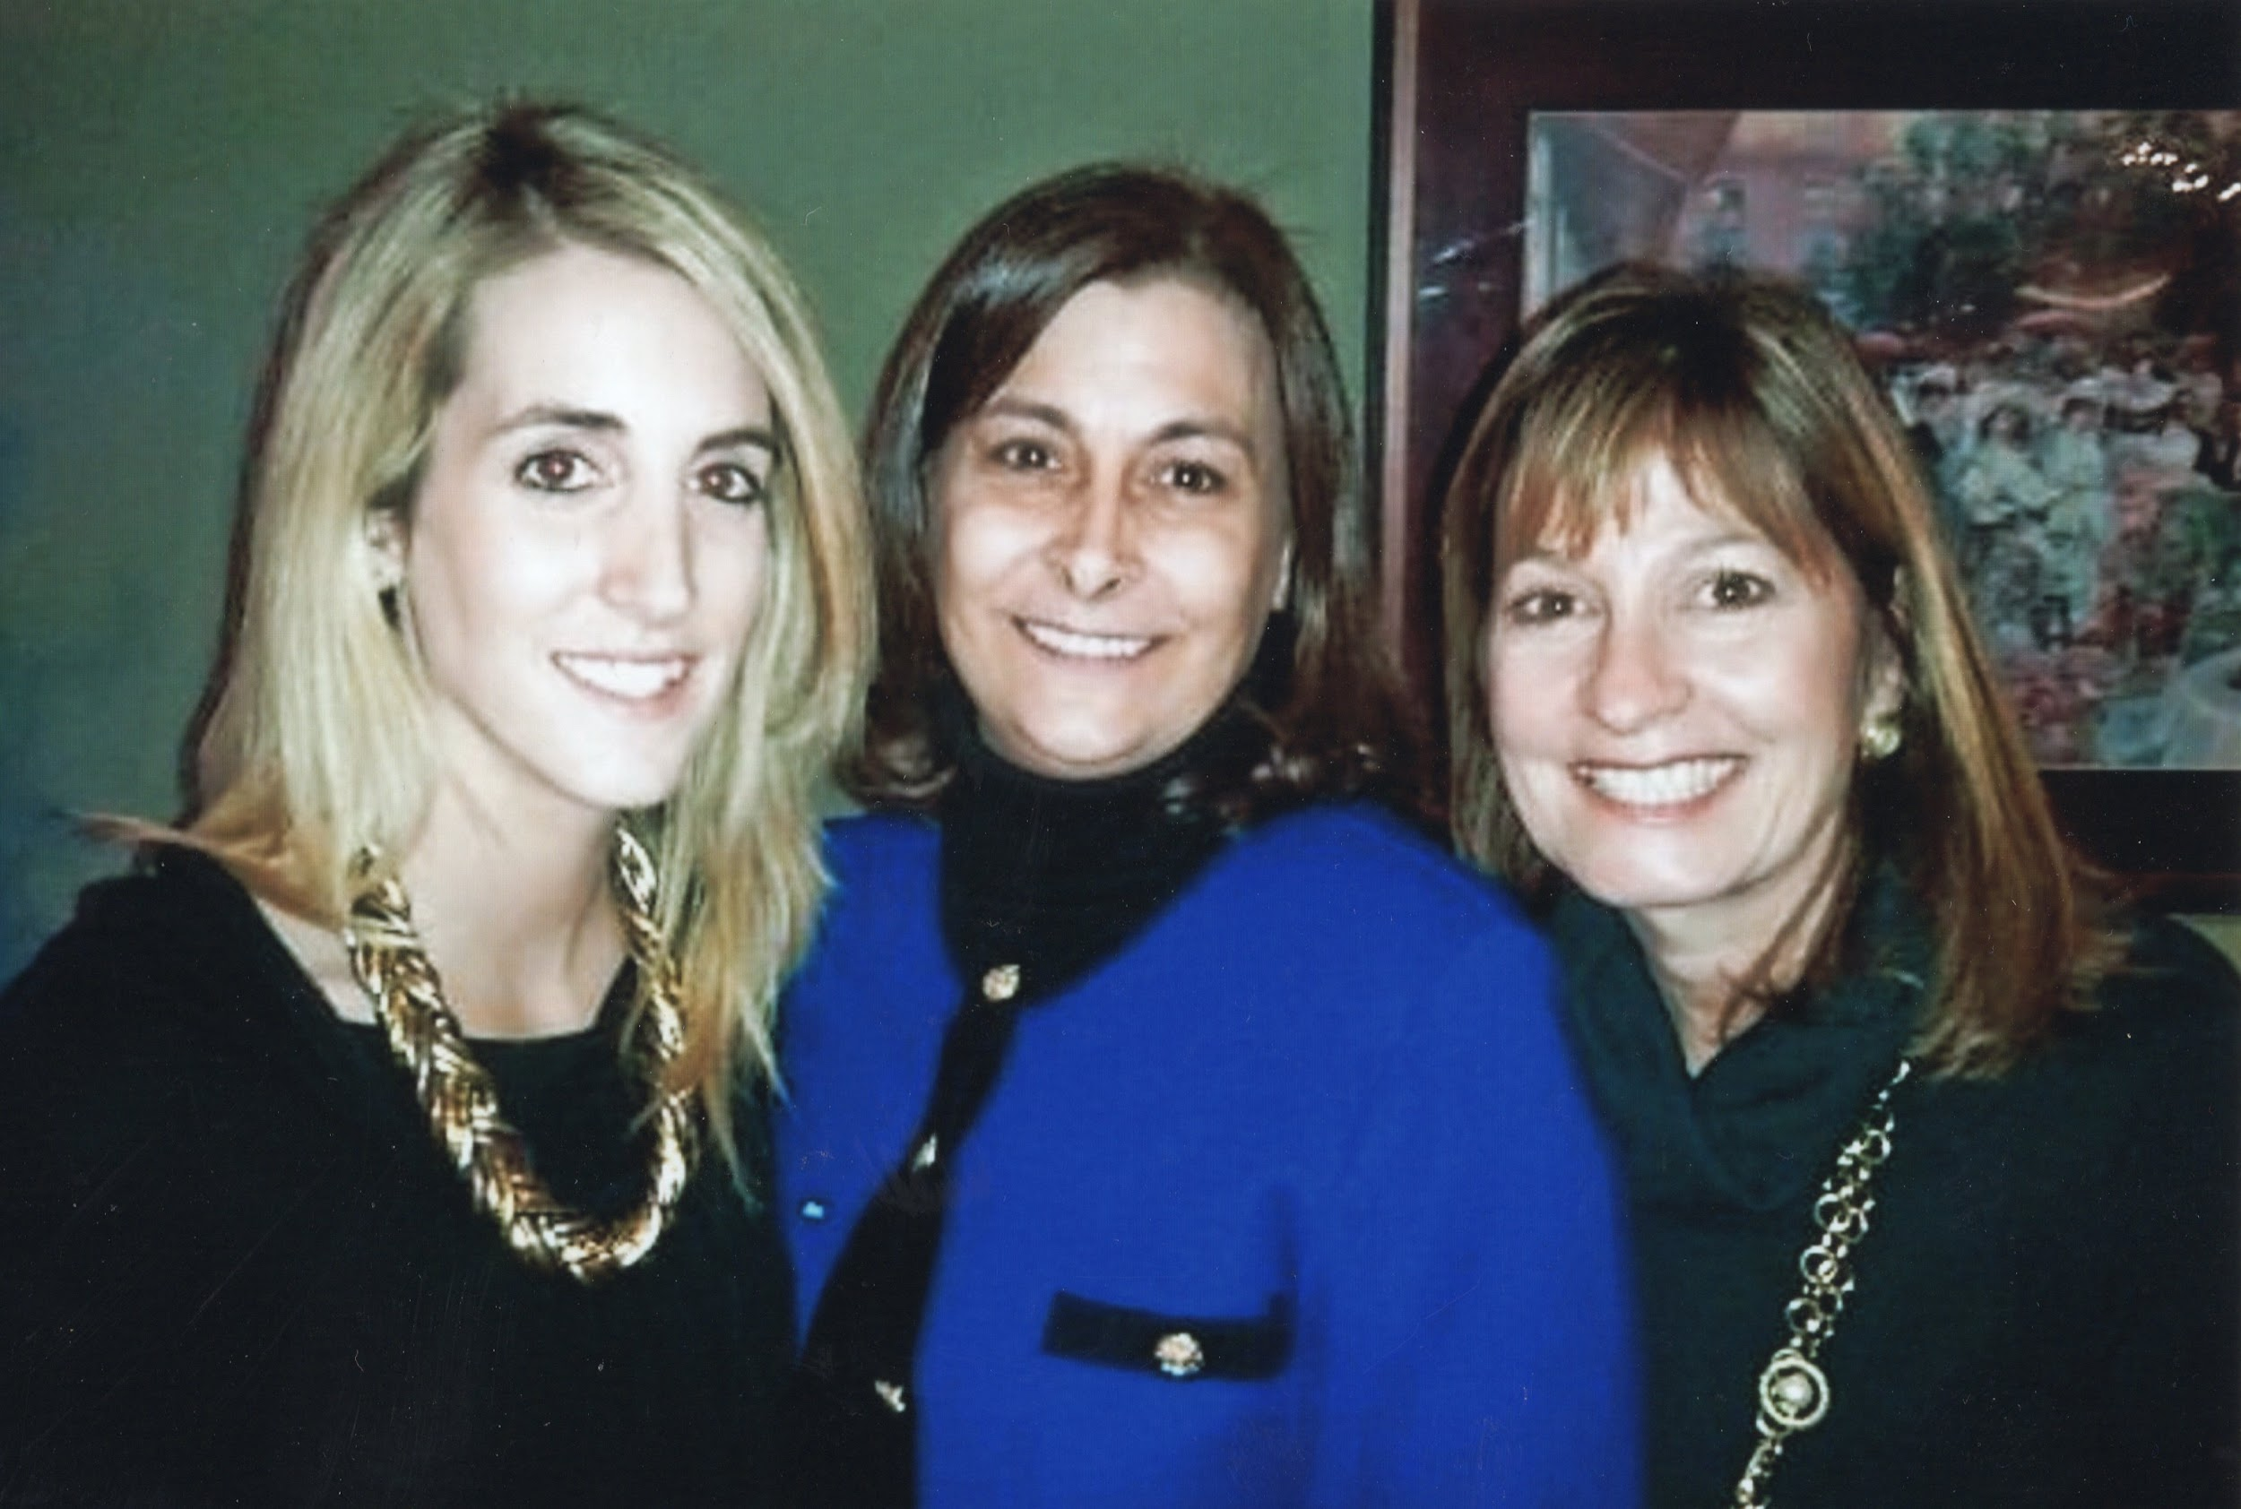
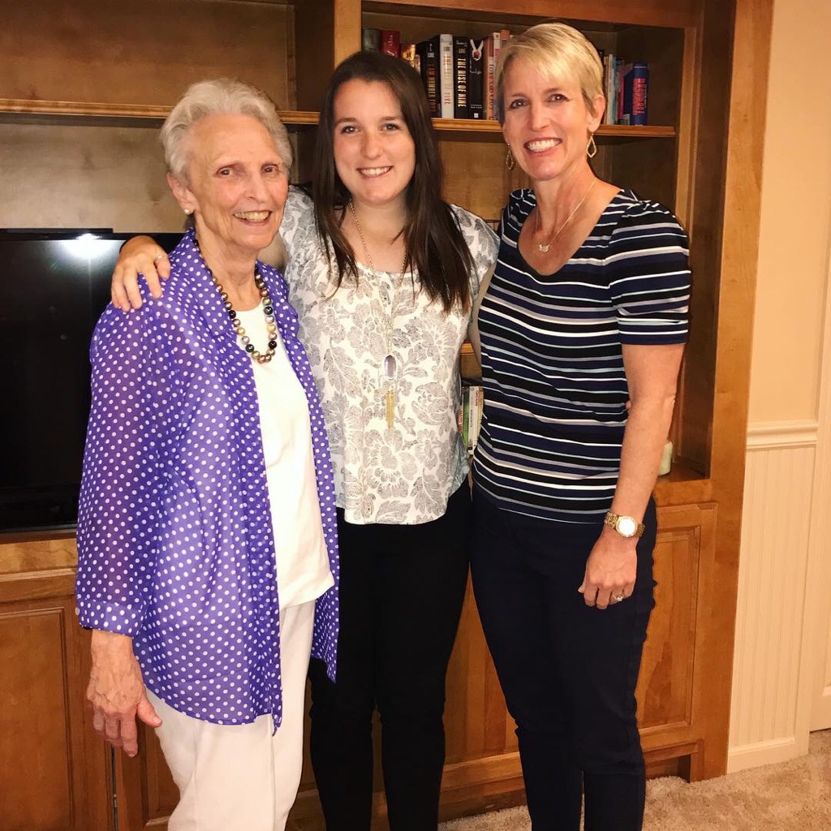
Erin Bleakley was initiated on December 14, 2010
Erin Bleakley, mother Kay Bleakley and Rosy Fender, who is in a P.E.O.
chapter in Lawrence and Kay’s cousin’s wife.
FAMILY
INITIATIONS
Katie Sullivan was initiated July 10, 2018
Grandmother, Norma Moeller, Chapter FE, Katie
Sullivan and her mother, Laura Sullivan

Slide 15
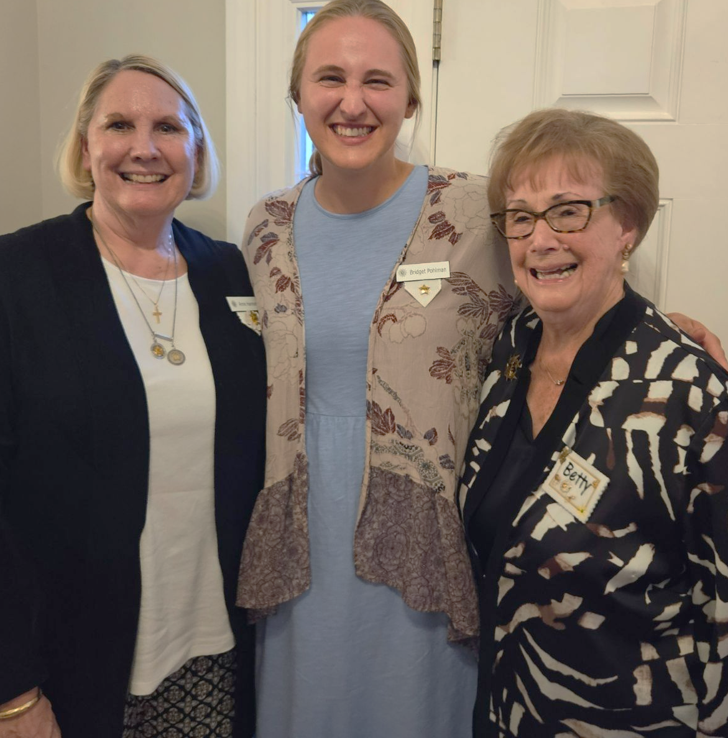
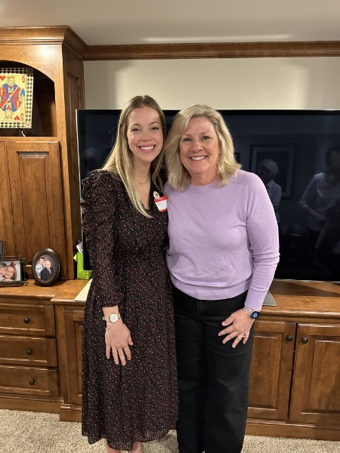
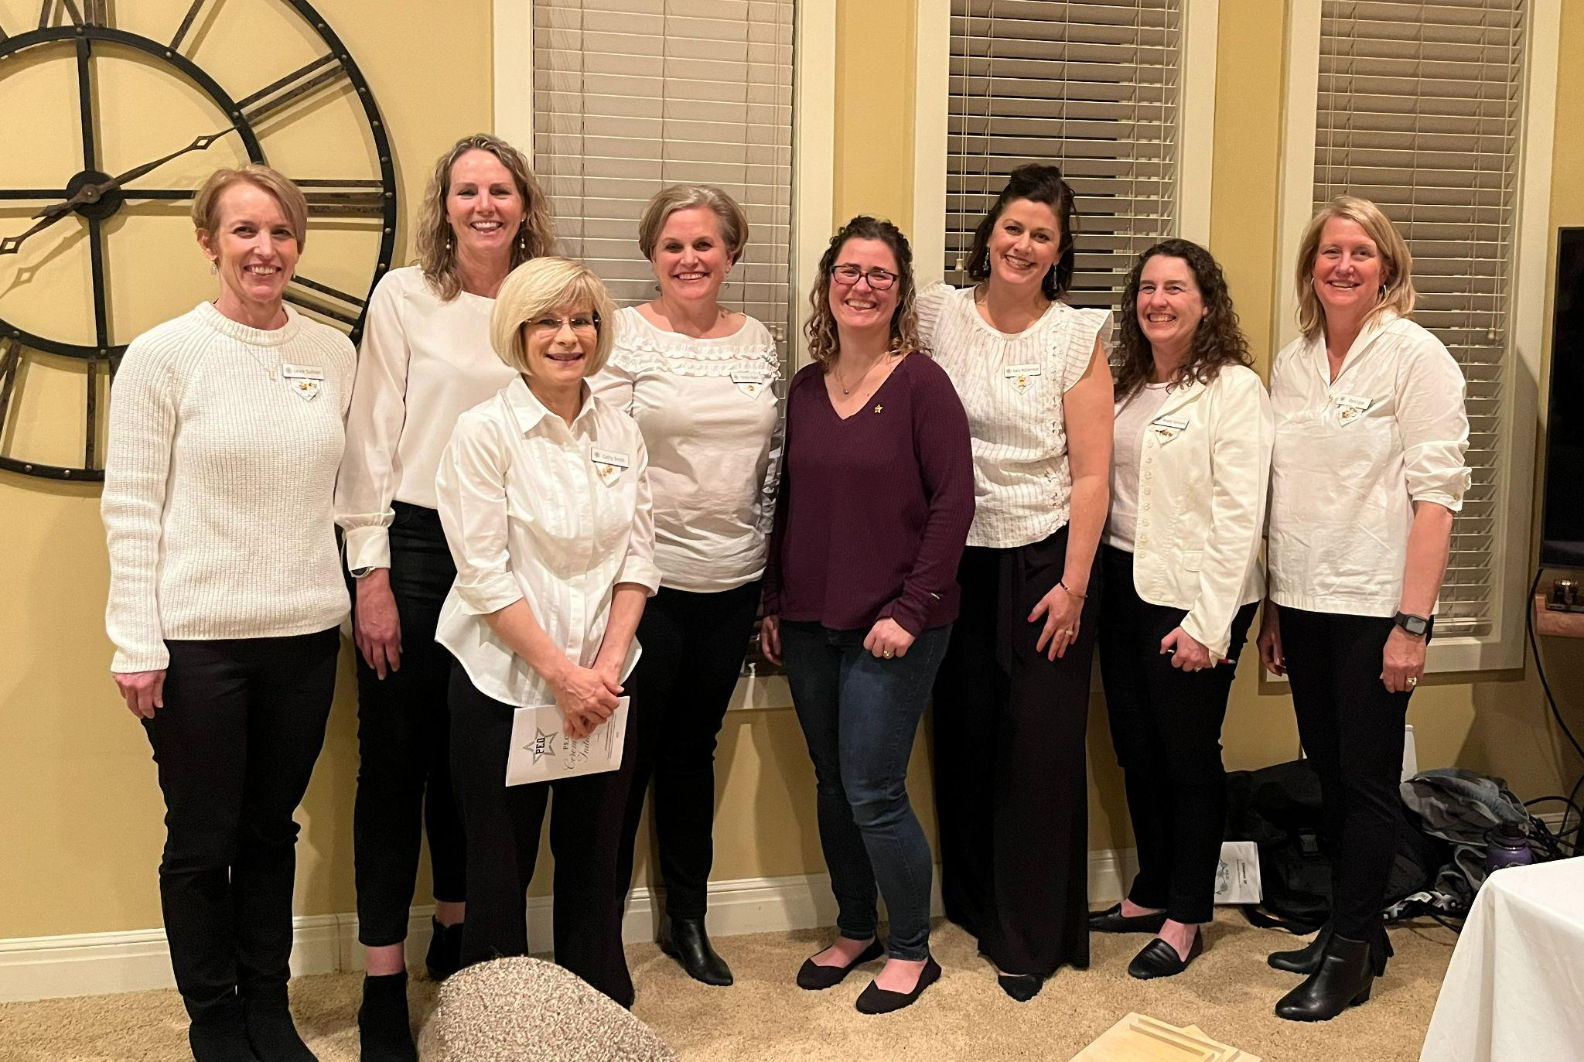
July 9, 2024 -Bridget Pohlman’s initiation
Grandmother - Betty Cleland,
Mother - Anne Hannon,
Daughter - Bridget Pohlman
(5th generation P.E.O.)
March 14, 2023
Jessica Lyman’s initiation
Her mother in law, Karen Lyman, is in our chapter.
March 11, 2025
Tally Jehle - daughter-in-law
Janet Jehle - mother-in-law

Slide 16
P.E.O. PROJECTS
Project Recipients
Name | Award | Date | Amount | Purpose
Gina Daghestani | Sunflower Grants |  | $ 1,000.00 | She had a fire in her apartment
Melissa Casperson | Sunflower Grants |  | $ 2,250.00
Georgi O'Toole | Sunflower Grants | 2014 | $ 800.00 | Medical bills
Madeline (Crawford) Summers | ELF Loan |  |  | Med School
Jenny (Guevel) Sturgeon | ELF Loan | 2017/2018 | $10,000.00 | Masters in Nursing to become a Nurse Practioner
Mia Murphy | ELF Loan | 2019 | $15,000.00 | Complete Masters in Occupational Therapy

Slide 17
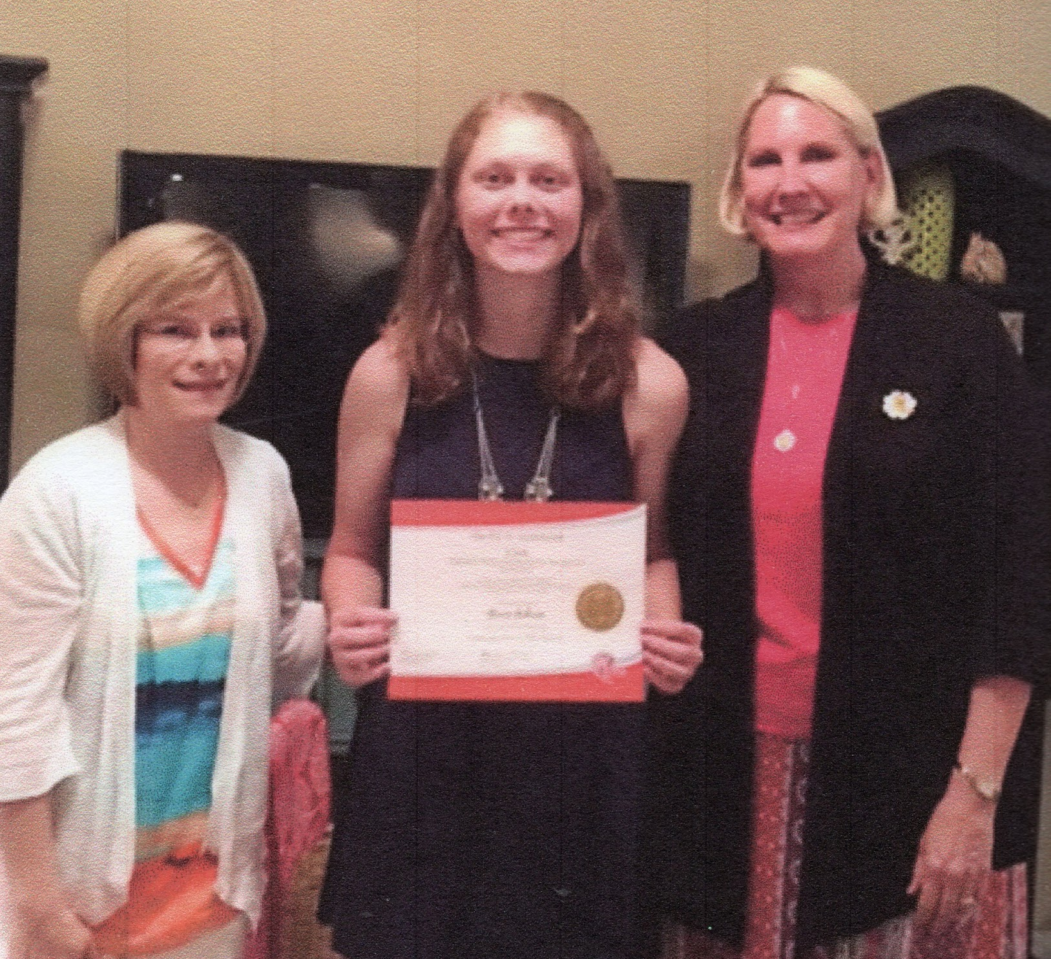
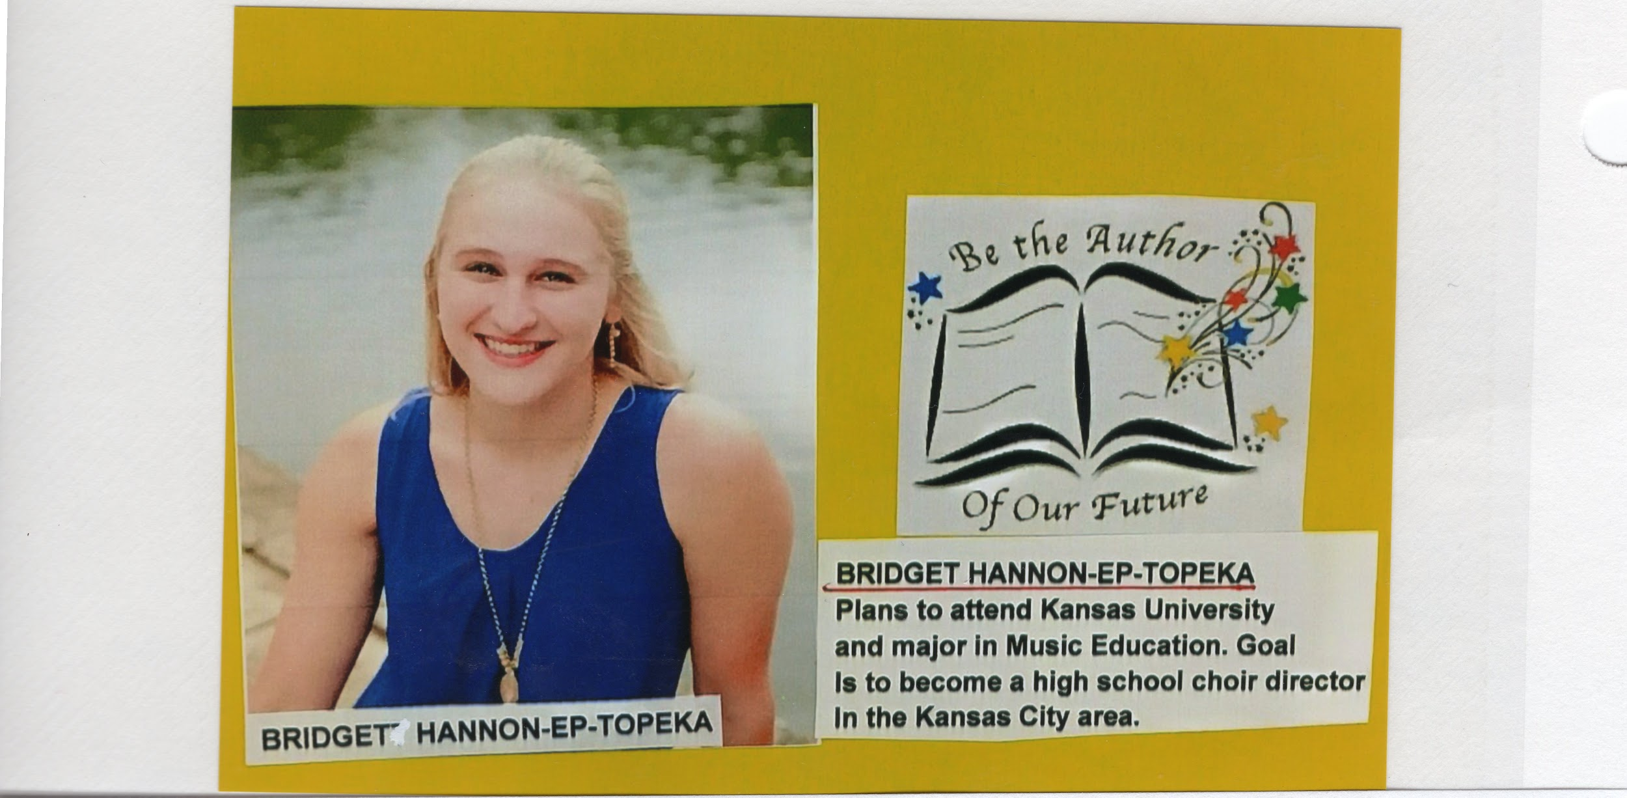
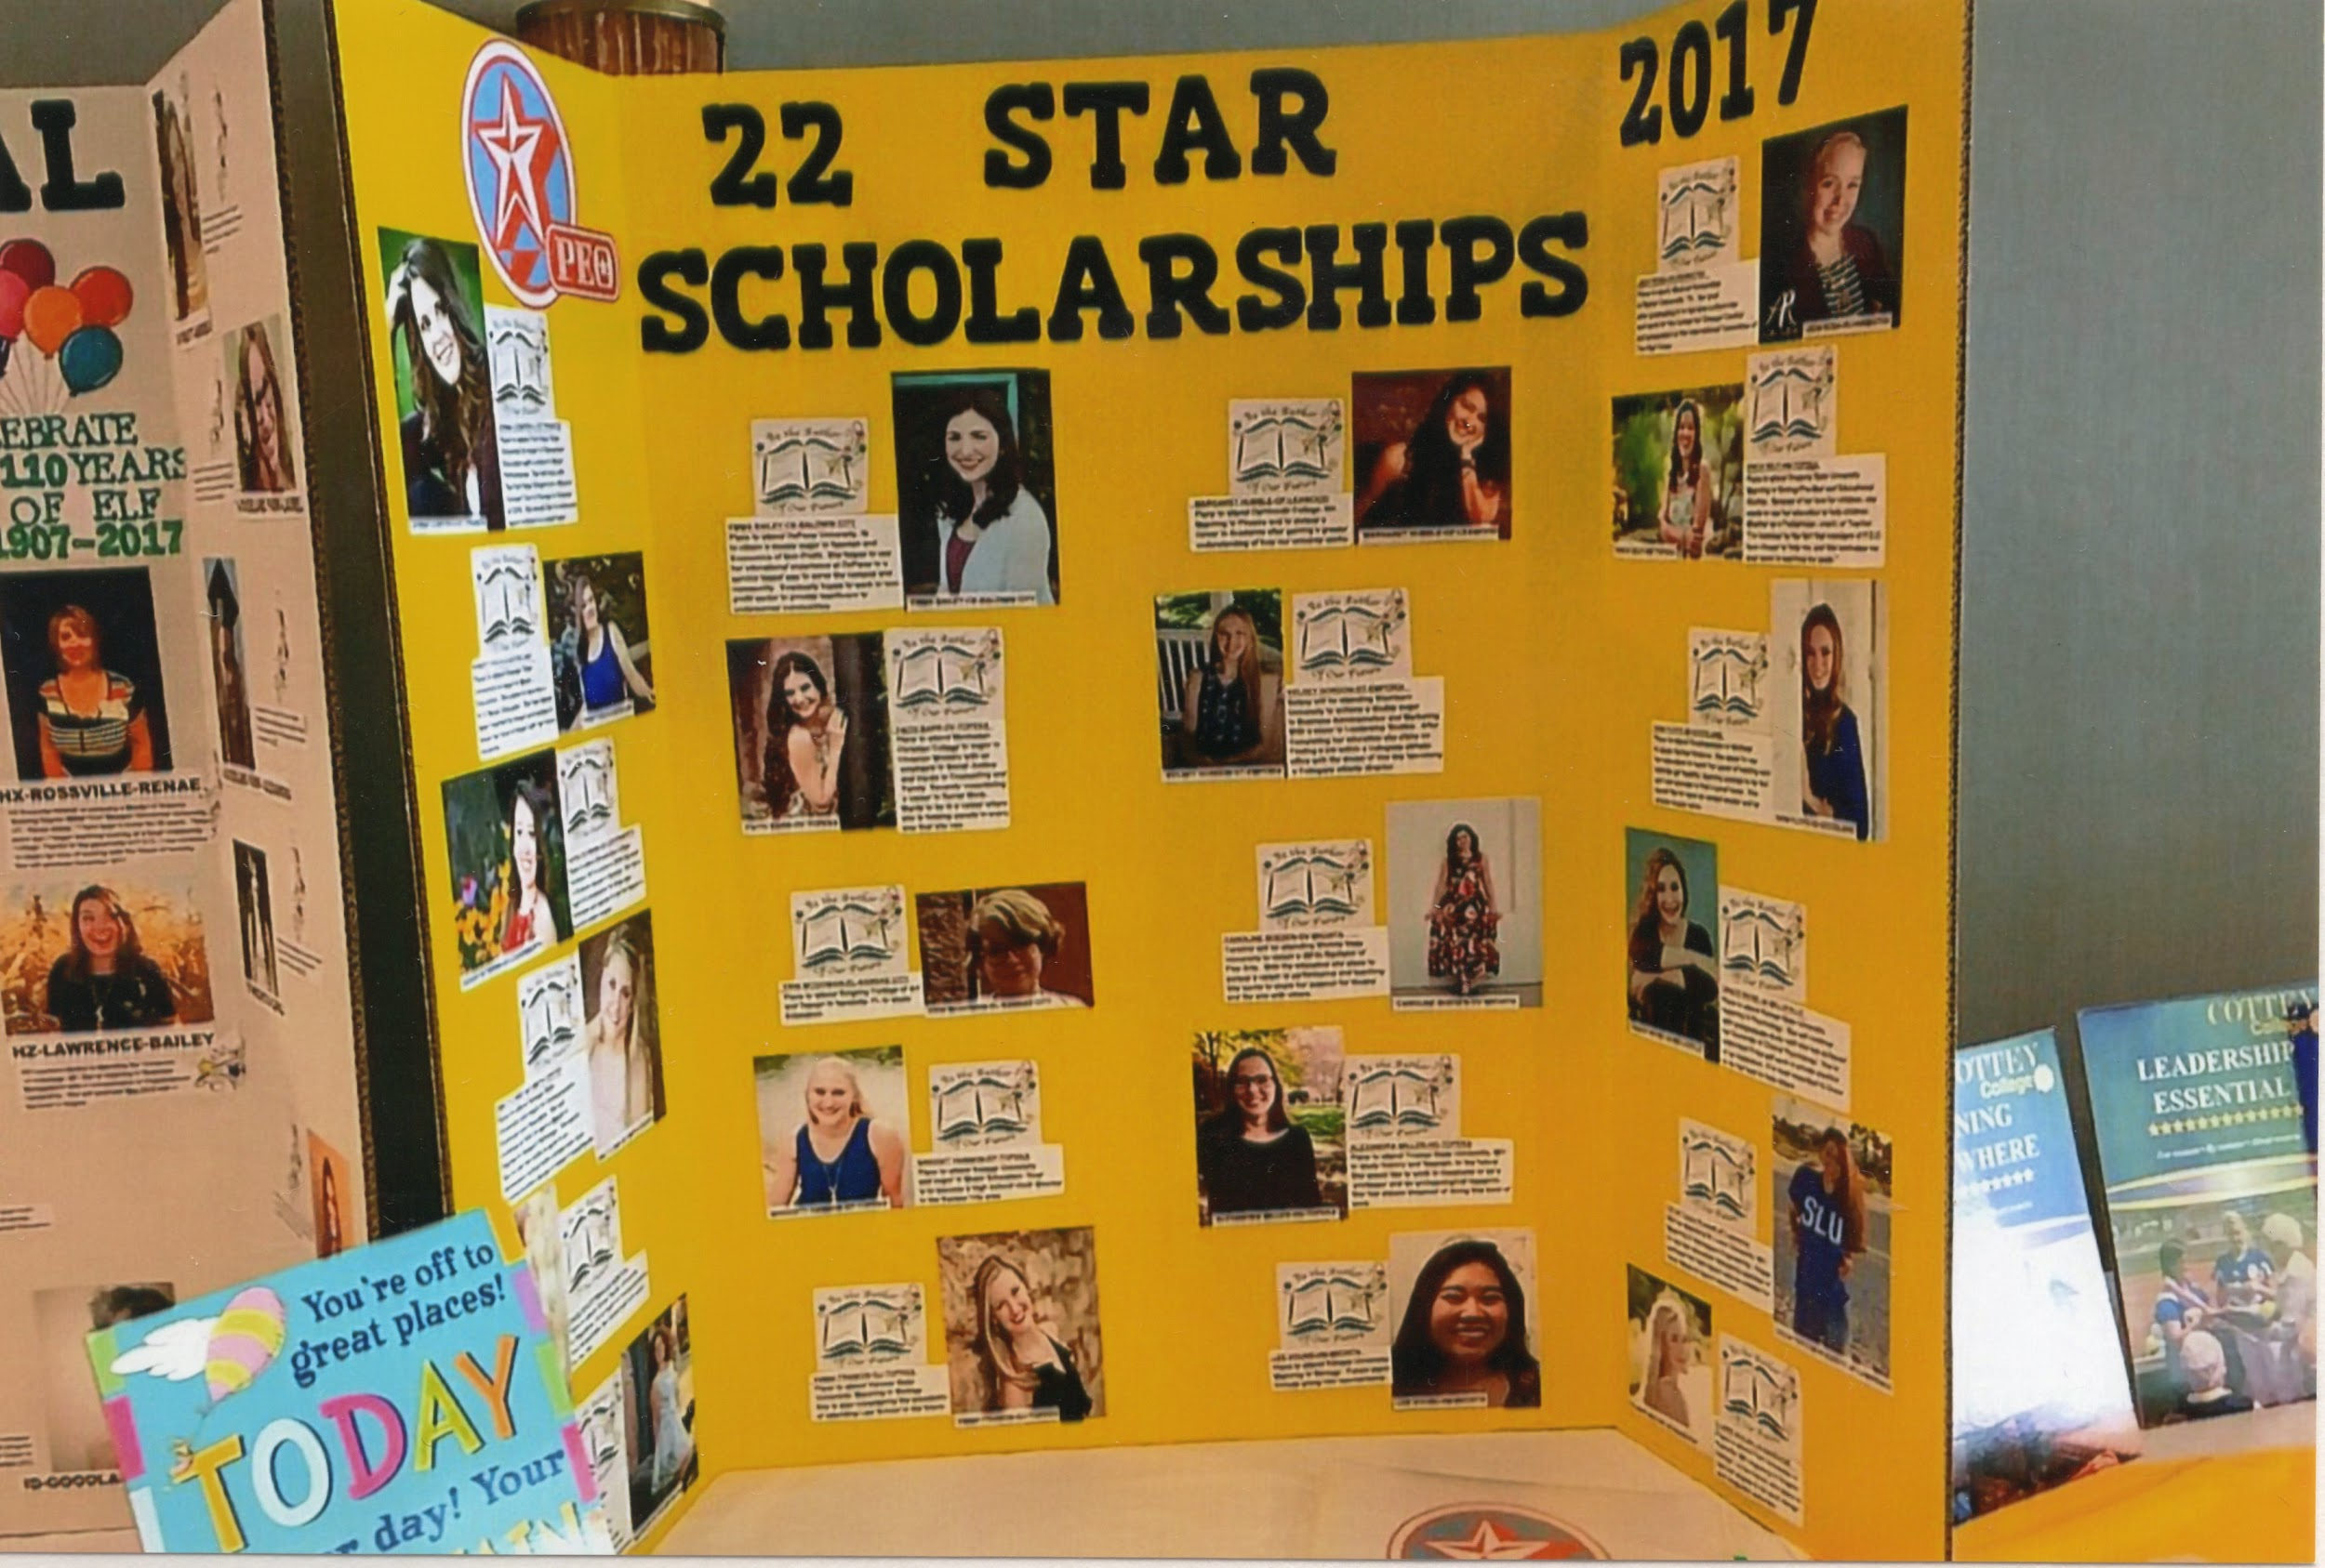
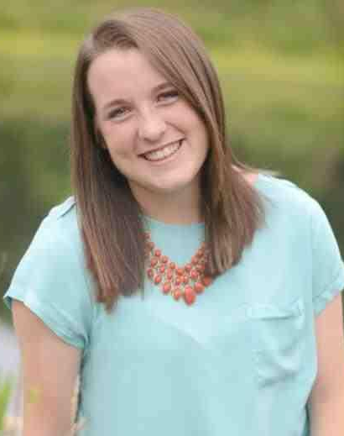
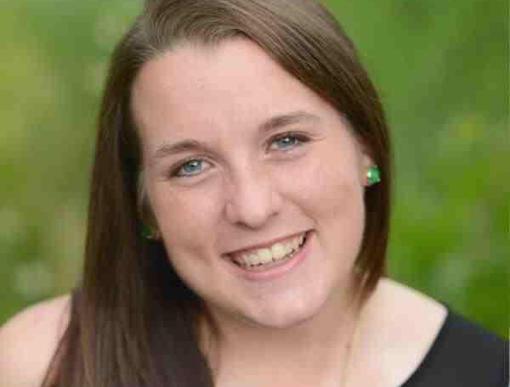
Chapter JF sponsored Gracie Goheen who received the STAR Scholarship in May 2015.
Anne Hannon’s daughter,
Bridget Hannon, received the STAR Scholarship in May 2017. Bridget was sponsored by her grandmother’s (Betty Cleland) Chapter EP in Topeka
Cathy Smith, Gracie Goheen & Anne Hannon
Laura Sullivan’s daughter, Katie Sullivan, received the STAR Scholarship in May 2015. She was sponsored by her grandmother’s (Norma Moeller) Chapter FE.

Slide 18
Chapter JF Golden Girls - 50 Year Membership in P.E.O.
Name | Date of Initiation | Chapter & City | Chapters Been In | Golden Girl Date
Debbi Maddy | December 22, 1969 | Chapter BA-Ashland, KS | Chapter BA & Chapter JF | 2019
Carolyn Young | January 8, 1974 | Chapter GA-Dodge City | Chapter GA & Chapter JF | 2024

Slide 19
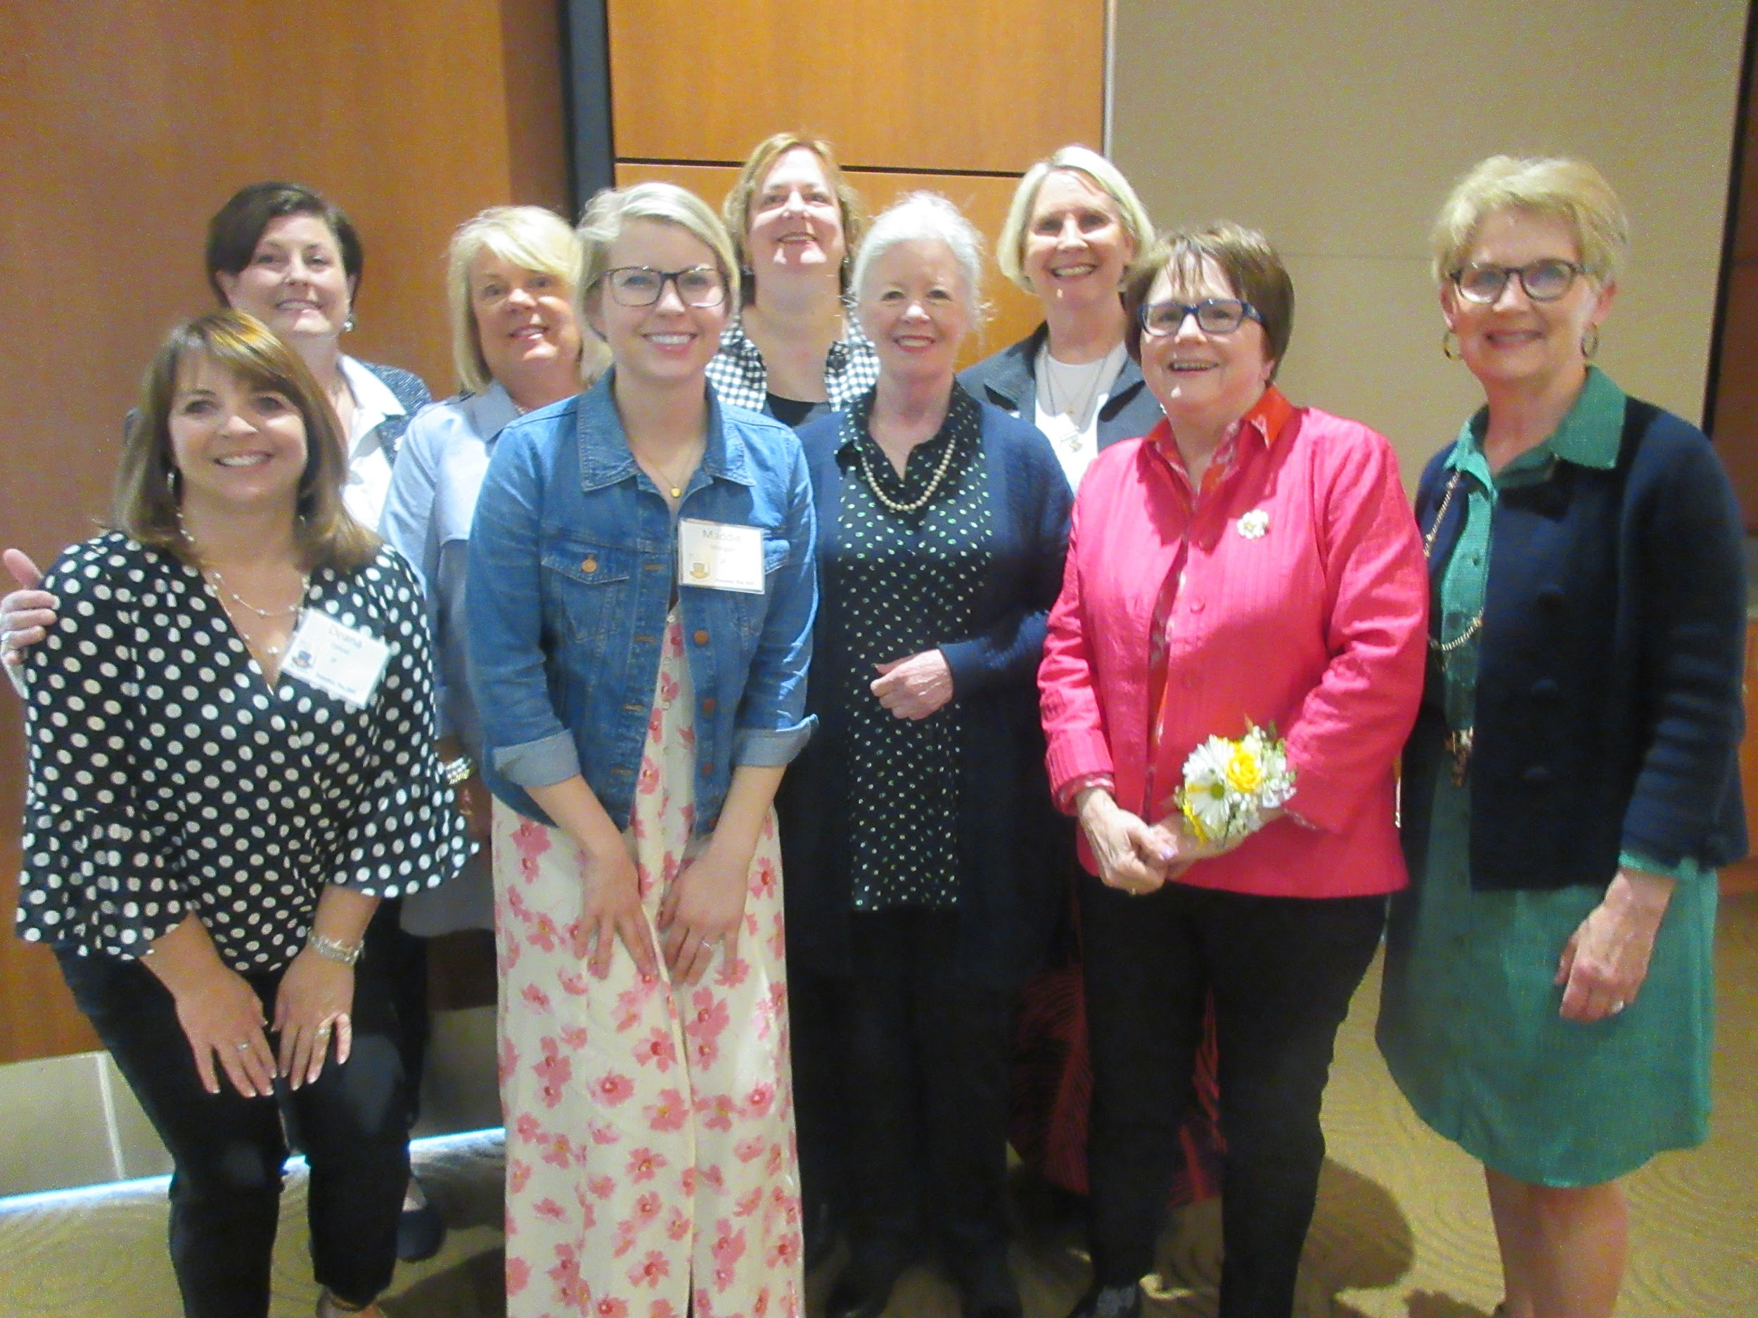
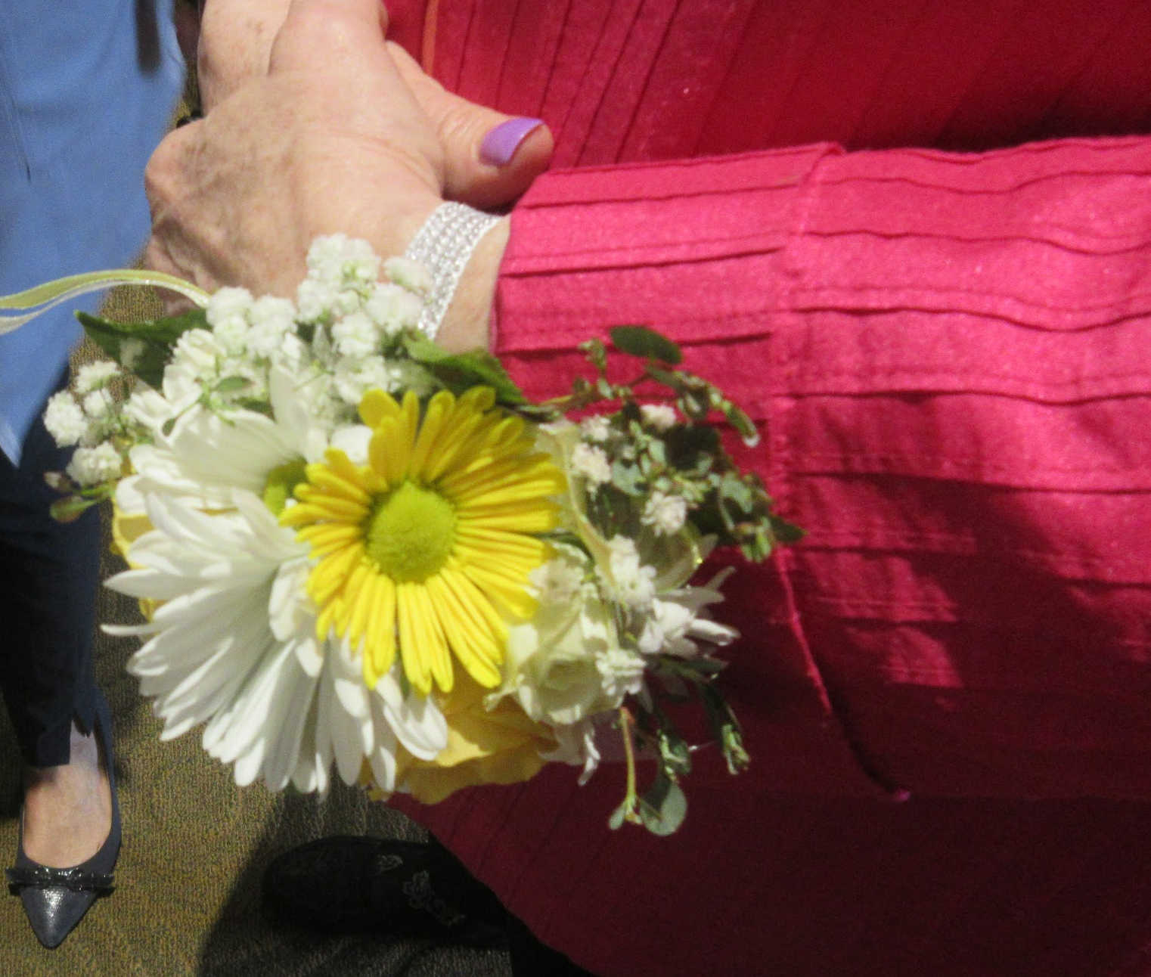
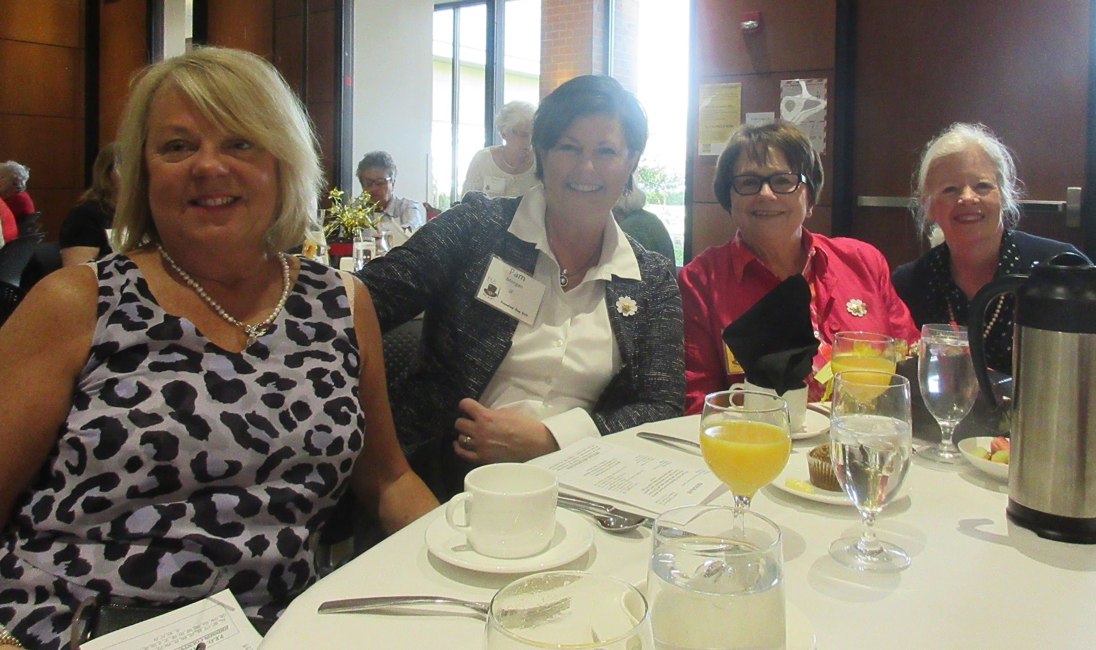
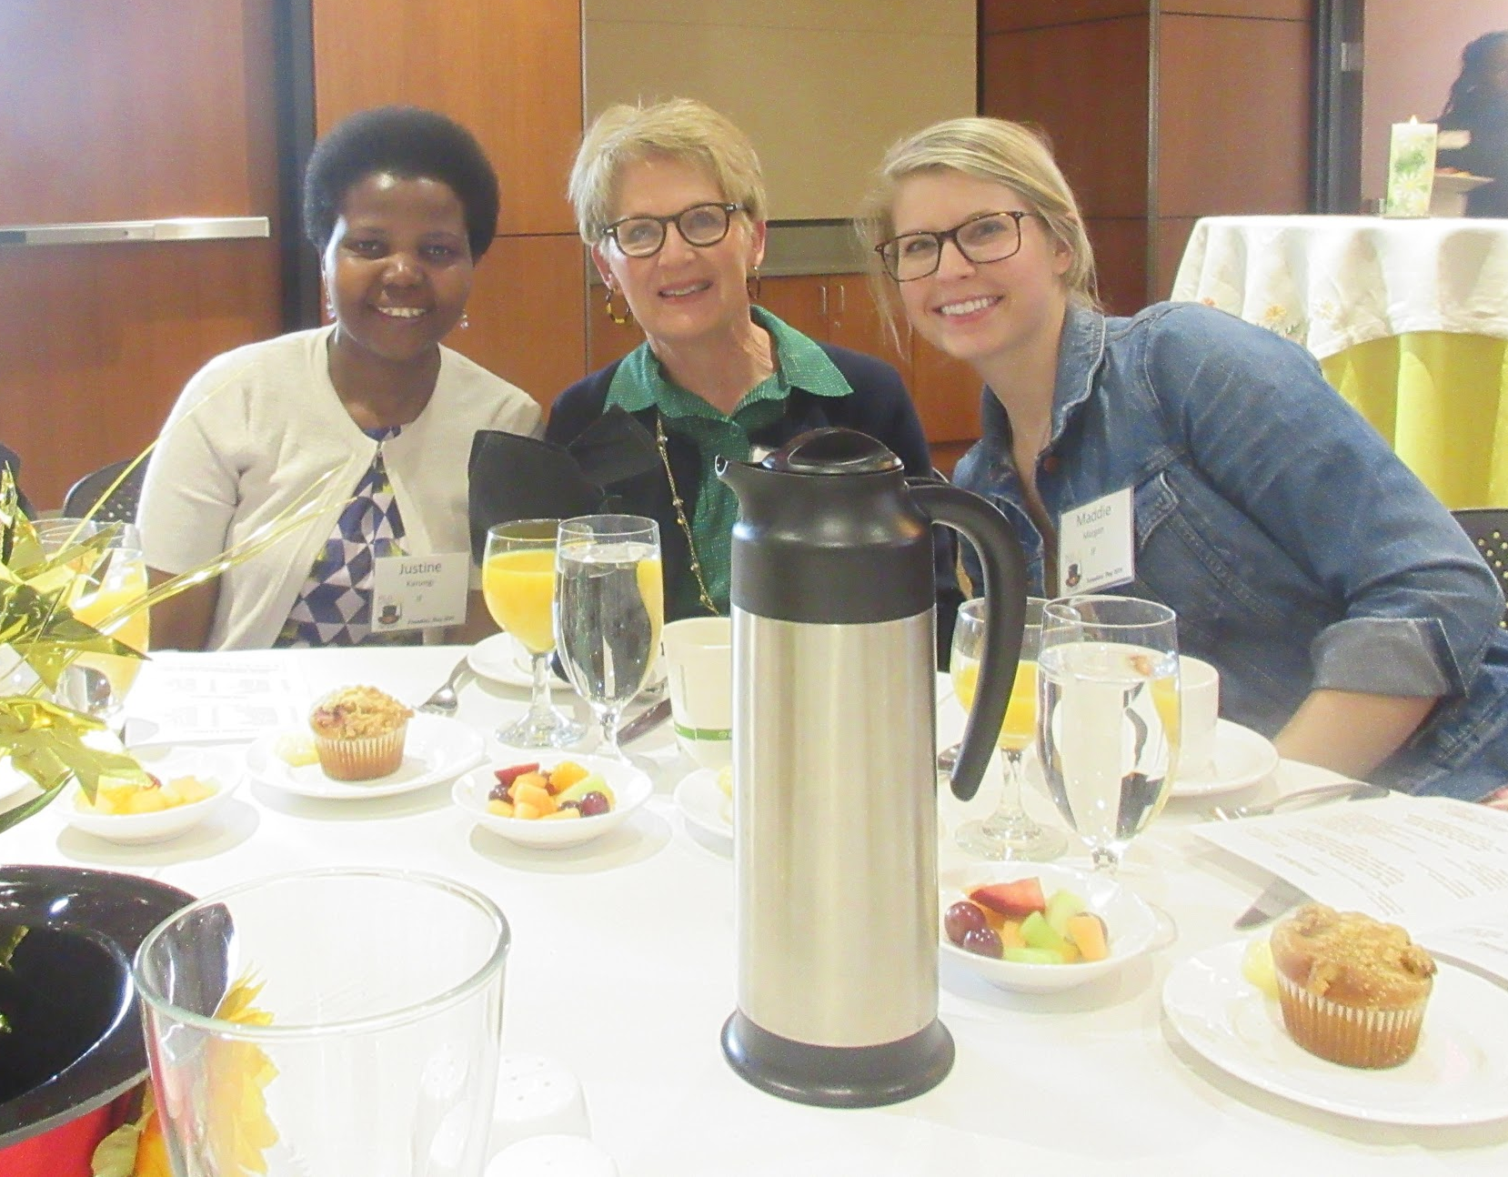
A beautiful corsage!
Chapter JF shows up to celebrate!!! Deana Zahnd, Maddie Morgan, MarLynne Morrison, Golden Girl Debbi Maddy, Susan Brown, Pam Morgan, Debi Hensley, Claudia Mills, Anne Hannon.
Justine Karungi, Susan Brown & Maddie Morgan
Debi Hensley, Pam Morgan, Golden Girl Debbi Maddy and MarLynne Morrison are having such a fun time!

Slide 20
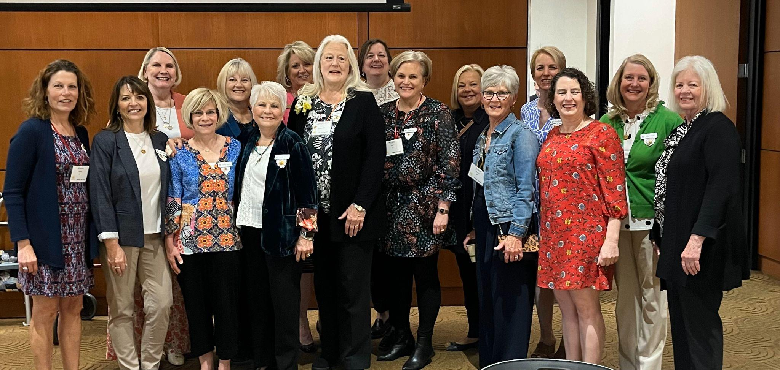
Golden Girls
Carolyn Young was our Golden Girl in 2024!
April 6, 2024: Chapter JF sisters show up to celebrate with our Golden Girl at Reciprocity Founders Day Celebration Brunch: Joann Lavery, Deana Zahnd, Anne Hannon, Cathy Smith, Melinda Young, Linda Nollen, Jan Guevel, Carolyn Young, Claudia Mills, Kristie Sigler, Debi Hensley, Susan Brown, Laura Sullivan, Melanie Townsend, Doris Lippe & MarLynne Morrison

Slide 21

Chapter Eternal
Name Born Died

Slide 22
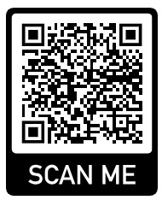
Getting To Know Our Sisters
Chapter JF P.E.O.
Notes:
Explain difference of this one.
This is great because it allows new members to get to know their new sisters!

Slide 23
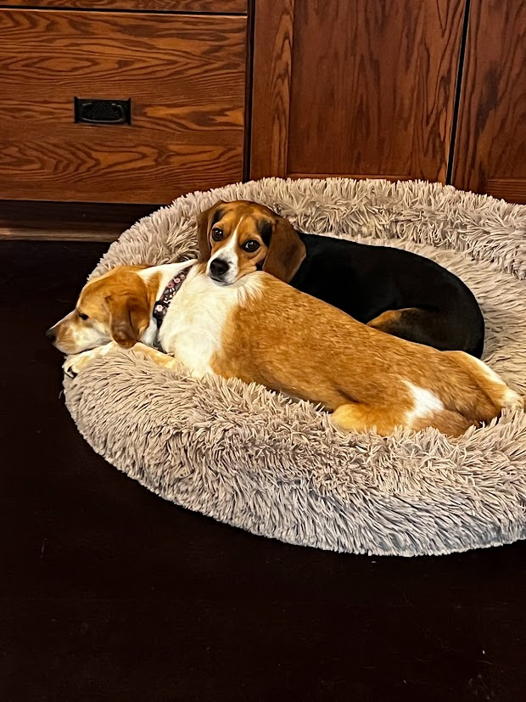
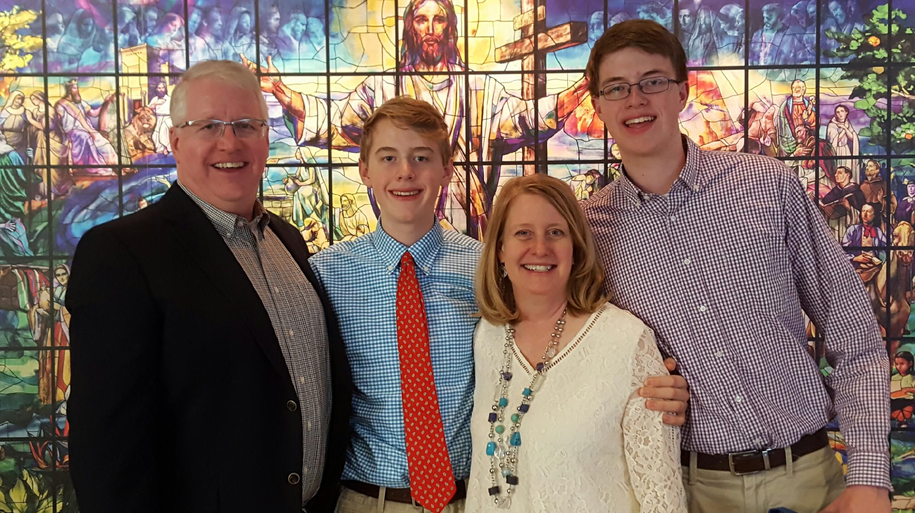
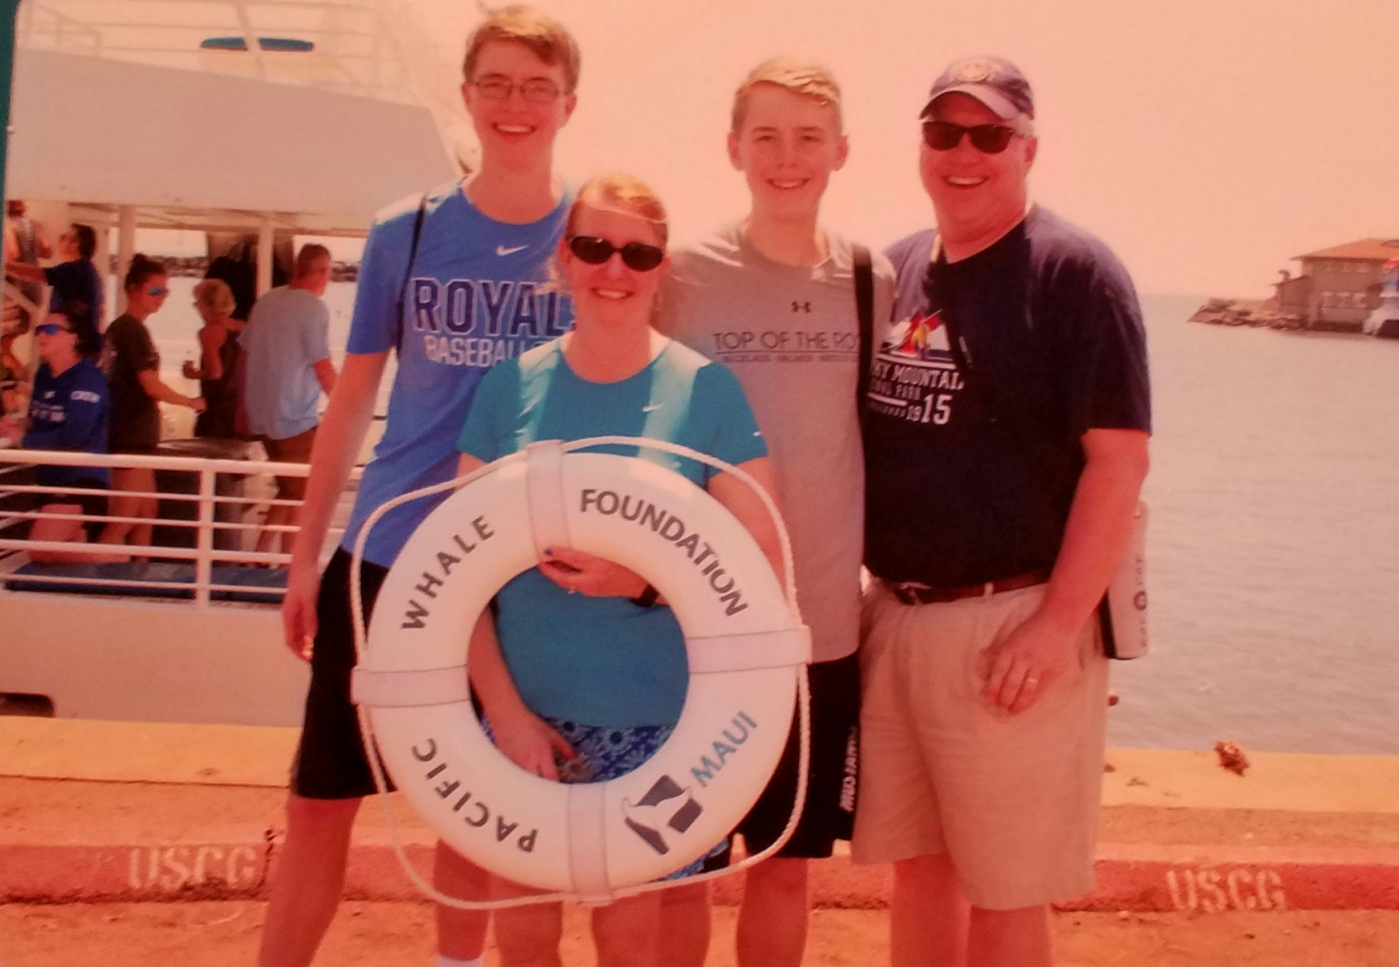
Doris Lippe
Place photo here
What are the names of your family members?
Darren is my Hubby. Matthew 24 and Jacob 22. Jacob is a senior at KSU and Matthew Lives and works in Lenexa as a sales rep.
What was your favorite family vacation?
That is a hard one. We love to travel as a family and have done a lot. We hit our goal of all 50 states. Estes Park Co. is probably my most memorable one, since we did that every summer for many years along with my husband's parents..
What is your favorite family tradition?
Gathering with family for all Holidays
What would your perfect day be like?
A cool summer day working outside or hiking.
Place photo here
Place photo here

Slide 24
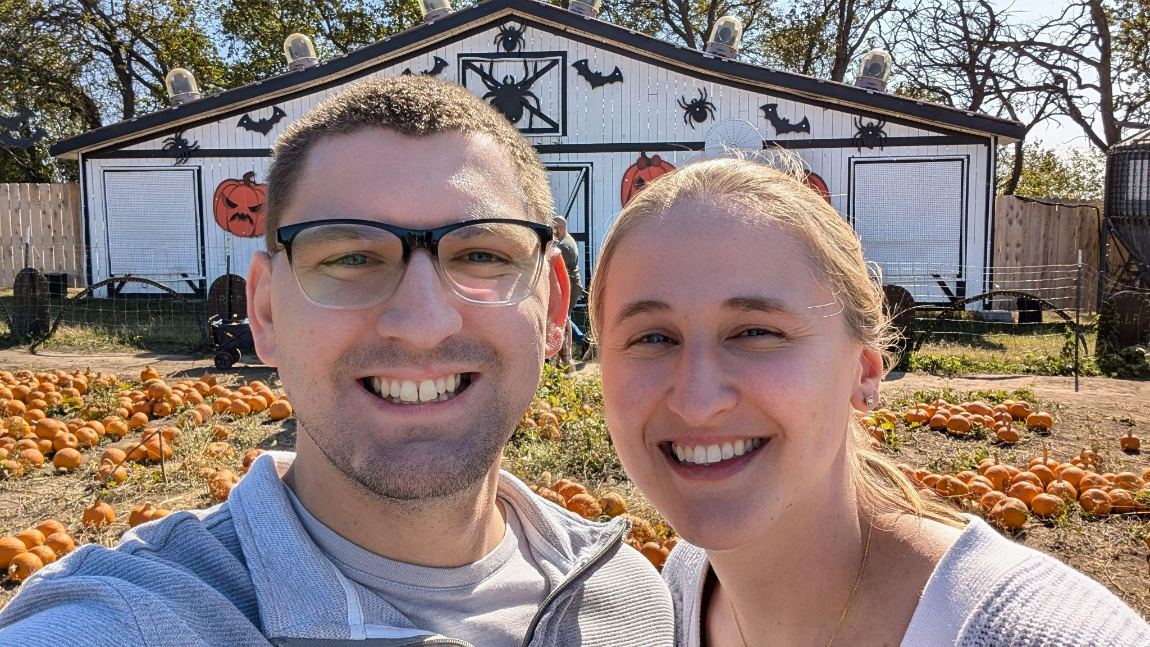
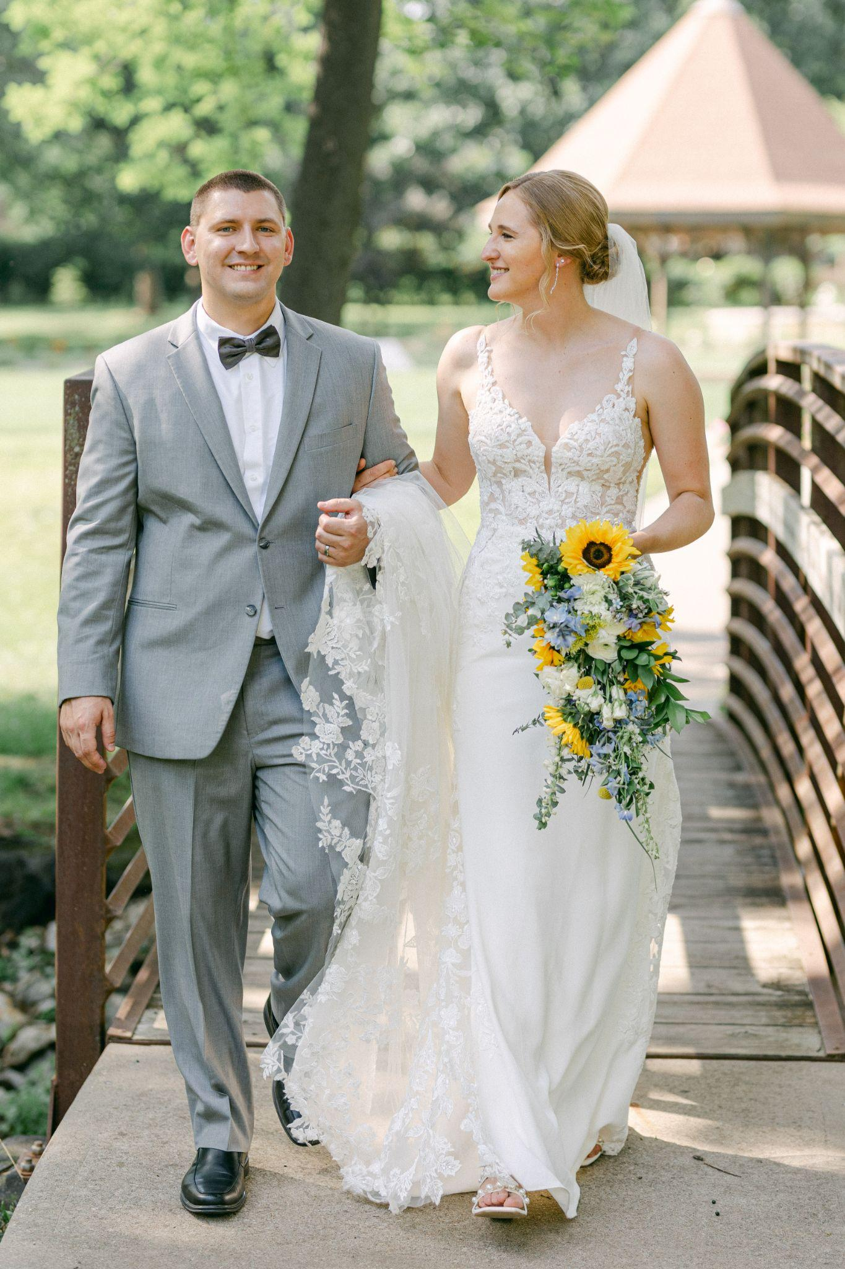
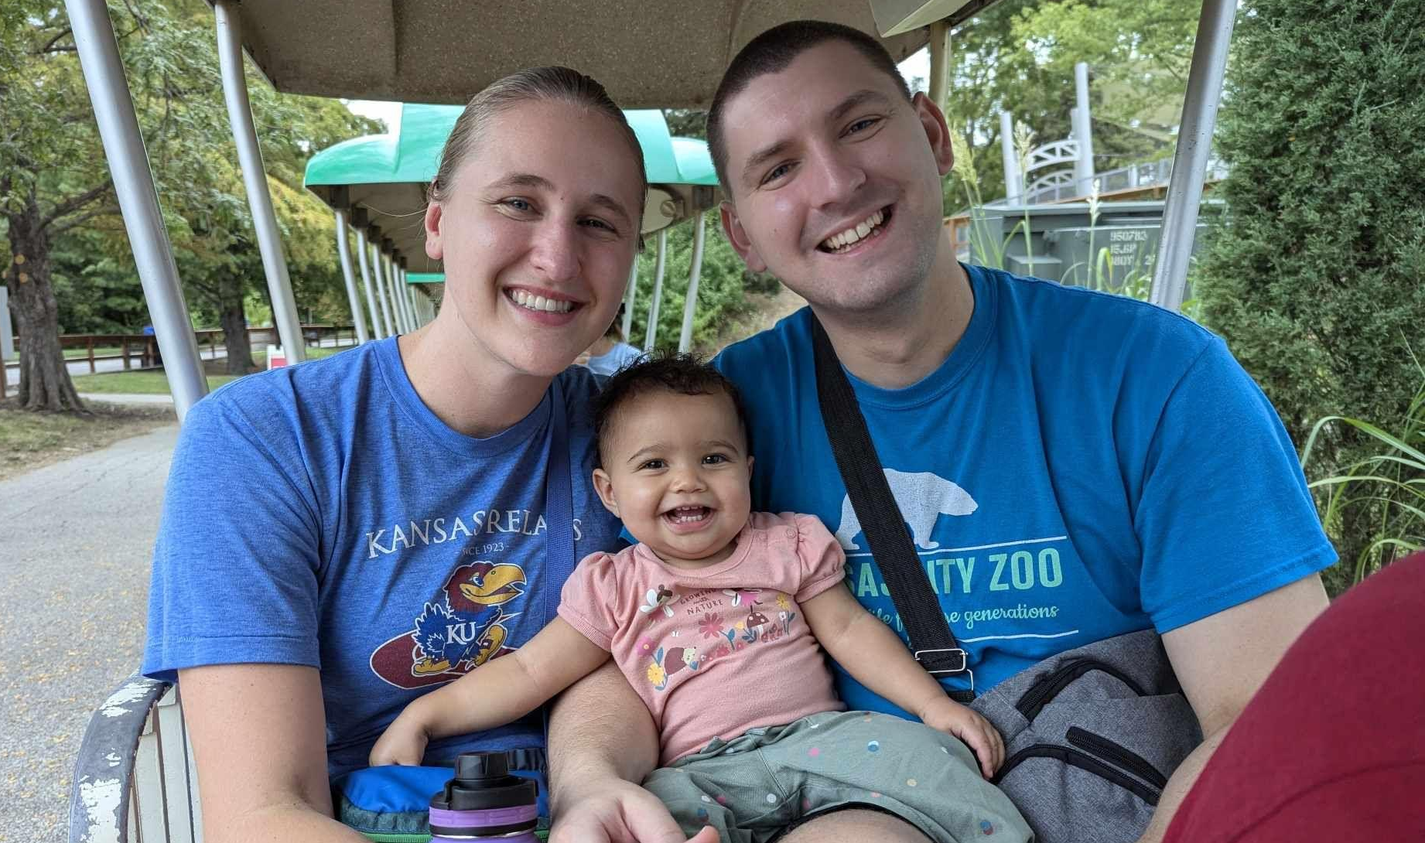
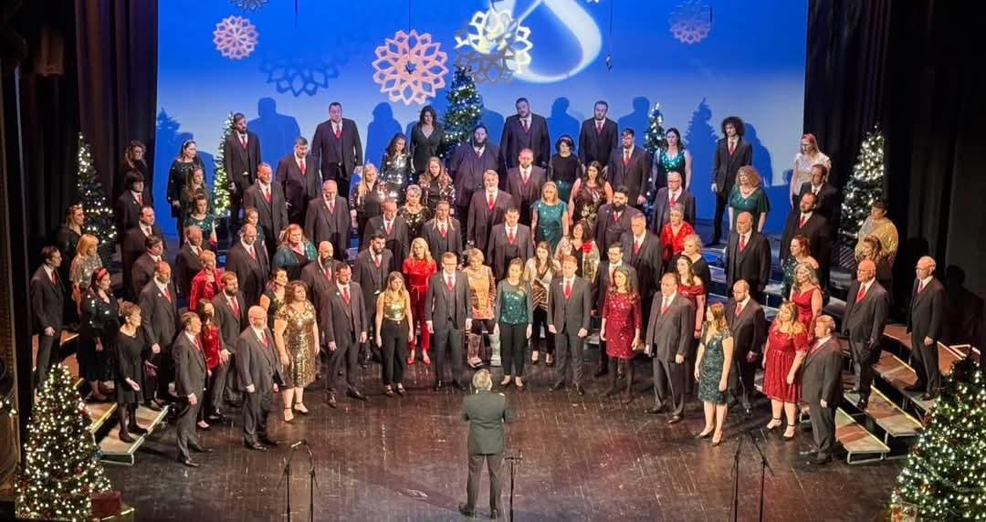
Bridget Pohlman
What are the names of your family members?
Ben Pohlman - husband
Anne Hannon - mom
What was your favorite family vacation?
Hawaii in the summer of 2024 with my parents, brother, and husband! We went to Kauai and O’ahu. My favorite part was staying in Kauai on the beach and learning to surf.
What is your favorite family tradition?
My favorite family tradition is playing board games at family get togethers or watching “It’s A Wonderful Life” on Christmas Eve.
What would your perfect day be like?
Spending time reading a book at a local coffee shop, going out to dinner with my husband, and either going to see a live musical in the evening or playing board games with friends!

Slide 25
Why should your chapter create one?

Slide 26
Accessibility
All you need is an internet connection to view! No physical book needed. Share with friends and family all over the world.
Notes:
Big, physical scrapbooks usually live at one sister’s home, and no one sees them. This way, anyone with an internet connection can access them! Including state officers and new sisters!

Slide 27
Preservation
Digital files don’t fade, tear, or get lost like physical photos or paper.
Notes:
No more need for keeping giant physical books that take up a lot of space! And, no need to worry about water or fire destroying memories.

Slide 28
Creativity
Tons of templates, fonts, and digital stickers to personalize it your way. You could even add videos or music!

Slide 29
Flexibility
Want to fix a typo? Add a new memory? You won’t need glue or scissors! You can keep evolving your scrapbook over time.
Notes:
Online scrapbooks are easy to add on to.

Slide 30
Organization
Searchable format makes it easy to find specific moments or members.
Notes:
With an online scrapbook, sisters can easily search for a member’s name and locate any memory with that person in it. A new sister can use this to learn the names of the women in her chapter.

Slide 31
Collaboration
Any member of your chapter can edit the scrapbook! Turns the scrapbook into a group project!

Slide 32
Let us show you how to get started!
Demo: Google Slides
Alternate platform suggestion: Canva
Notes:
Our Chapter has utilized Google Slides to create our scrapbooks, but Canva is another platform that would be great to use if you are familiar with it.
For the sake of time, we will show how to make only one of our scrapbooks, “Chapter History”.
We have step by step instruction videos on how to make both of the scrapbooks included in the resources you can access with our QR code!

Slide 33
Suggestions for Success
Utilize sisters who are tech savvy to help you get started as well as YouTube tutorials!
Publish links in your Chapter’s yearbook:
  The “editable” link for your “Getting to Know Your Sisters” scrapbook (link or QR code)
  The “viewing” link for your “Chapter History” scrapbook (link or QR code)
Host a program where all sisters update their sister slide together!
Don’t put all the work on your historian to keep track of photos.
Keep a hard copy on a flashdrive, and update it every year.
Scanning already existing scrapbooks into an online format is possible, with the right printer. Seek help from a printing shop!
Notes:
Don’t put all the work on your historian: Create a google folder for sisters to upload pictures to so the historian can update it, Pull pictures off of social media
Insert scanned pages as images!

Slide 34
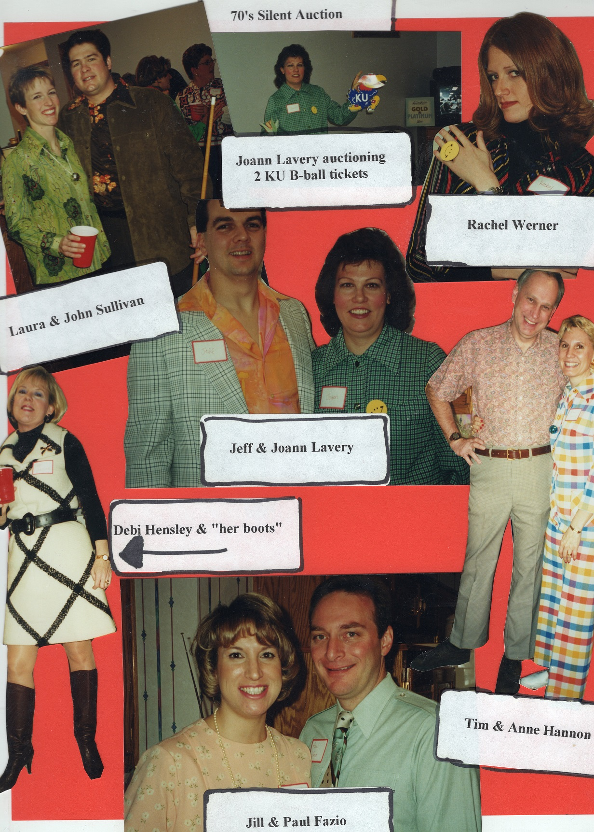
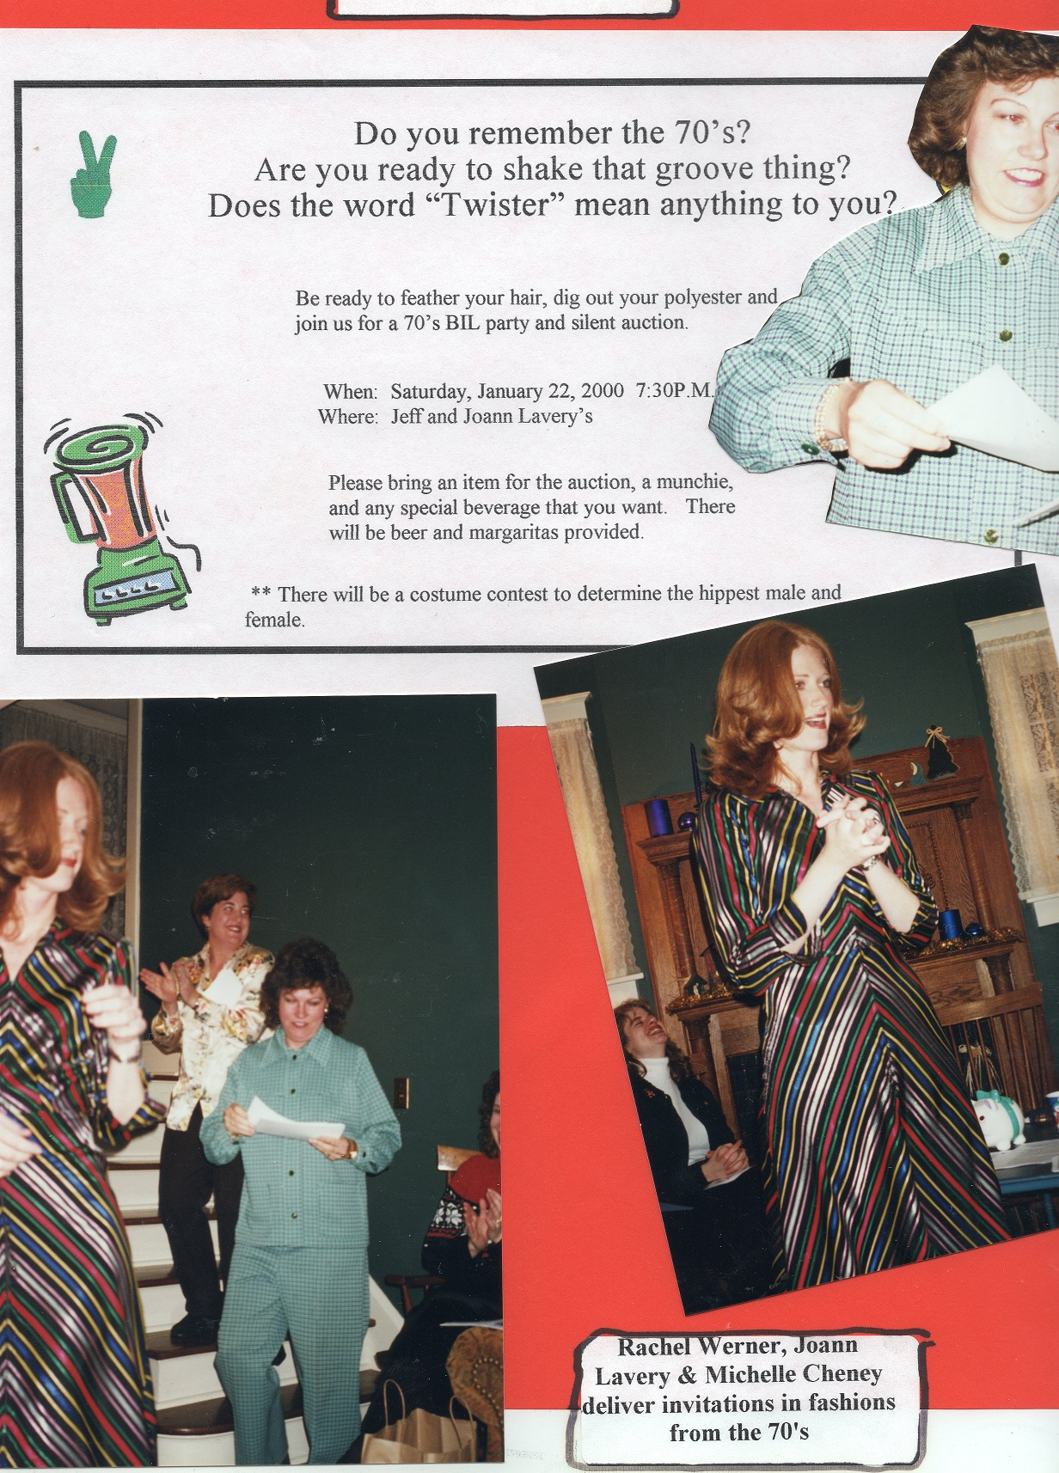
Fundraising Auction
Notes:
Insert scanned pages as images!

Slide 35
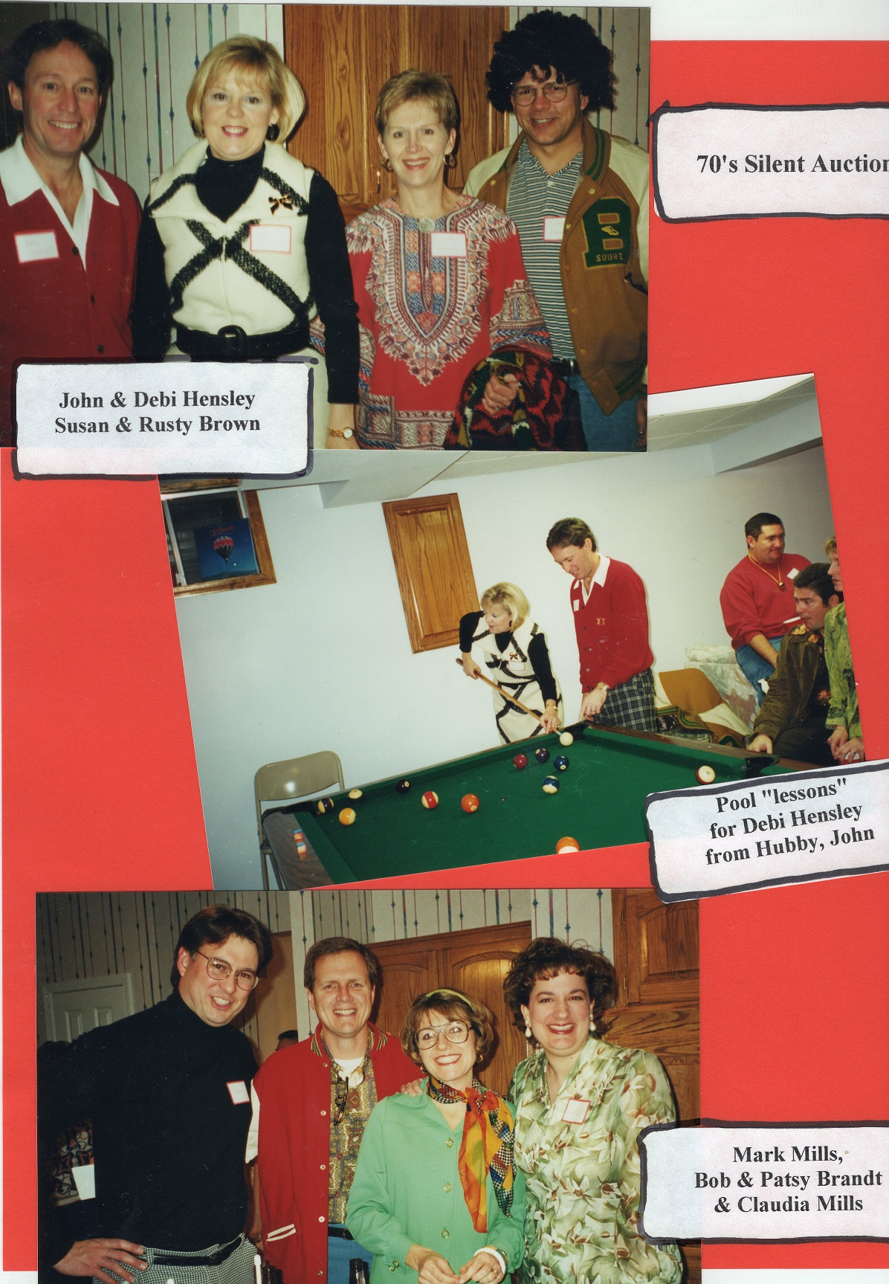
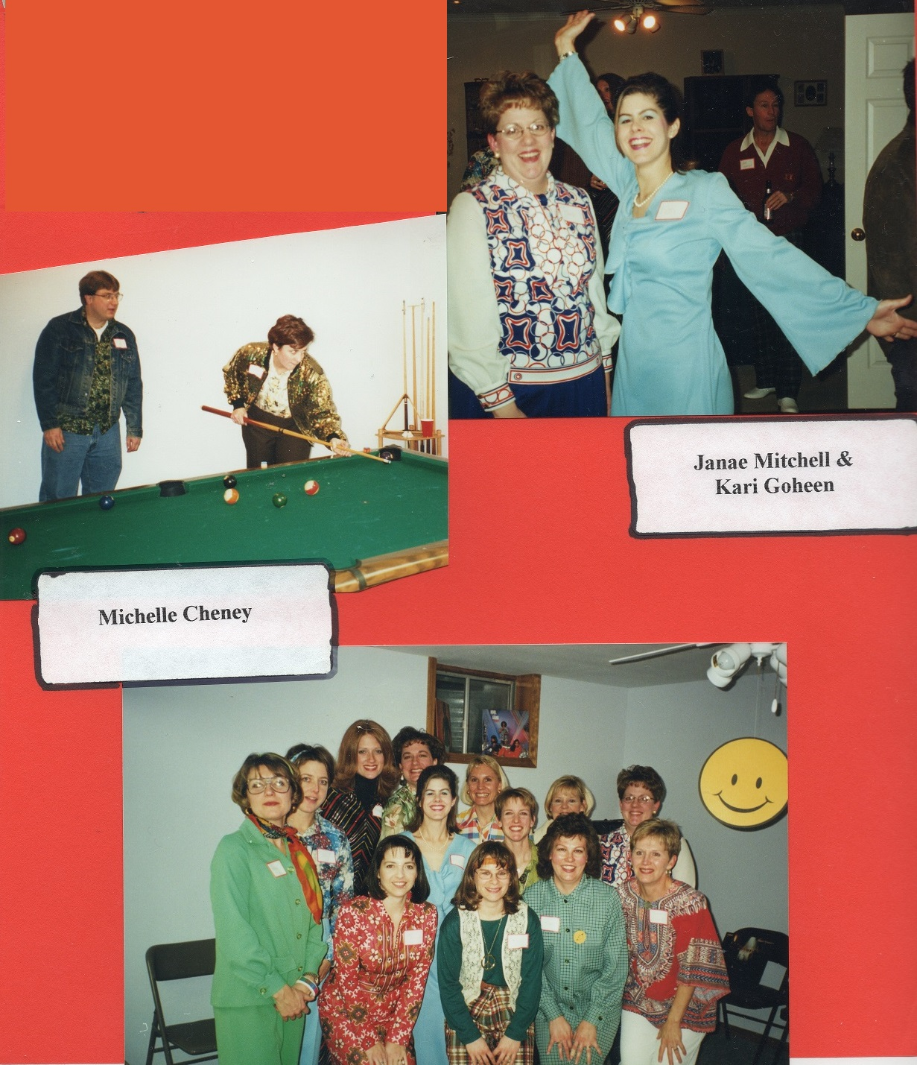
70’s Silent Auction
Husband Kurt looks on as Michelle takes aim. “This ball in the side pocket”

Slide 36
Questions?
Notes:
Anne Hannon repeat question

Slide 37
“As I have tried to recall early days, I have come to realize as never before, how really important our everyday life is, and how much it means to those who come after us. We who were early P.E.O.s lived those days and did not think them of enough importance to write them down, and did not try to remember events, and how eagerly those records are sought today. Thus, the small events of today may be the great things of tomorrow.”
~Lulu Corkhill, hostess of 2nd ever P.E.O. Convention
Notes:
1882 P.E.O. Convention
Bloomfield, IA

Slide 38


Thanks!
For a copy of our presentation as well as step-by-step videos on how to make your own scrapbook, take a picture of our QR code!
Or, visit peokansas.org → Convention Seminars
Notes:
Our QR code includes a copy of our presentation, as well as 2 videos and a step by step guide with instructions on how to create an online scrapbook!
If you need help accessing the QR code, please visit with one of the Chapter JF sisters after the presentation.
All: Thanks for making memories with us, and good luck!

