Slide 1
Sunflower Grants Corporation: A Kansas Project of P.E.O.
Exploring the mission and initiatives of the corporation
Notes:
AI-generated content may be incorrect. --- Welcome to the presentation on the Sunflower Grants Foundation, the Kansas State Chapter of P.E.O. In this session, we will explore the foundation's purpose, its connection to the P.E.O. Sisterhood, and the impactful initiatives it supports.

Slide 2
Sunflower Seeds for Sharing:
Mission
History
Structure and Organization
Application Process
Funding and Support
Seeds that were planted
Notes:
The Sunflower Grants Foundation plays a vital role in providing educational grants to women in Kansas. This foundation is dedicated to empowering women through education and support.

Slide 3
Overview of the Corporation
Mission of the Sunflower Grants Corporation:
As legacies of the P.E.O. Founders, who envisioned a sisterhood where, at all times and under all circumstances, we find ways to express a loving concern for each other, the Sunflower Corporation strives to meet financial needs of sisters and others that cannot be met by other means.
Originally, the plan was to build a P.E.O. Home for sisters “who may lack adequate financial means to provide for themselves without distress”.
Notes:
The Sunflower Grants Foundation focuses on enhancing educational opportunities for women. By providing financial assistance, it aims to facilitate higher education and personal growth.

Slide 4
History and Establishment
Vision:
In 1929, KSC President Hortense Seales, appointed a committee to investigate the possibilities of P.E.O. Home in Kansas. Wall Street had collapsed; the Dirty Thirties were on the way as well as a national depression that would last a decade, but P.E.O.s were determined to make a difference.
Evolution of the Dream:
At Convention 1939, the committee reported that a Home was possible; KSC transferred $5,000. in government bonds to establish the Home Fund toward the establishment of a P.E.O. Home in Kansas.
Evolution Over Time
Over the y, the foundation has evolved significantly, adapting to better support women in their academic journeys.apsed and
Beacon of Hope
Today, the foundation stands as a beacon of hope for many women, inspiring them to pursue their academic goals.
This Photo by Unknown Author is licensed under CC BY-SA-NC
Notes:
The foundation was established to address the educational needs of women in Kansas. Over the years, it has evolved to support numerous women in their academic pursuits, becoming a beacon of hope.

Slide 5
Key Ingredient: Funds
Interest on Investments:
The Home Fund grew slowly the first 10 years with interest and a few memorial gifts.
Member and Chapter Contributions:
In 1949, the Home Committee suggested a gift of $.50 per member by Convention. 53 of the 166 Chapters responded with $749.50. This pattern of voluntary contribution continued until 1955. In 1956 annual dues were increased by $1. to support the Home Fund. By the end of 1962, balance of the Home Fund was $104,663.75. This assessment continued until 1968.
Developments: With assets of $ 171,853.95. in 1968, the Home Board of Trustees recommended that building could begin. The target goal of $200,000. was very close!
Notes:
The Kansas State Chapter implements various initiatives, such as scholarship programs and educational workshops, aimed at empowering women through education and career development.

Slide 6
Where’s the Home?
Reality vs Dream
Cost of construction for new housing in 1968 was about $25,000. and a bid had been placed on land in Emporia, but the prospect of owning, maintaining, staffing and complying with health and safety regulations for a Home was daunting.
Local Chapters Speak
Partnerships and cooperation with local chapters is a hallmark of Kansas P.E.O., and many chapters were expressing concern that it was impractical to build a Home.
Resolution
After careful consideration, The Home Board of Trustees recommended the creation of a plan where the income from the Home Investments be used to aid sisters who may need help to live in their own homes, homes of relatives or retirement homes. The recommendation was approved at the 1970 Convention. Assets were $207,989.06.
Notes:
Collaborating with community organizations enhances the foundation's reach and effectiveness. Partnerships with local businesses and educational institutions play a vital role in its success.

Slide 7
Where We Are Today
IRS requirements necessitated formation of a corporation (1963) , making all active P.E.O. members also members of the corporation! YOU BELONG!
1971 the Sunflower P.E.O. Grants Plan was created. Two existing funds (the Welfare Fund and the Home Fund) were combined.
Application was made for 501(c) (3) status; this was granted in 1971
This status makes it necessary to extend our generosity to ALL In Need.

Slide 8
Structure and Organization
The Kansas State Chapter manages the Home Fund which funds the Kansas P.E.O. Sunflower Corporation and contributes all interest earned from it to the Corporation.
Sunflower Corporation uses the funds from interest and contributions to pay small operative expenses and fund grants.
Sunflower Board of Trustees is composed of 6 voting members and two ex-officio members. This is a Leadership Team of a 4- year duration to which any active P.E.O. may be appointed by the KSC Vice-President. Each year a new member joins the Board.
Trustees meet 3 times a year to consider applications and award grants
Report of the Corporation is given once a year at Convention.
National Organization
The national organization oversees the overall mission and goals of the P.E.O. Sisterhood, ensuring alignment with its educational initiatives for women.
Notes:
The P.E.O. Sisterhood is structured into local chapters, state chapters, and a national organization. Each level plays a role in supporting educational initiatives for women.

Slide 9
Grant Application Process
Notes:
Understanding the grant application process is crucial for potential applicants. This section covers the eligibility criteria and the steps needed to apply.

Slide 10
Eligibility Criteria
Residential Criteria
Applicants must be permanent residents of Kansas and United States Citizens.
Financial Criteria
Financial criteria are that the one-time grant addresses a specific need and will positively impact their circumstances. Grants are always paid to a vendor, and this need cannot be met by any other resource.
Membership Criteria
There are NO membership criteria; the applicant need not be a P.E.O., but must be sponsored by an active member, not a Chapter. Eligibility is not dependent on age, race, gender, ethnicity, or religion.
Notes:
To be eligible for a grant from the Sunflower Grants Foundation, applicants must meet specific educational and financial criteria. This ensures that support reaches those who need it most.

Slide 11
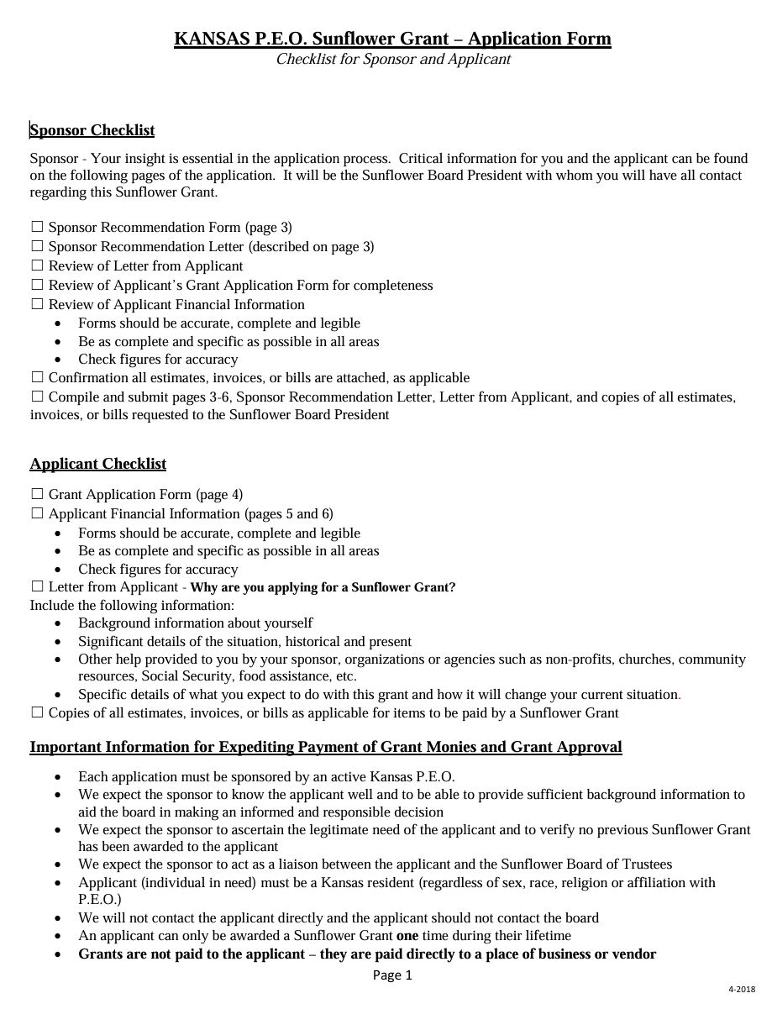
The Application
.
Notes:
The application process involves several steps, including submission of personal information, educational history, and financial need assessment. Detailed requirements are provided to guide applicants.

Slide 13
Sponsor’s Participation
Confidentiality of applicant’s information limits the process to one sponsor. Please do not involve your chapter or other sisters.

Slide 14
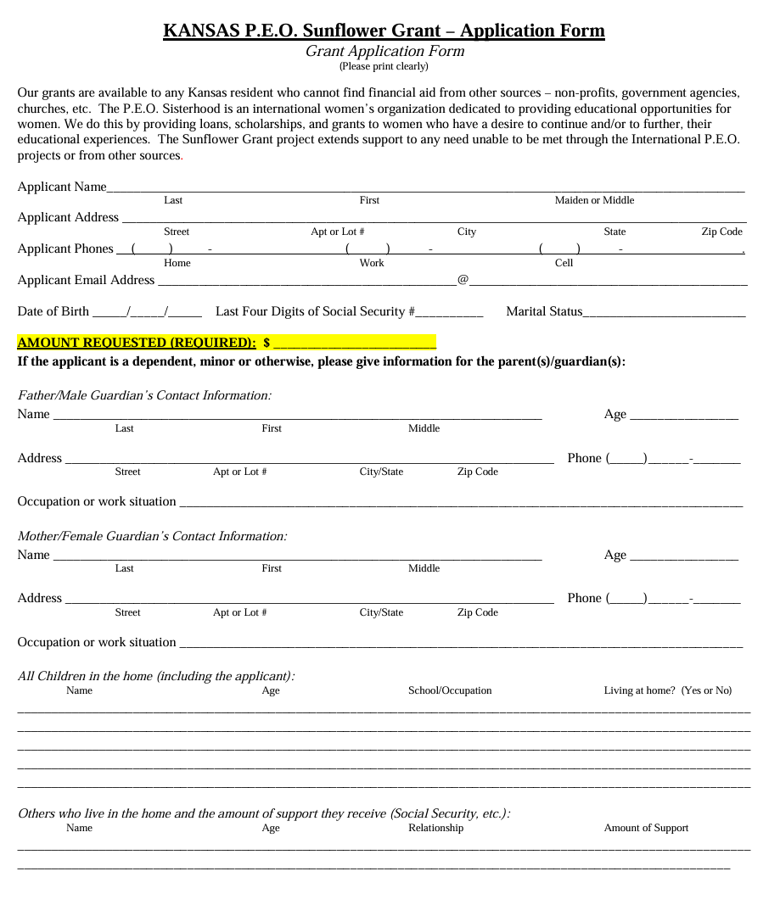
Applicant’s Demographics & Request

Slide 15
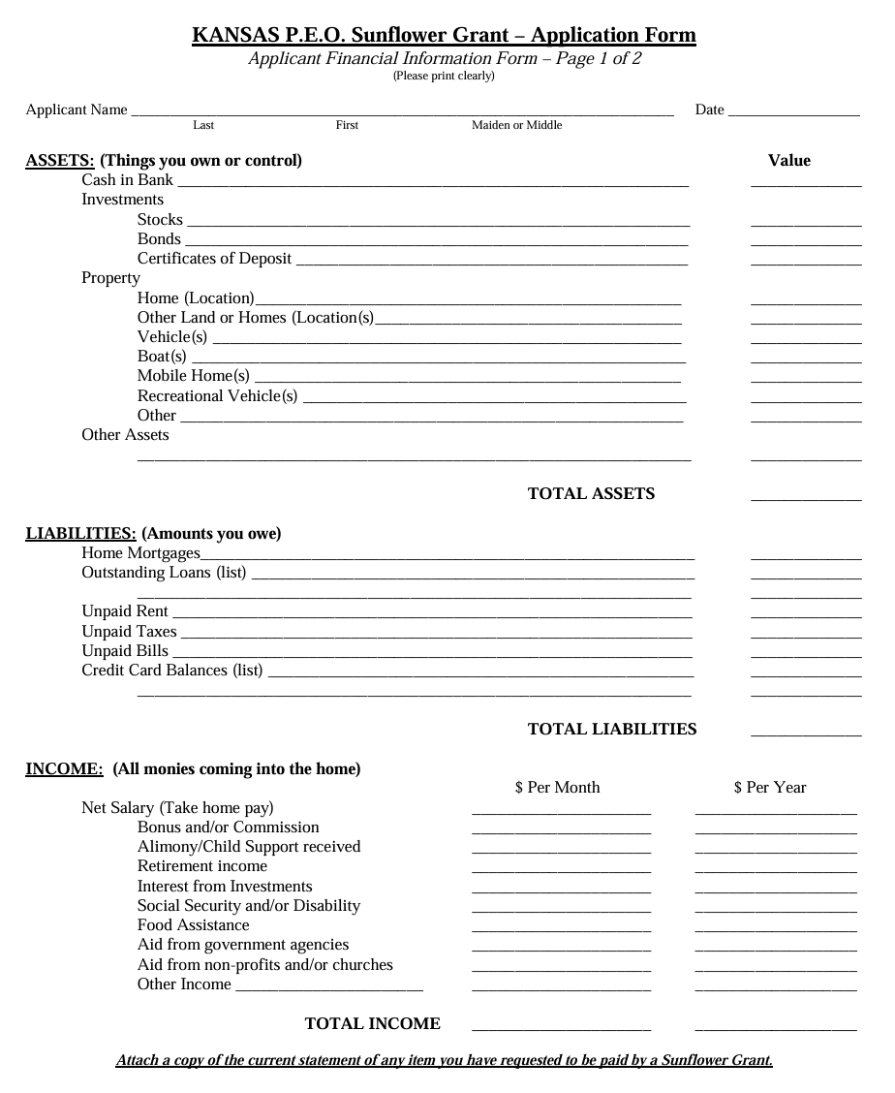
Payments are always to a specific vender for a specific liability. Attachment of all documents is necessary for a completed application.

Slide 16
The Hardest Part
Open Minds and Open Hearts
Create Open Hands

Slide 17
Selection and Awarding Process
Application Submission
Applications are submitted by the applicant’s P.E.O. sponsor to the current president of the Board of Trustees who then reviews them for completeness and then forwards them to board members.
Grant Awarding
The Board of Trustees meets 3 times a year, about a month after the application deadlines of February1, May 1 and October 1 to consider the requests and distribute the funds.
Notes:
Once applications are submitted, they undergo a thorough review process. Successful applicants are awarded grants based on their demonstrated need and commitment to education.

Slide 18
Funding and Support
Notes:
The foundation relies on various sources of funding and support to sustain its initiatives. This section discusses potential sources and ways to contribute.

Slide 19
Sources of Funding
Donations
Donations from individuals and chapters are a vital source of funding that supports the Kansas P.E.O. Sunflower Corporations’ initiatives. Donations received April through December 2024 were $13,352.
Fundraising Events
Organizing fundraising events in your Chapters helps raise funds while engaging the community and raising awareness of the Sunflower Grants availability to anyone in need.
Interest Earned
Interest from the Home Fund investments that have been deposited in the Sunflower Grants account since April 2024 total $14,803.77.
Total Funds: $1,109,666.02 Yearly Budget of $60,000.
Notes:
Funding for the Sunflower Grants Foundation comes from donations, fundraising events, and partnerships with local organizations. These resources are essential for supporting educational grants.

Slide 20
How to Contribute and Support
Monetary Donations
Making monetary donations is a straightforward way to support the Sunflower Grants Foundation and its initiatives. Chapters can mail donations to the Executive Treasurer. Individuals can also mail contributions or donate online by clicking HERE.
Spreading Awareness
Helping to spread the word about the Sunflower Corporation's mission can contribute significantly to its success. Talk in your Chapter; talk in your church; talk, talk, talk ! We have the opportunity to spread the “light of our Star” in our communities. As Founder Alice Bird Babb put it,”…Our real work is not to go out and search for the ‘Holy Grail’, but to do the daily rounds, the common task right at our own door.”
Sponsor an applicant
“Blessed is our P.E.O. sister (and others) in need who will let the need be known.”
Notes:
There are various ways to contribute to the Sunflower Grants Foundation, including monetary donations, volunteering at events, or helping spread the word about its mission to empower women.

Slide 21
Seeds we have planted: ---Seizure service dog ---Water heater or refrigerator ---Physical therapy sessions ---Accessible bathroom remodel ---Septic tank replacement ---Wheelchair for outdoor use ---Medical bills ---Hearing aids, dentures ---Living expenses while off work for surgery ”All the flowers of tomorrow are in the seeds of today”-Charlotte Street, KSC President 1970-71 2024-25 grants (8)= $34,662.36 Total grants= $1,770,776. ( Since 1971)

Slide 22
Conclusion
We of the Board of Trustees are both humbled and grateful to be a small part of the loving generosity of Kansas P.E.O.s.
“We are a band of sisters bound together by the ties of affection for each other and as far as possible for all others. It is for each of us to make the world better and happier. To this end it is ours to make LOVE IN ACTION the keystone of P.E.O. . . “
Mary Allen Stafford

