Slide 1
Welcome to the
Birthday Party!
Celebrating Our Anniversary Chapters

Slide 3
125 Years

Slide 4
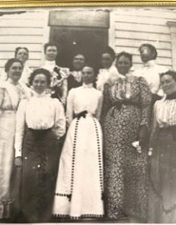
Chapter F
Pratt
Organized July 13, 1900

Slide 5
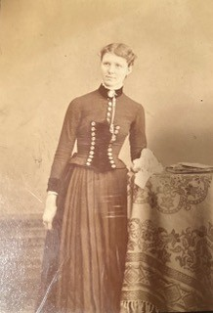
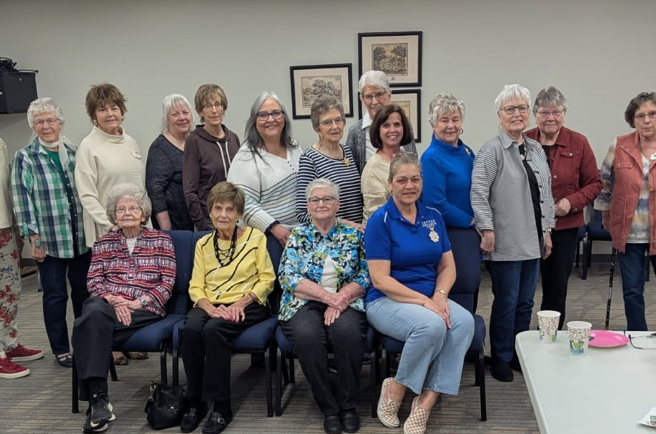
Maime Axline Faye

Slide 6
100 Years

Slide 7
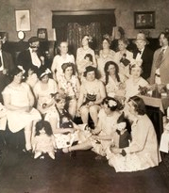
Chapter CP
Pittsburg
Organized March 23, 1925

Slide 8
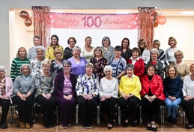
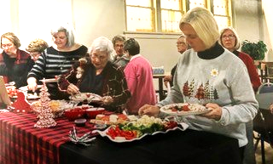
Chapter Holiday Party
100th Anniversary Celebration

Slide 9
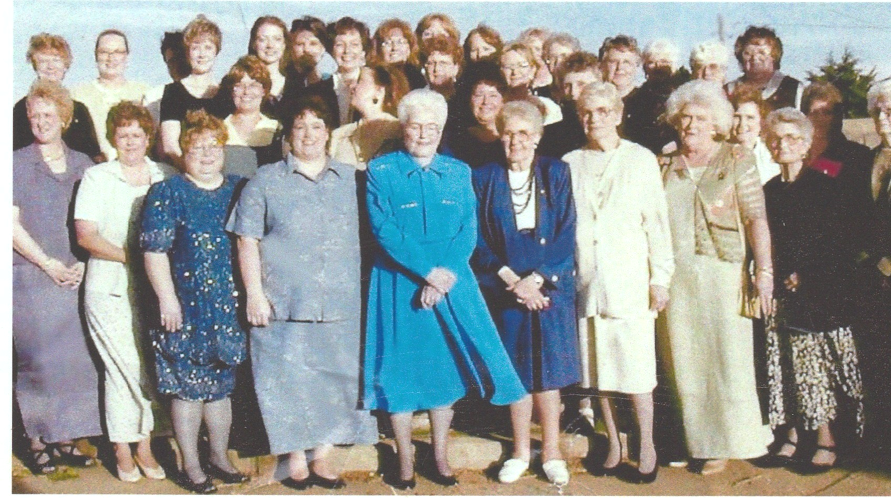
Chapter CQ
Kinsley
Organized May 2, 1925

Slide 10
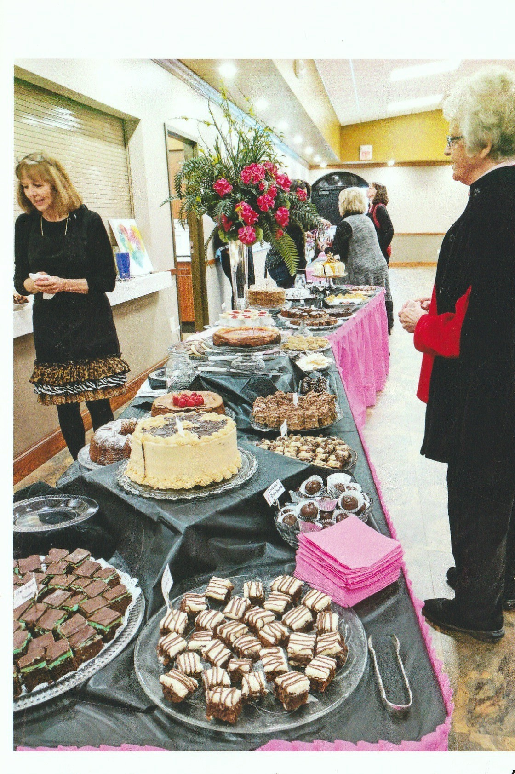
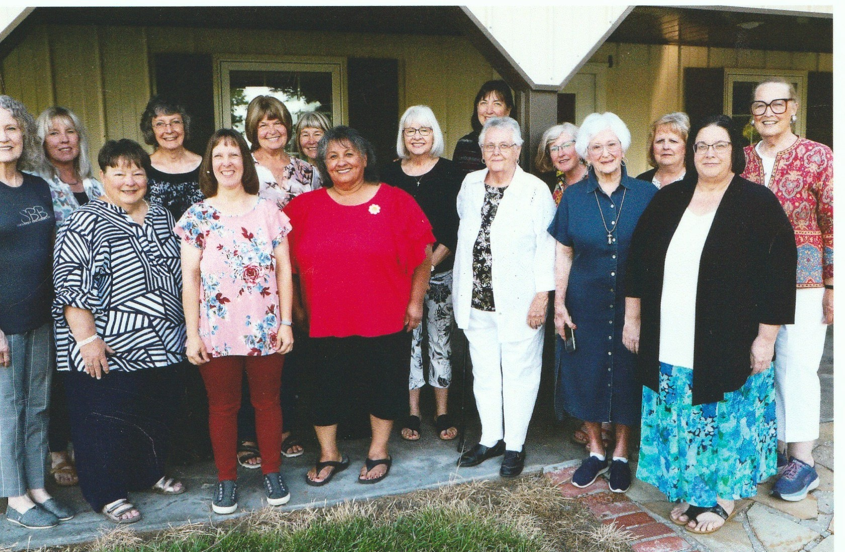
A Chocolate Affaire

Slide 11
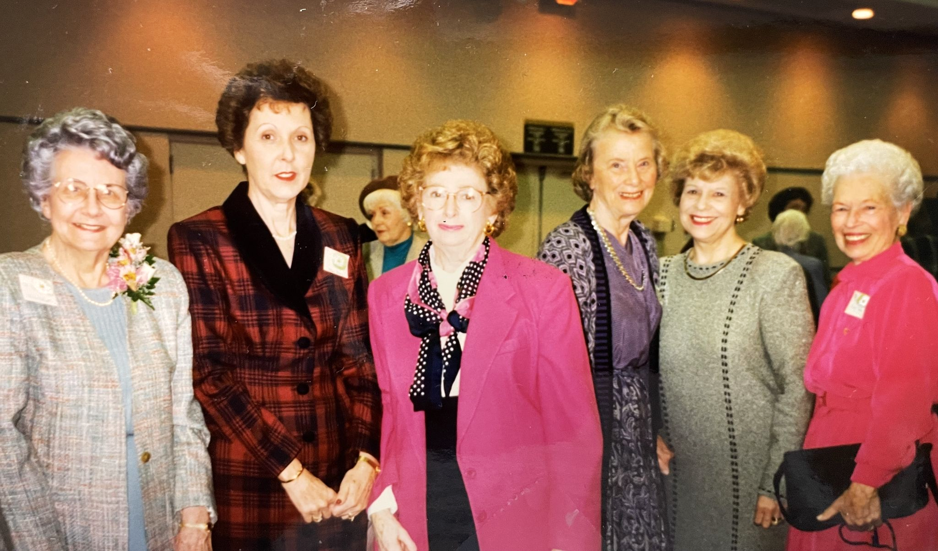
Chapter CS
Topeka
Organized September 26, 1925

Slide 12
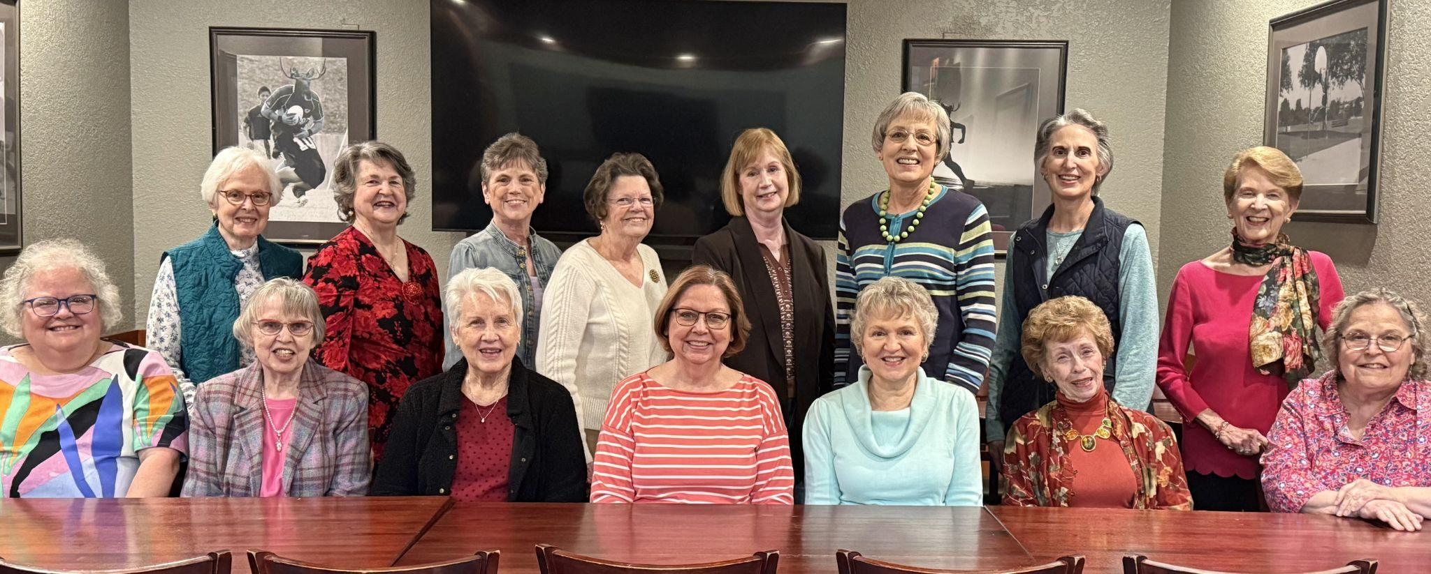
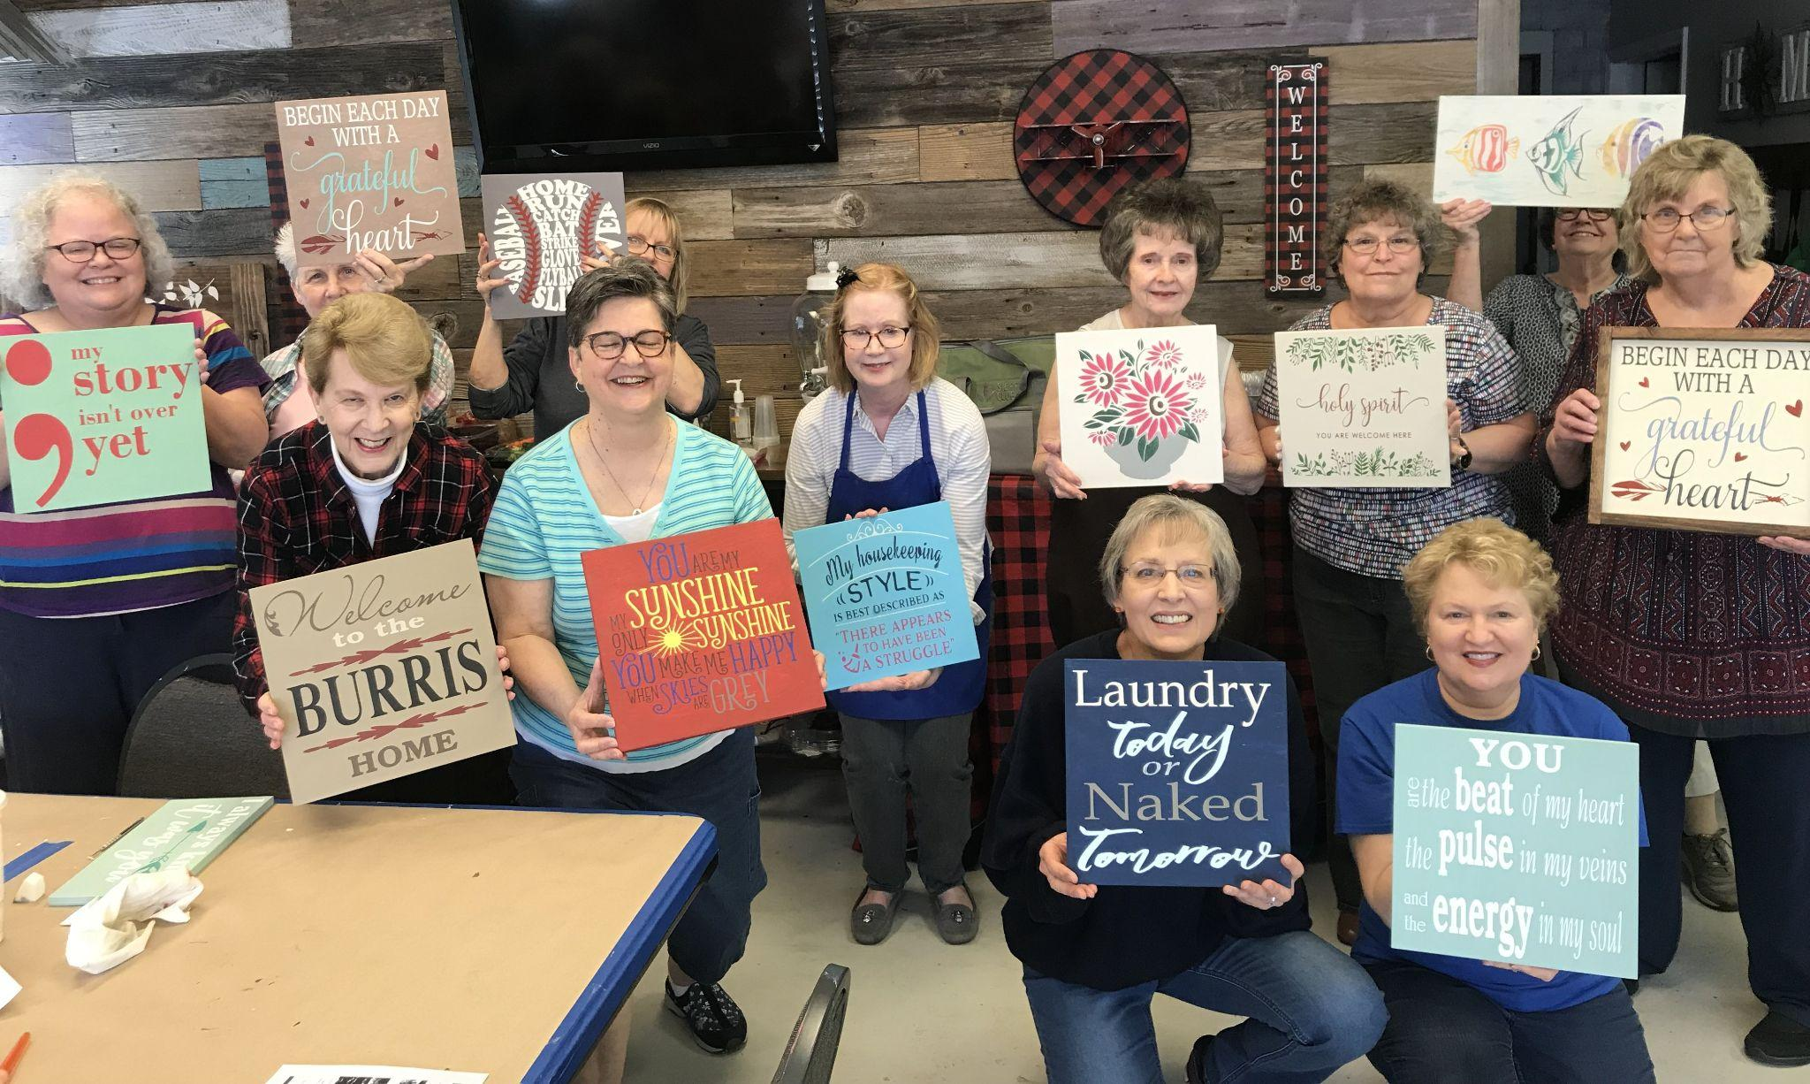
Chapter Social

Slide 13
75 Years

Slide 14
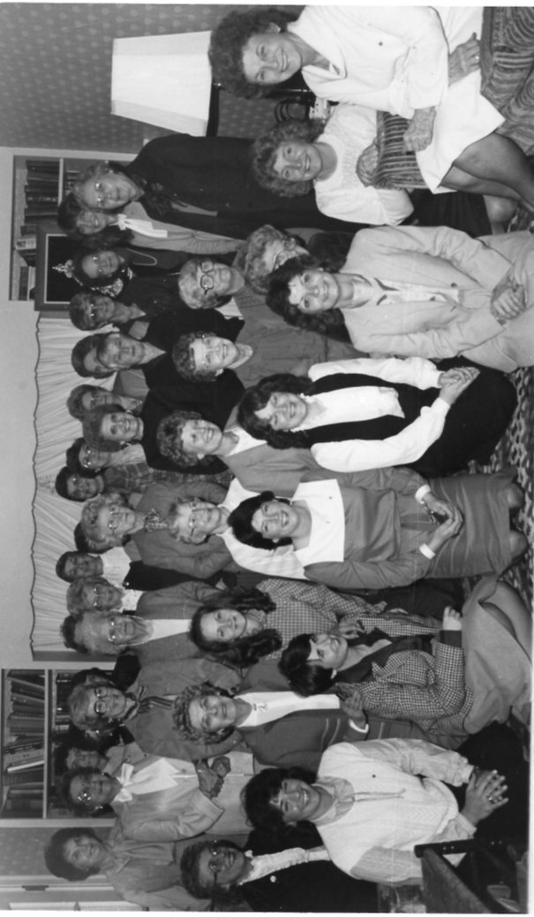
Chapter FP
Independence
Organized January 12, 1950

Slide 15
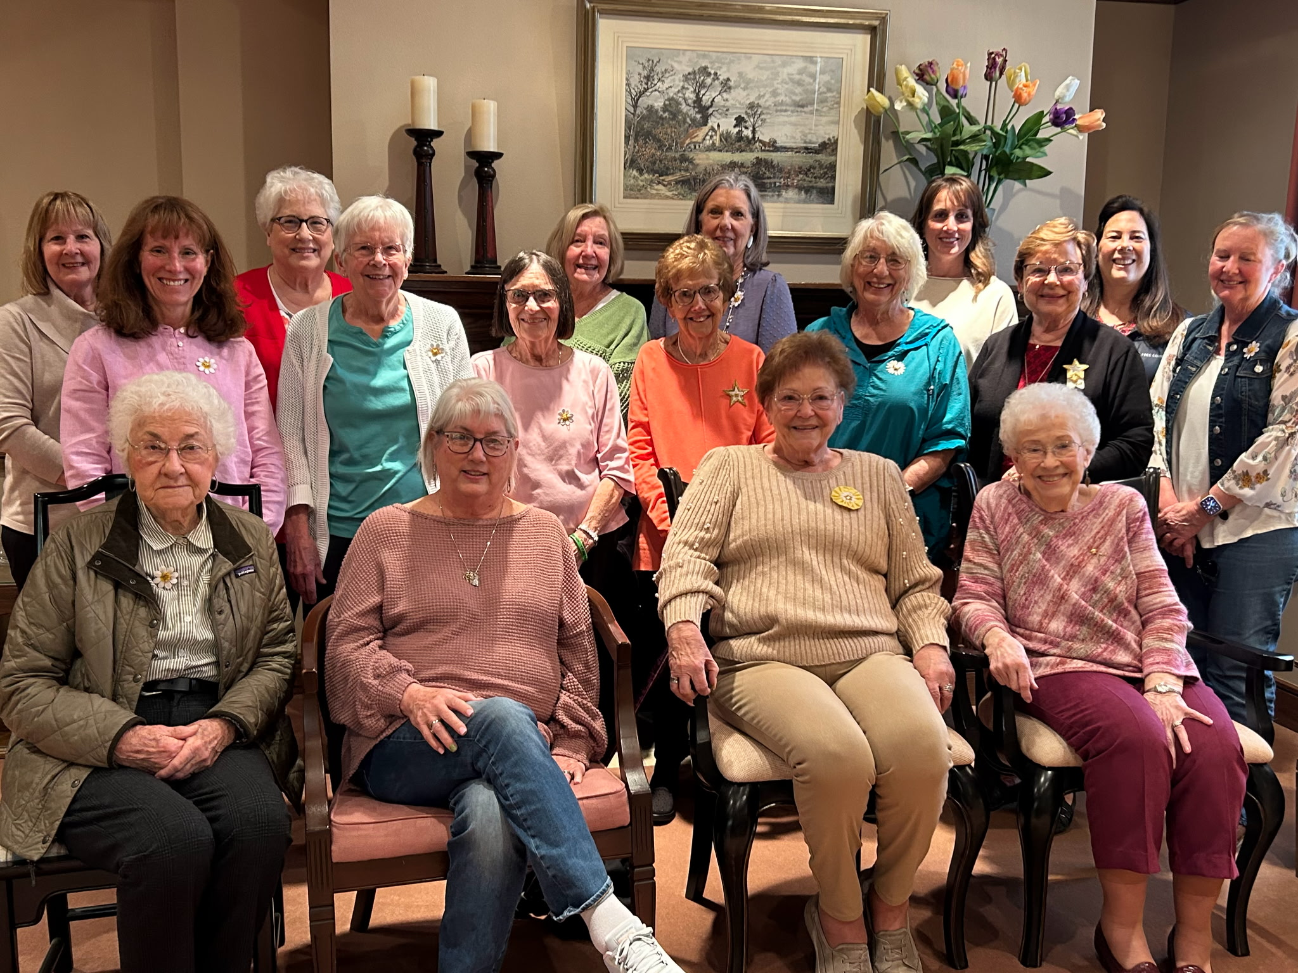
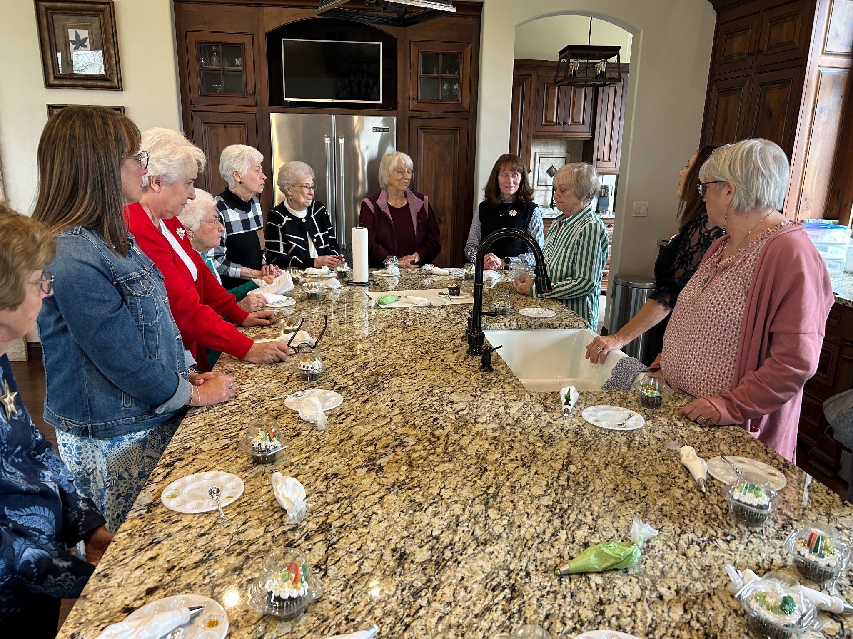
Cookie Decorating Party

Slide 16
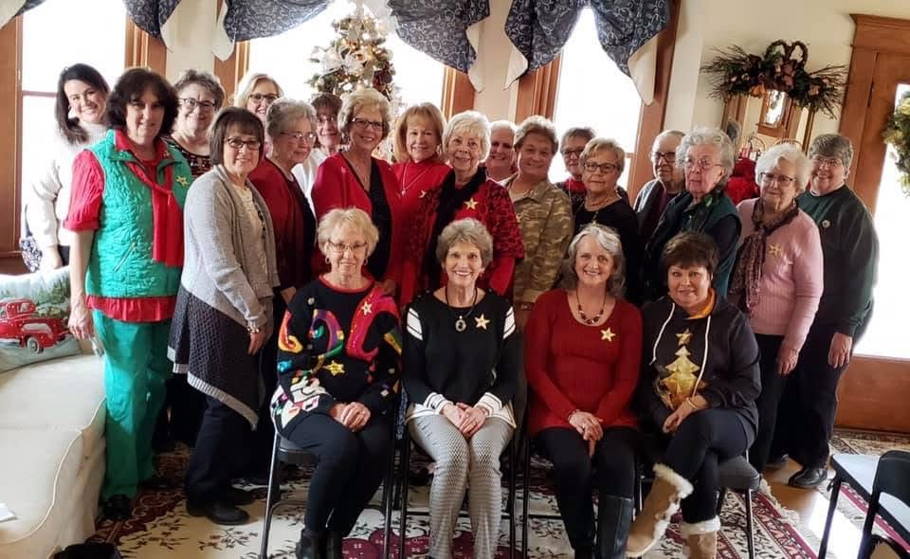
Chapter FR
Eureka
Organized February 11, 1950

Slide 17
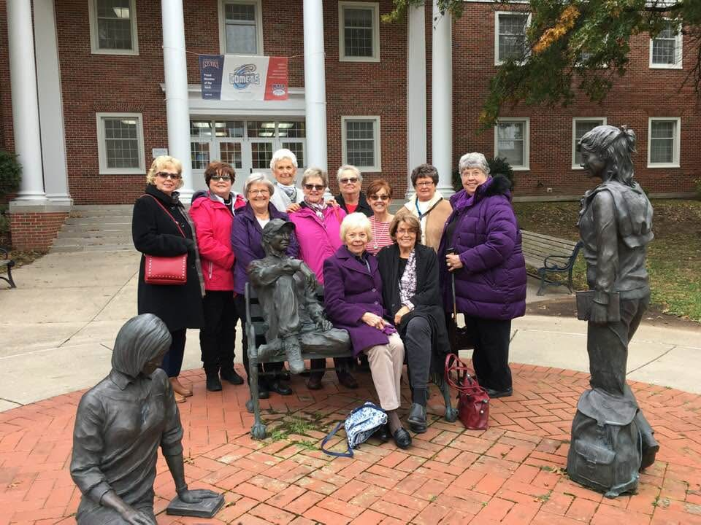
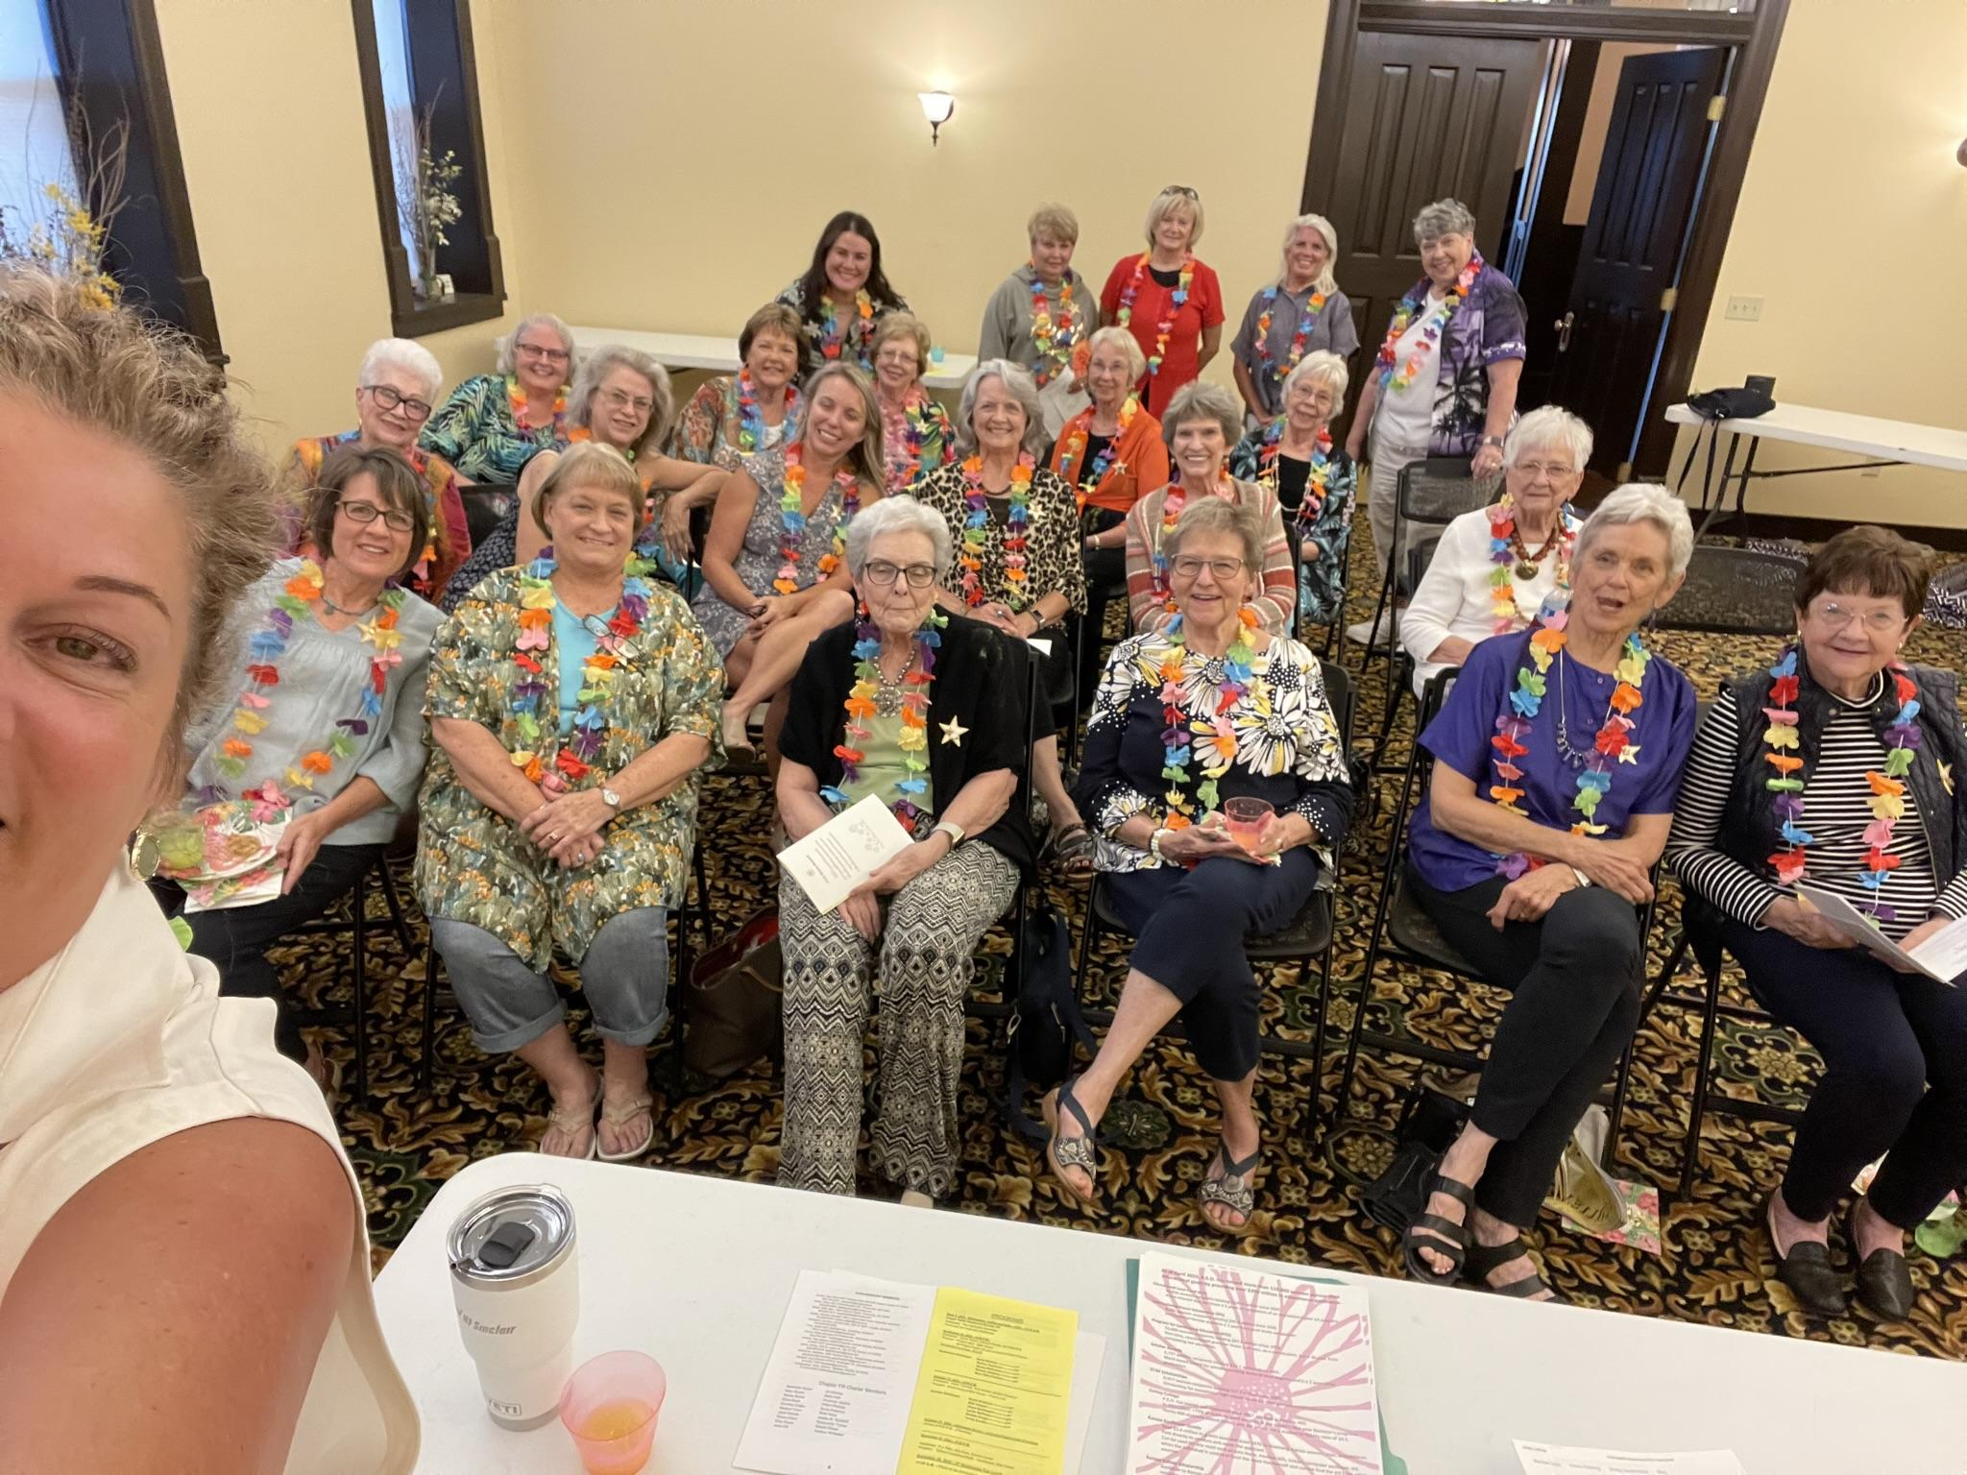
Cottey College Visit

Slide 18
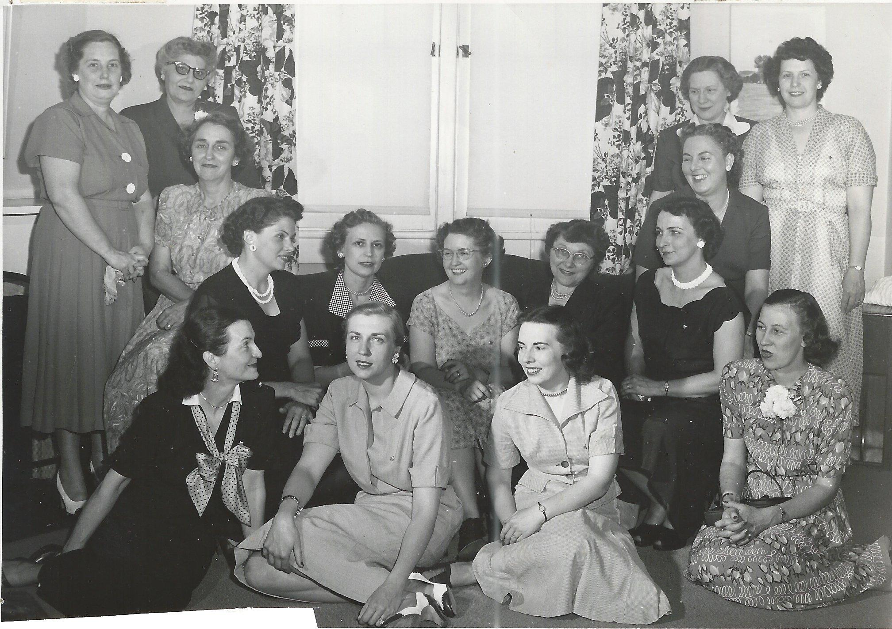
Chapter FT Atchison
Organized April 3, 1950

Slide 19
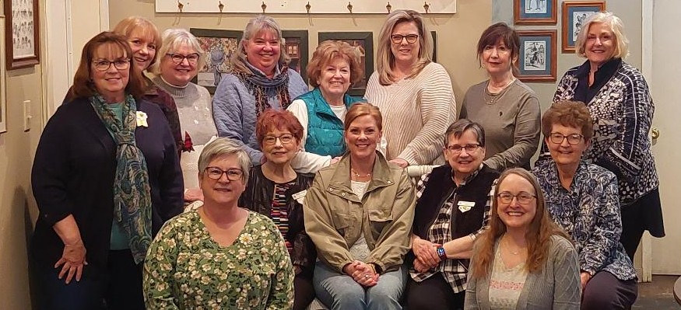
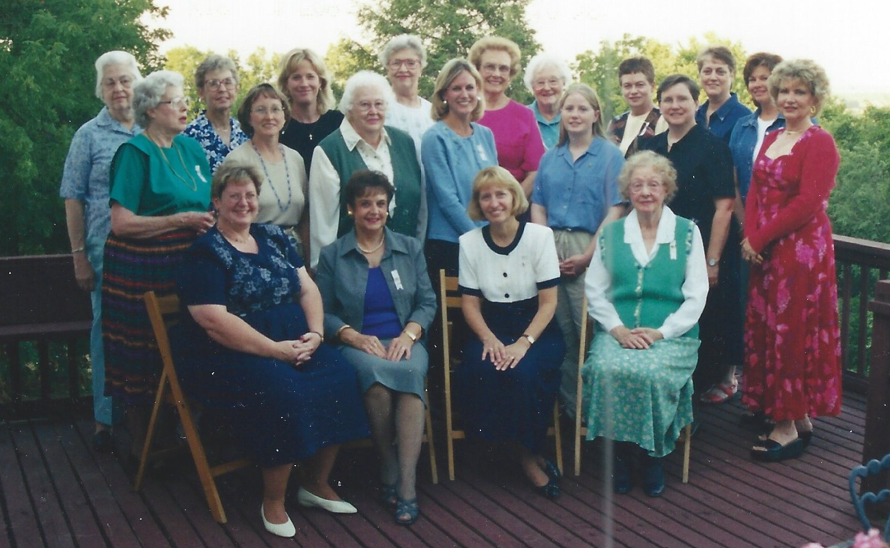
50th Anniversary
March 2025

Slide 20
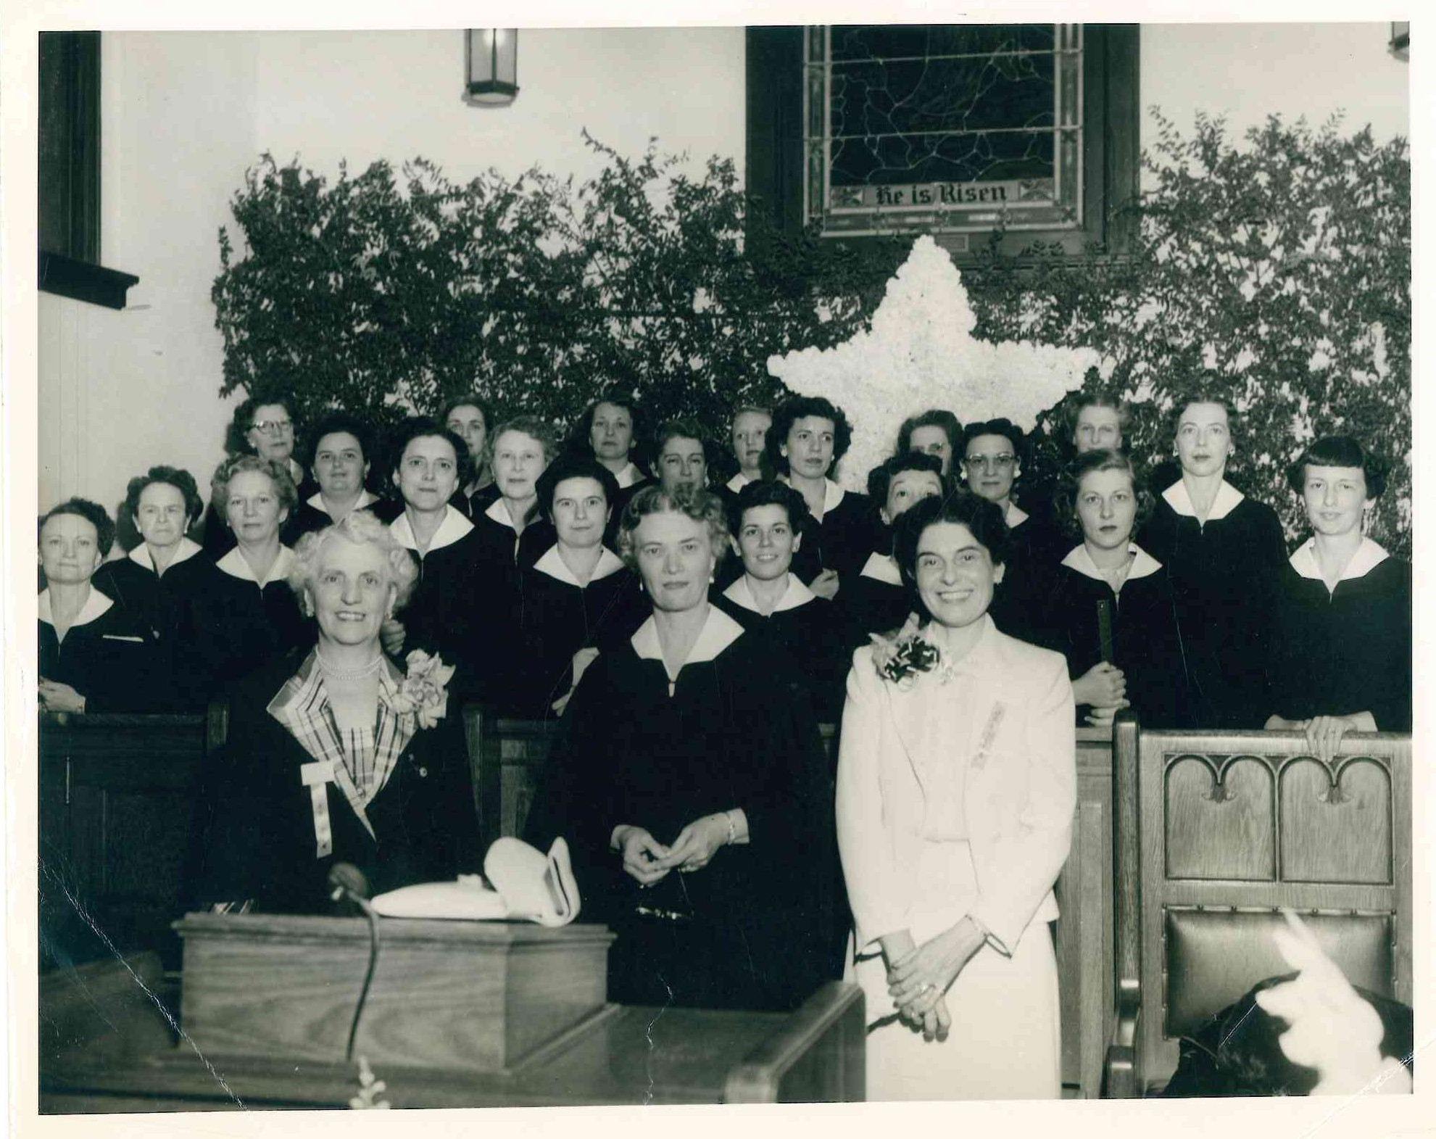
Chapter FU Fort Scott
Organized October 31, 1950

Slide 21
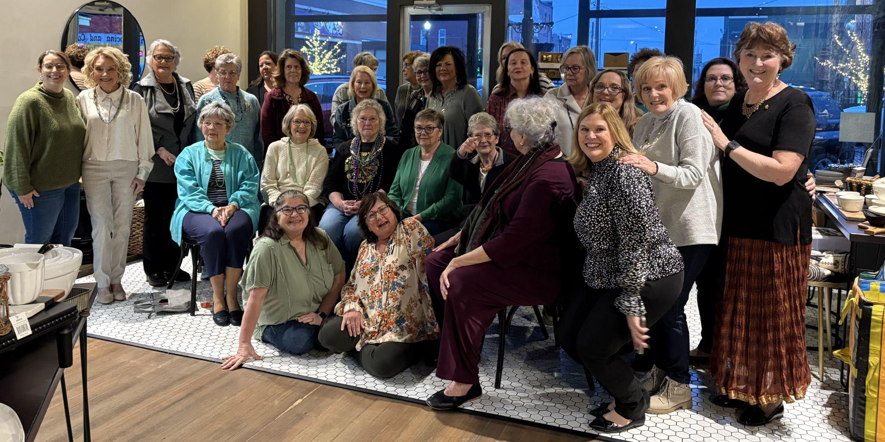
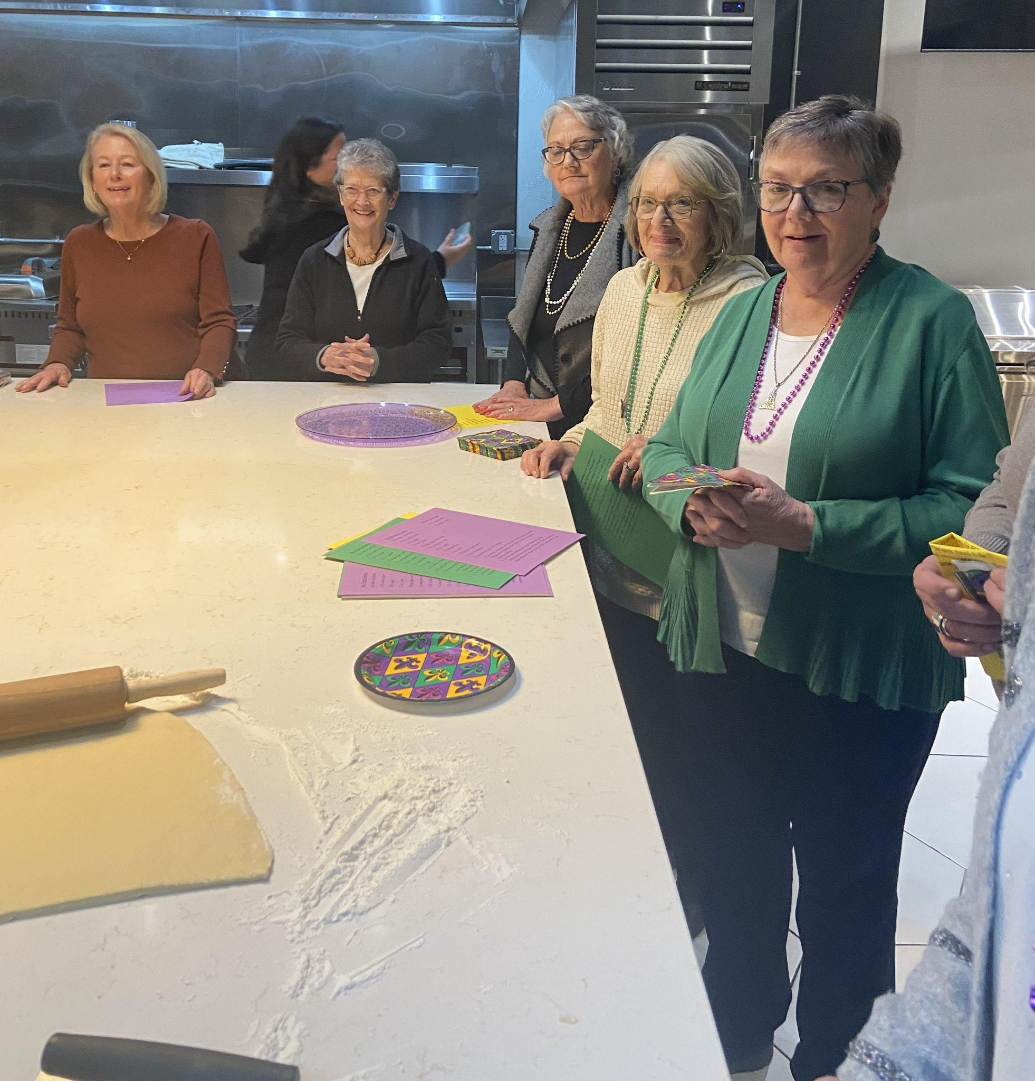
Mardi Gras Fun

Slide 22
50 Years

Slide 23
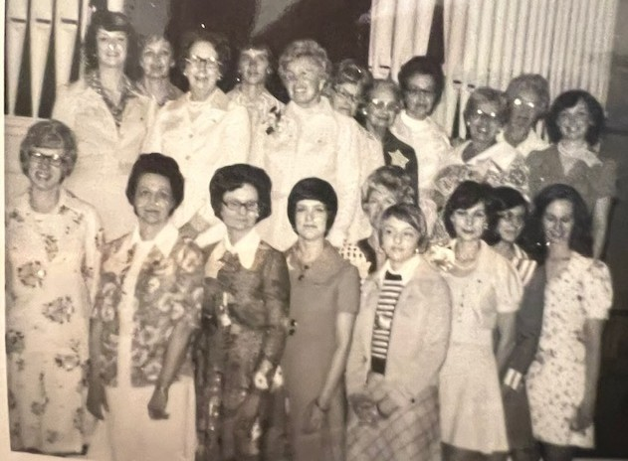
Chapter HL Olathe
Organized April 6, 1975

Slide 24
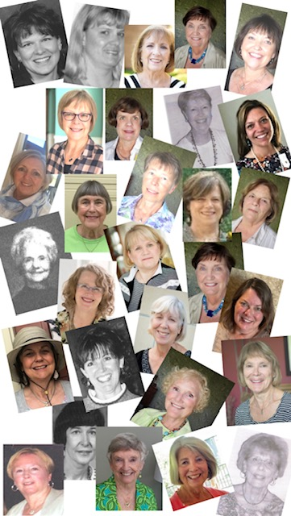
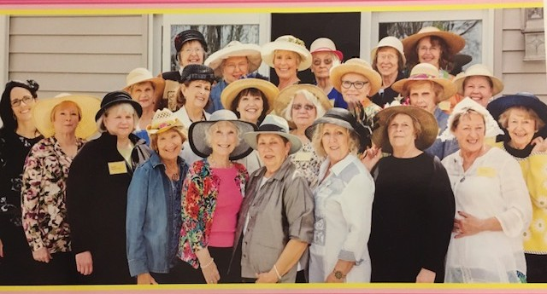
Hats Off to Chapter HL

Slide 25
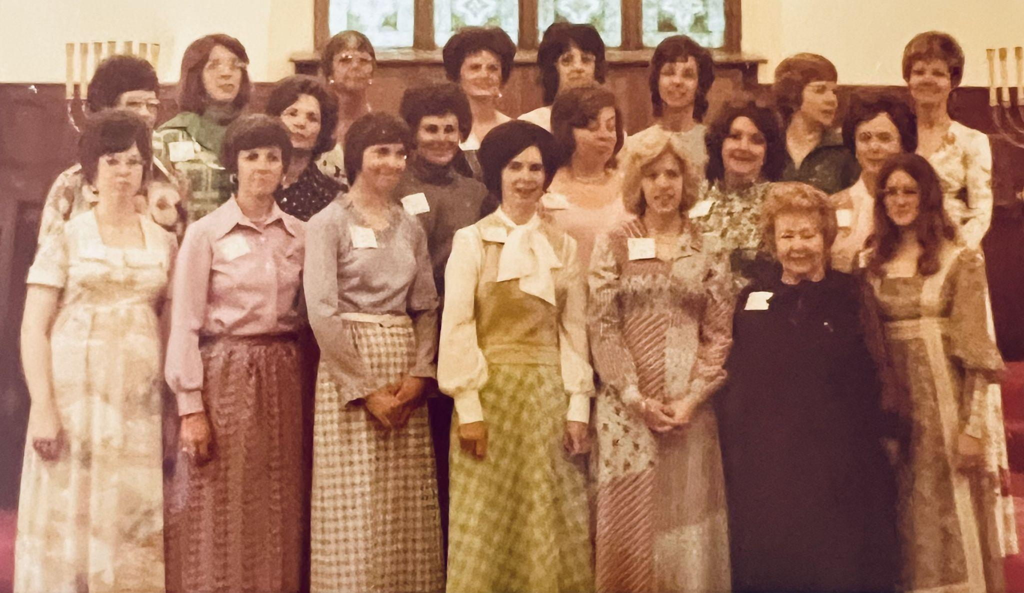
Chapter HM Dodge City
Organized April 20, 1975

Slide 26
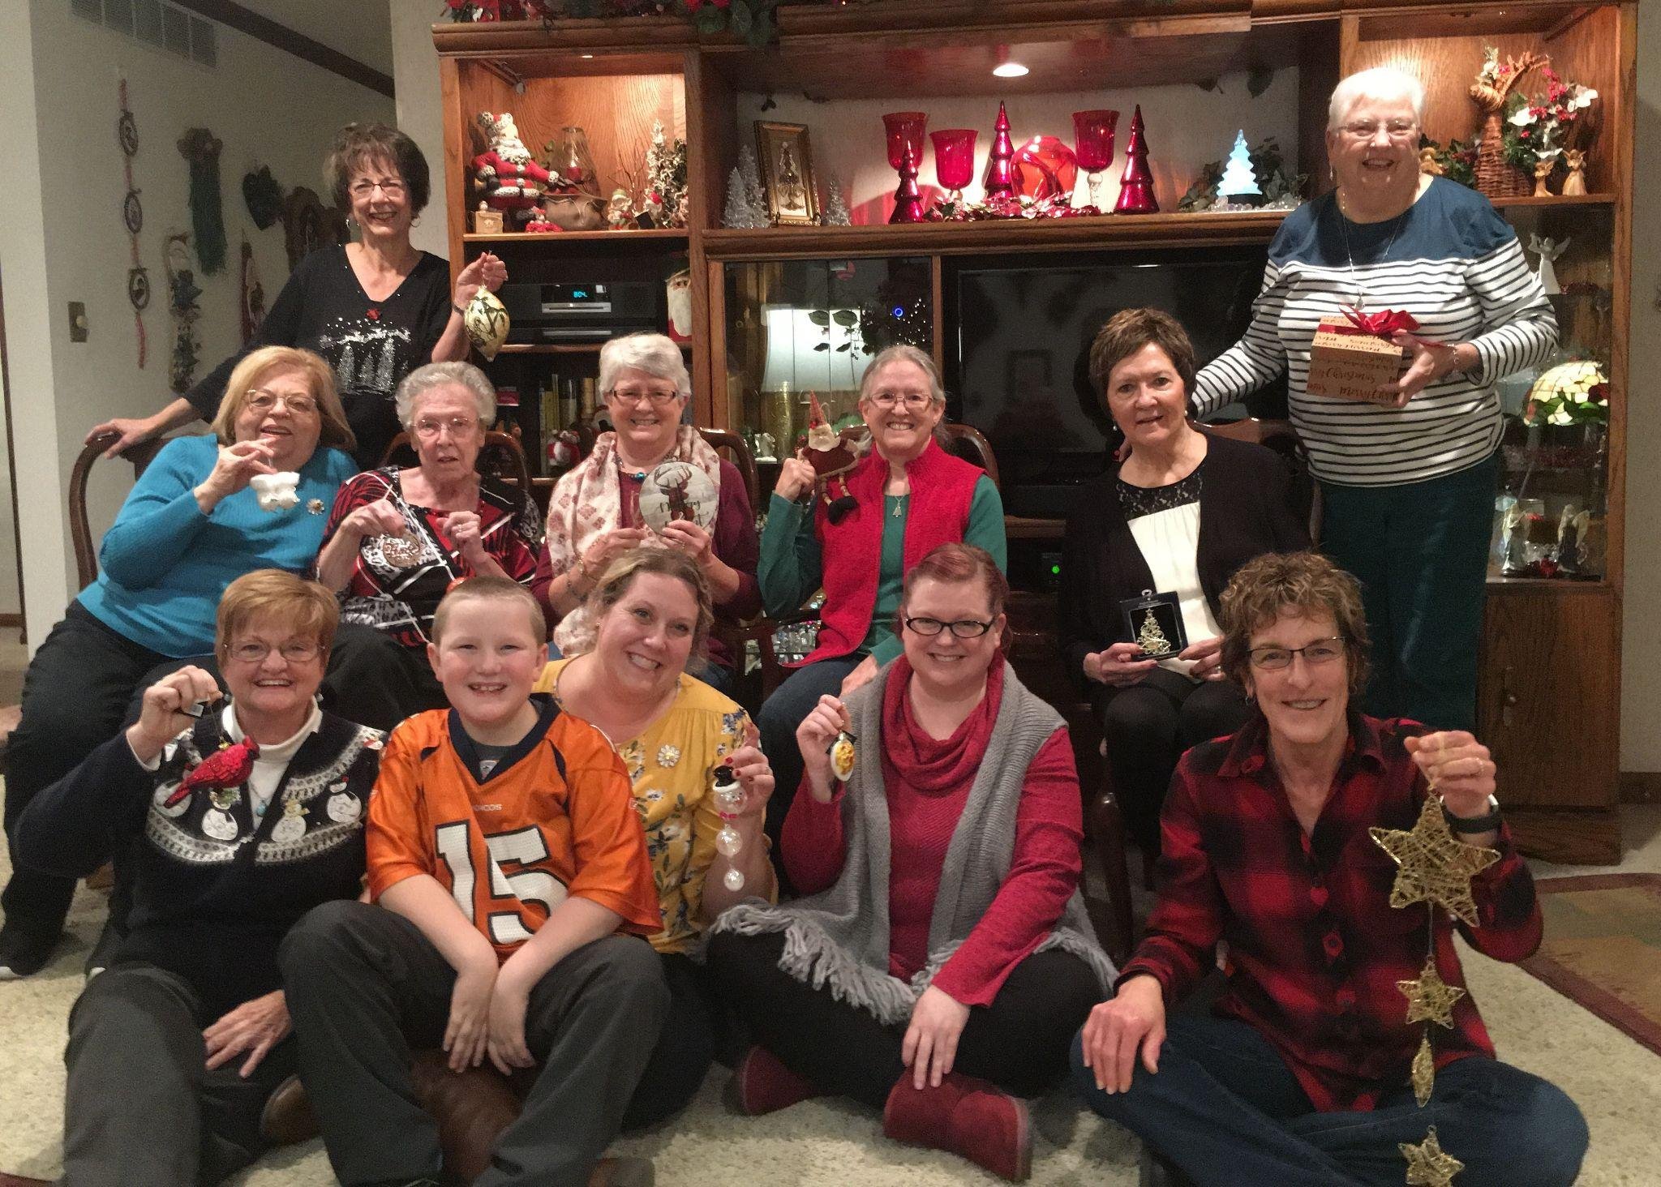
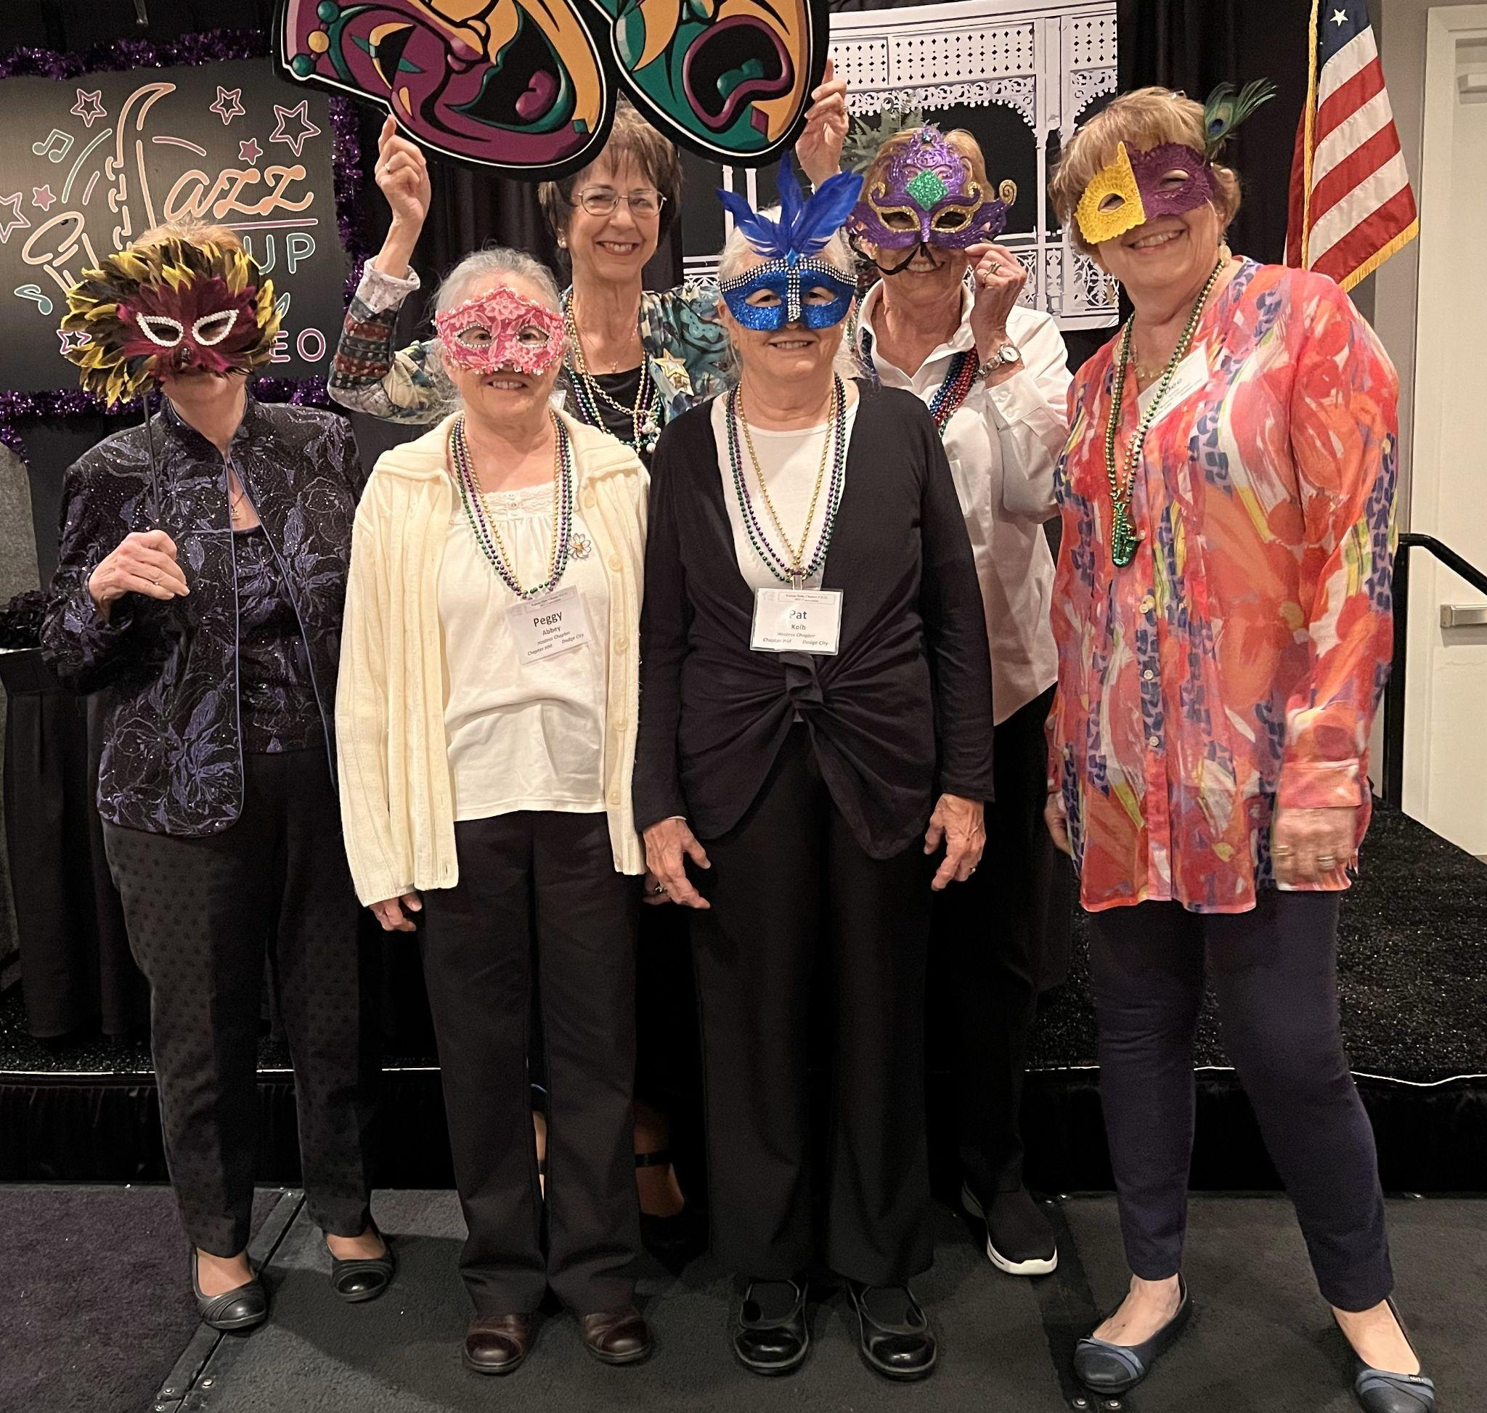
Holiday Party 2024
2022 Convention Hostess Chapter

Slide 27
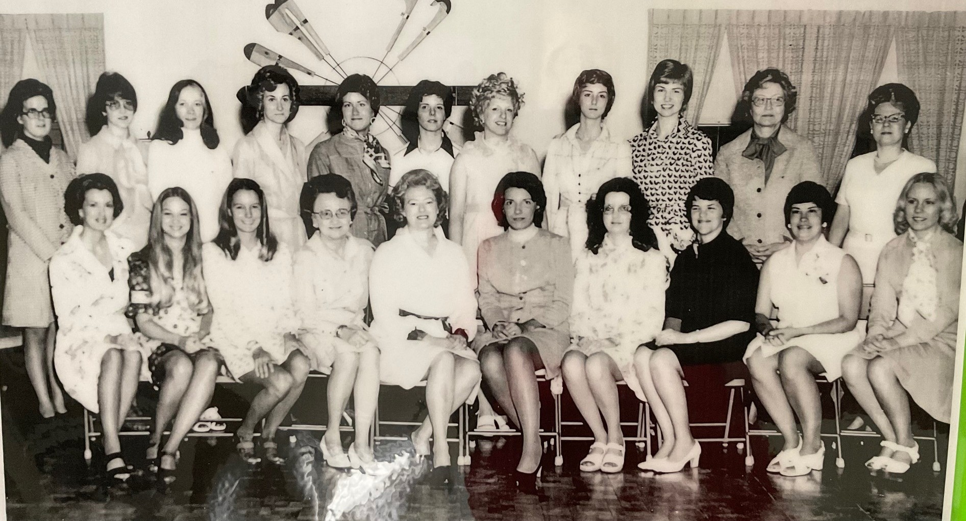
Chapter HN Wichita
Organized May 3, 1975

Slide 28
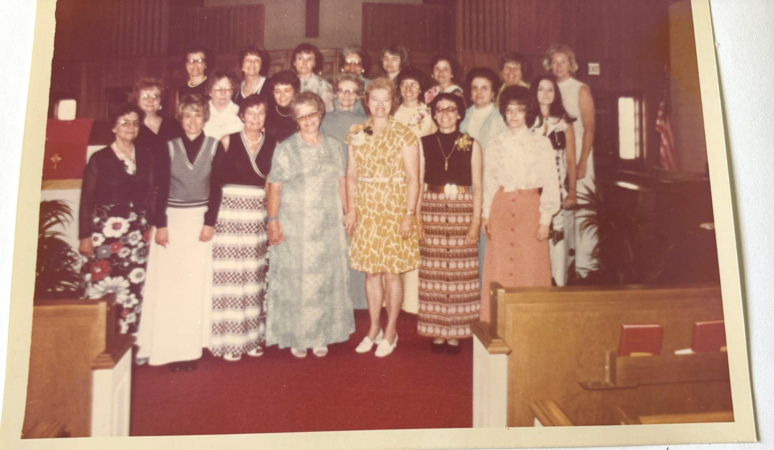
Chapter HP Hutchinson
Organized May 22, 1975

Slide 29
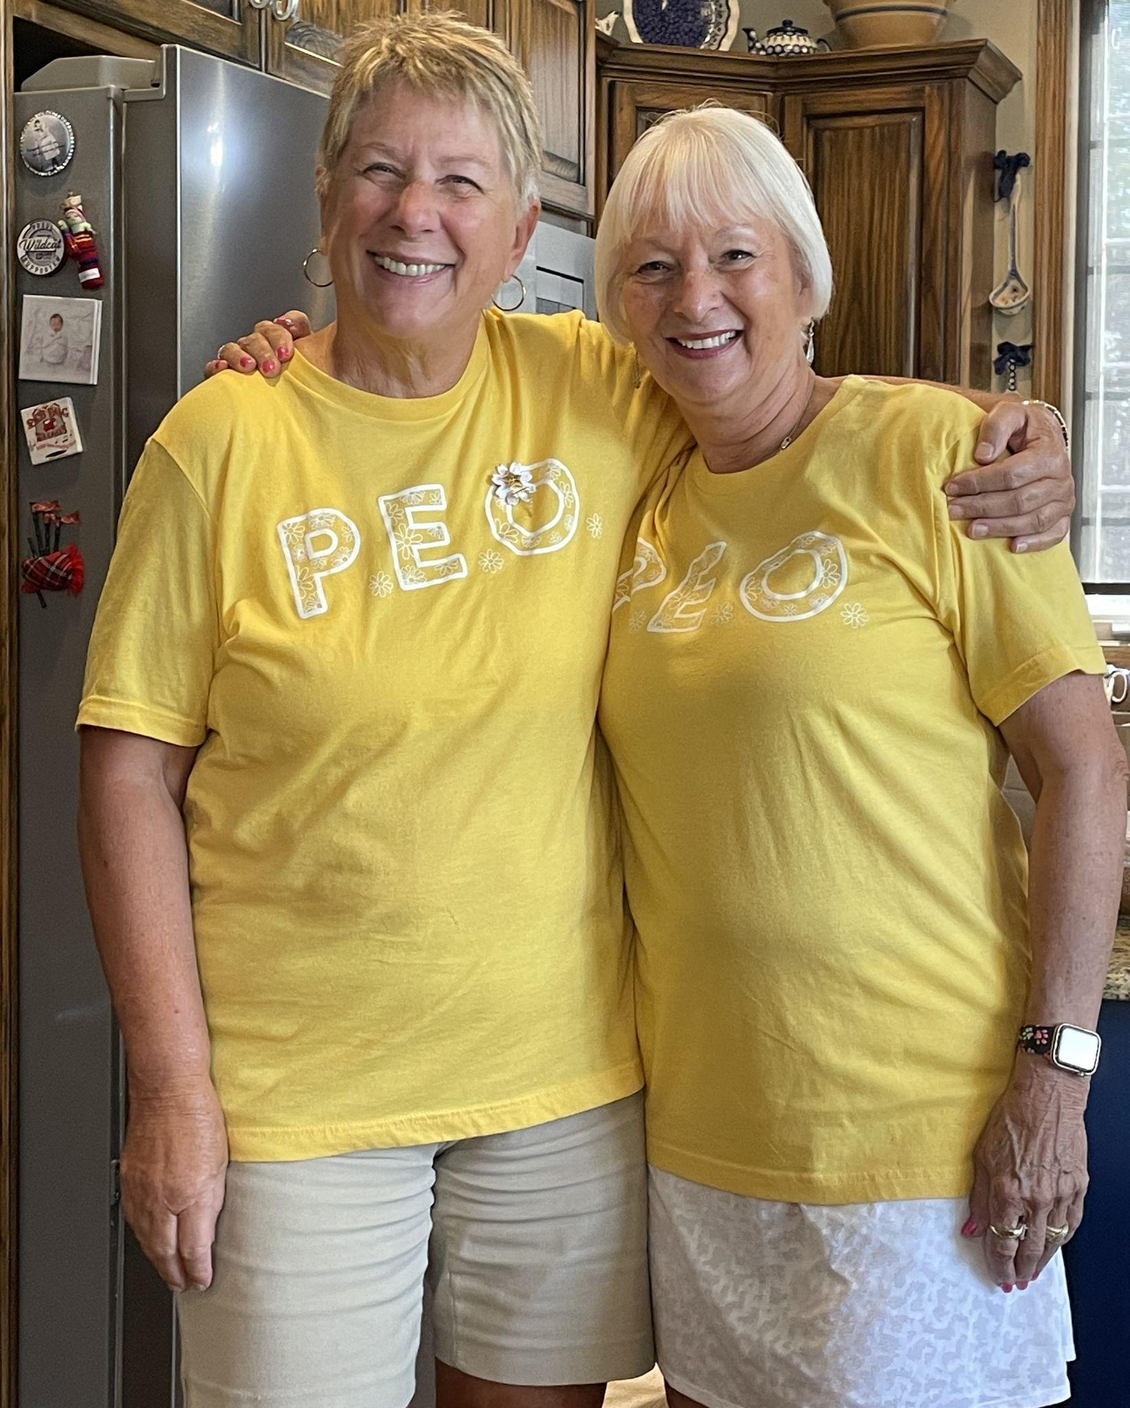
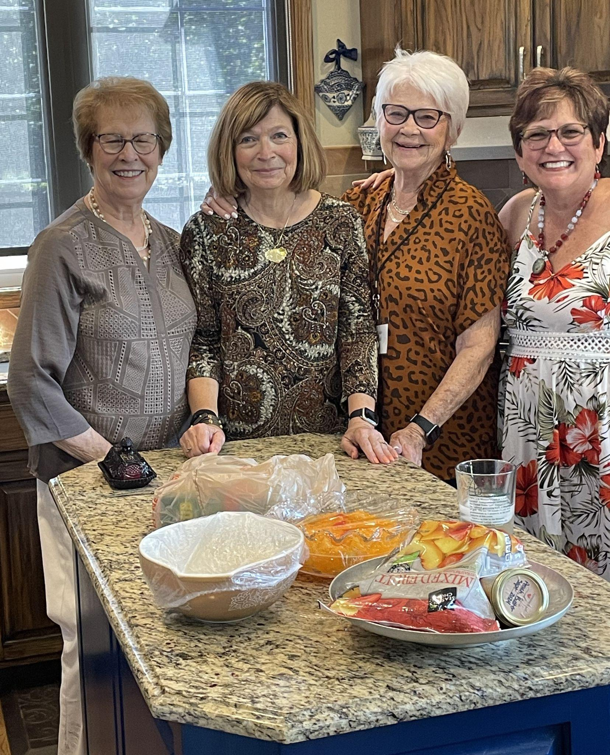

Slide 30
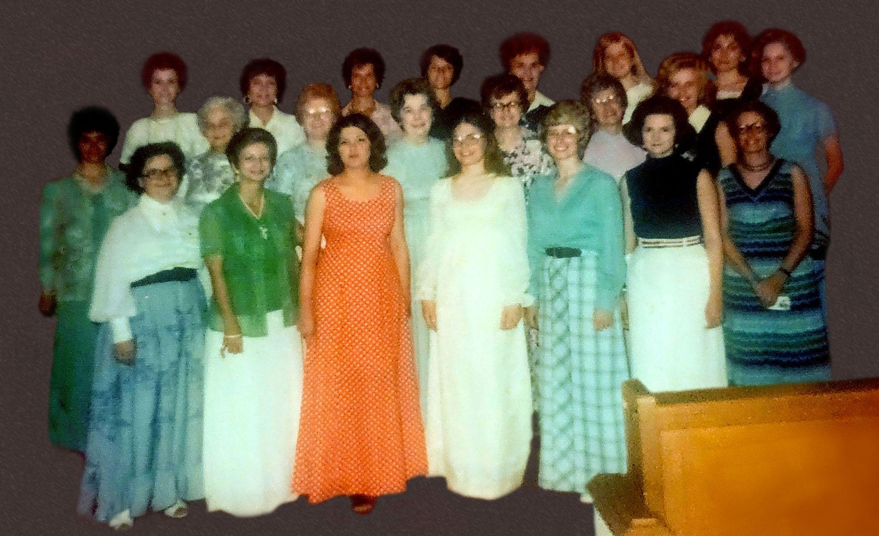
Chapter HQ Hutchinson
Organized May 22, 1975

Slide 31
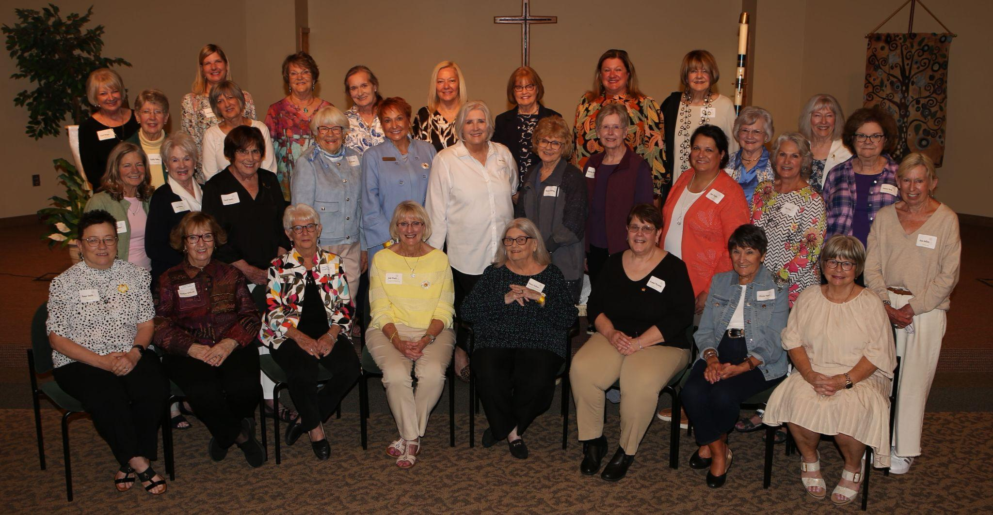
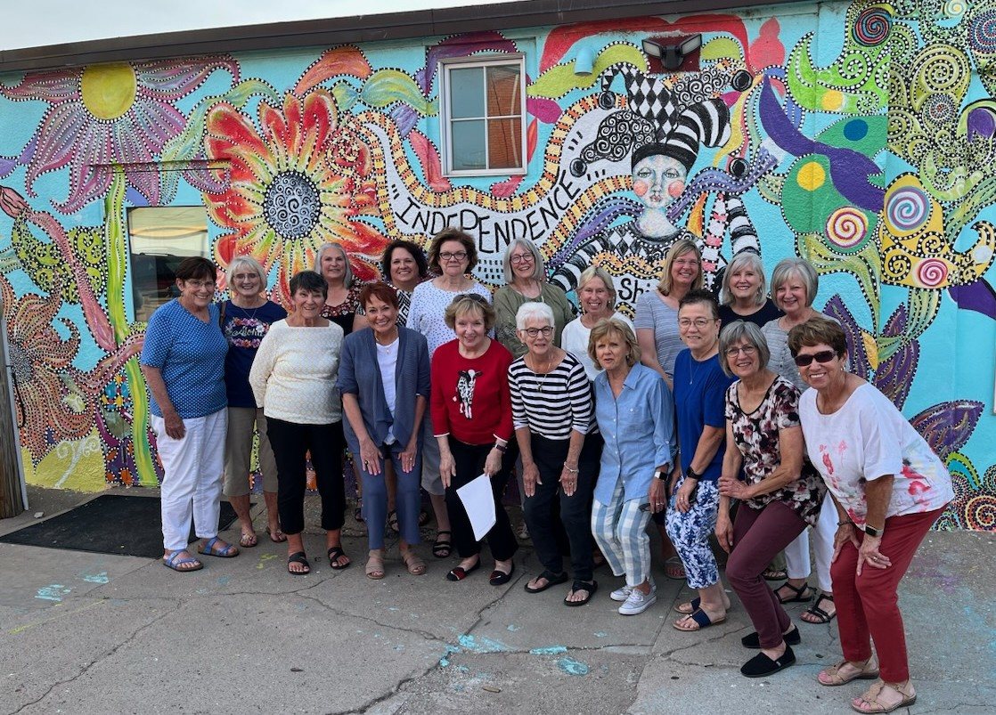

Slide 32
Thank you for celebrating with us!

