Slide 1
The Member Journey
Period of Instruction- Convention of Kansas State Chapter 2024
Notes:
This plays while the board exits the dais and Jan and Susan get set up.

Slide 2
The Member Journey
Period of Instruction- Convention of Kansas State Chapter 2024

Slide 3
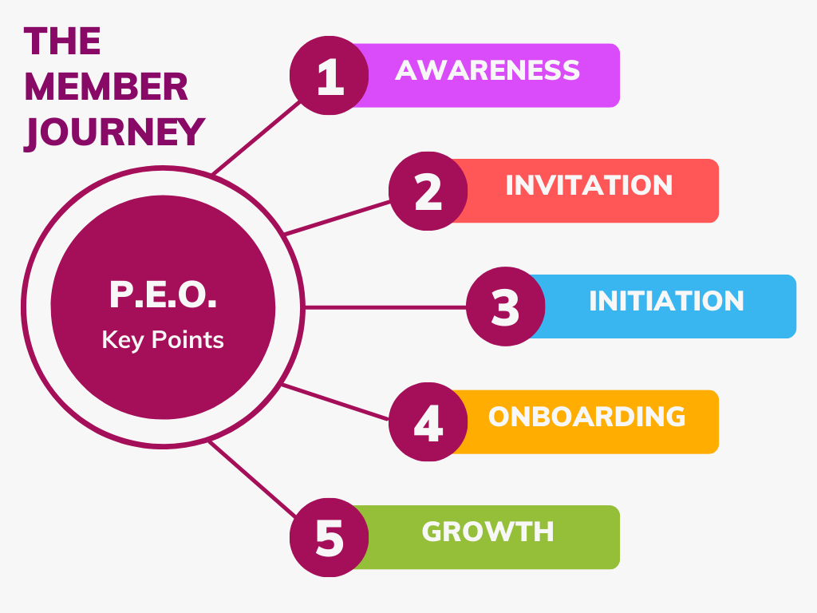

Slide 4
#1 Members Have Choices
Awareness: Do I want to be part of this organization?

Slide 5
#1 Members Have Choices
Awareness: Do I want to be part of this organization?
Invitation: Do I accept?

Slide 6
#1 Members Have Choices
Awareness: Do I want to be part of this organization?
Invitation: Do I accept?
Initiation: Did I make the right choice?

Slide 7
#1 Members Have Choices
Awareness: Do I want to be part of this organization?
Invitation: Do I accept?
Initiation: Did I make the right choice?
Onboarding: Will I get involved?

Slide 8
#1 Members Have Choices
Awareness: Do I want to be part of this organization?
Invitation: Do I accept?
Initiation: Did I make the right choice?
Onboarding: Will I get involved?
Growth: Will I stay?

Slide 10
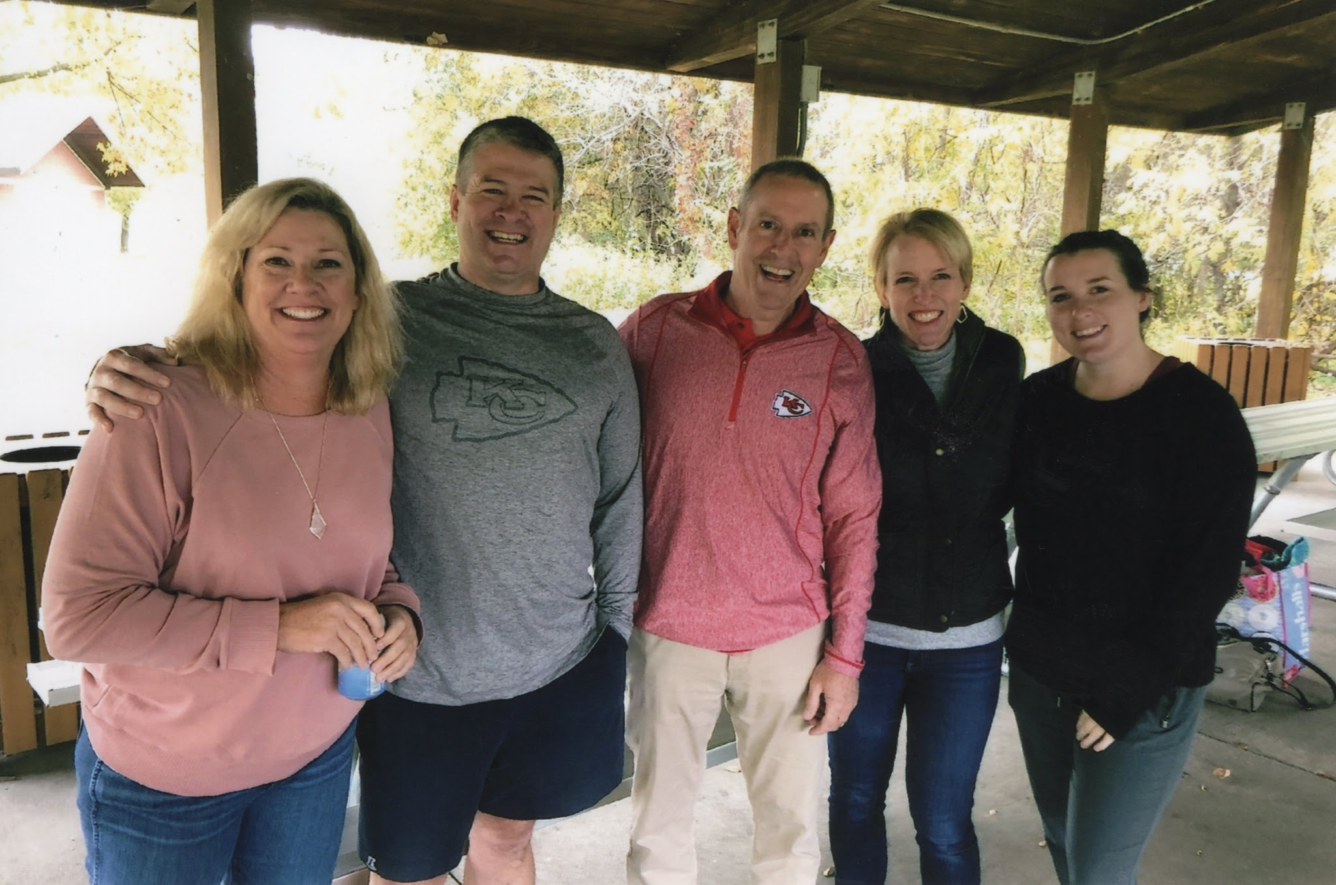
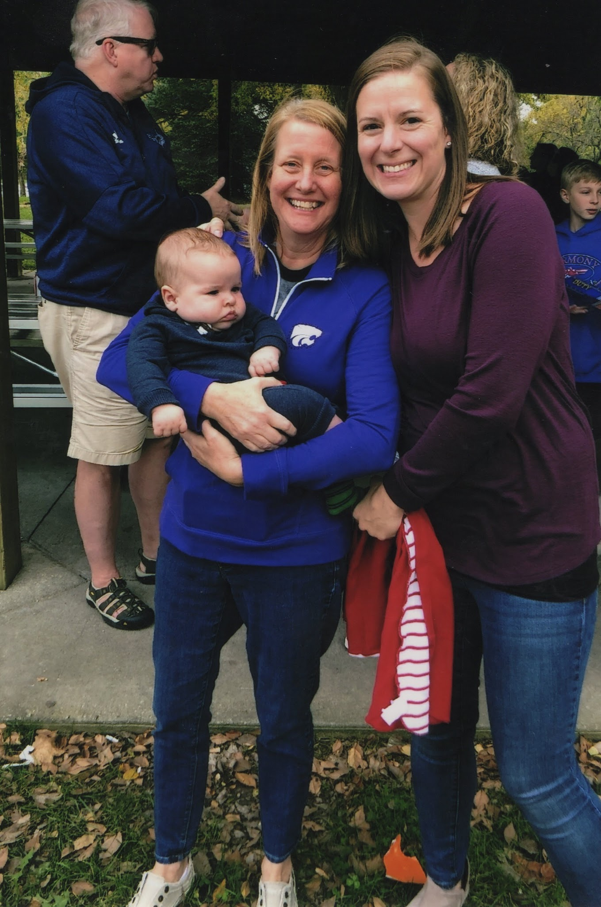
AWARENESS: What Are Your Touchpoints?

Slide 11
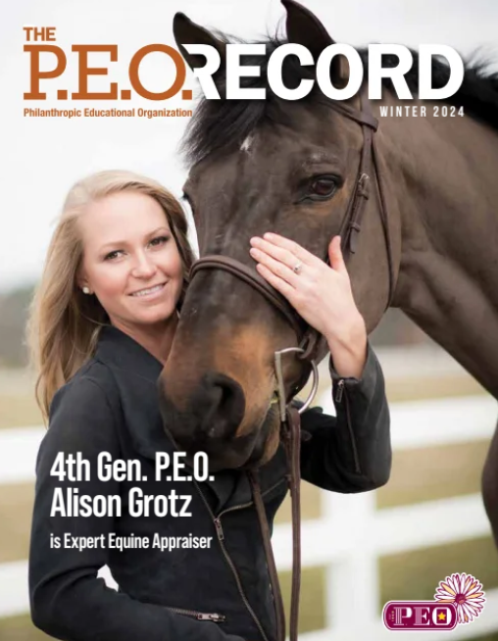
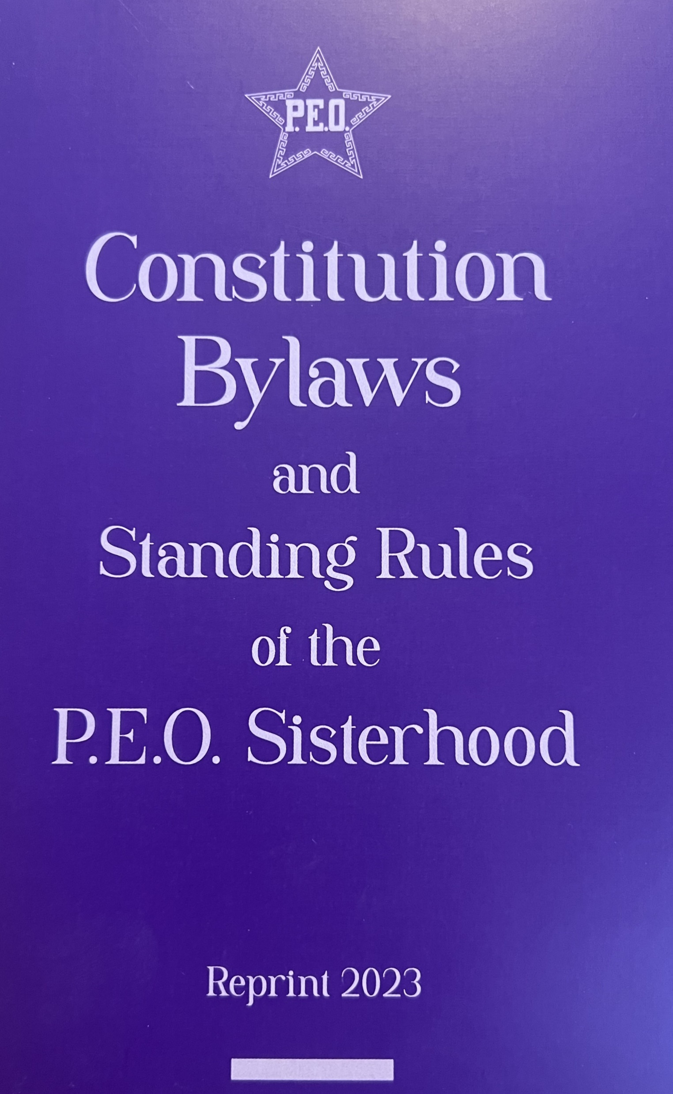
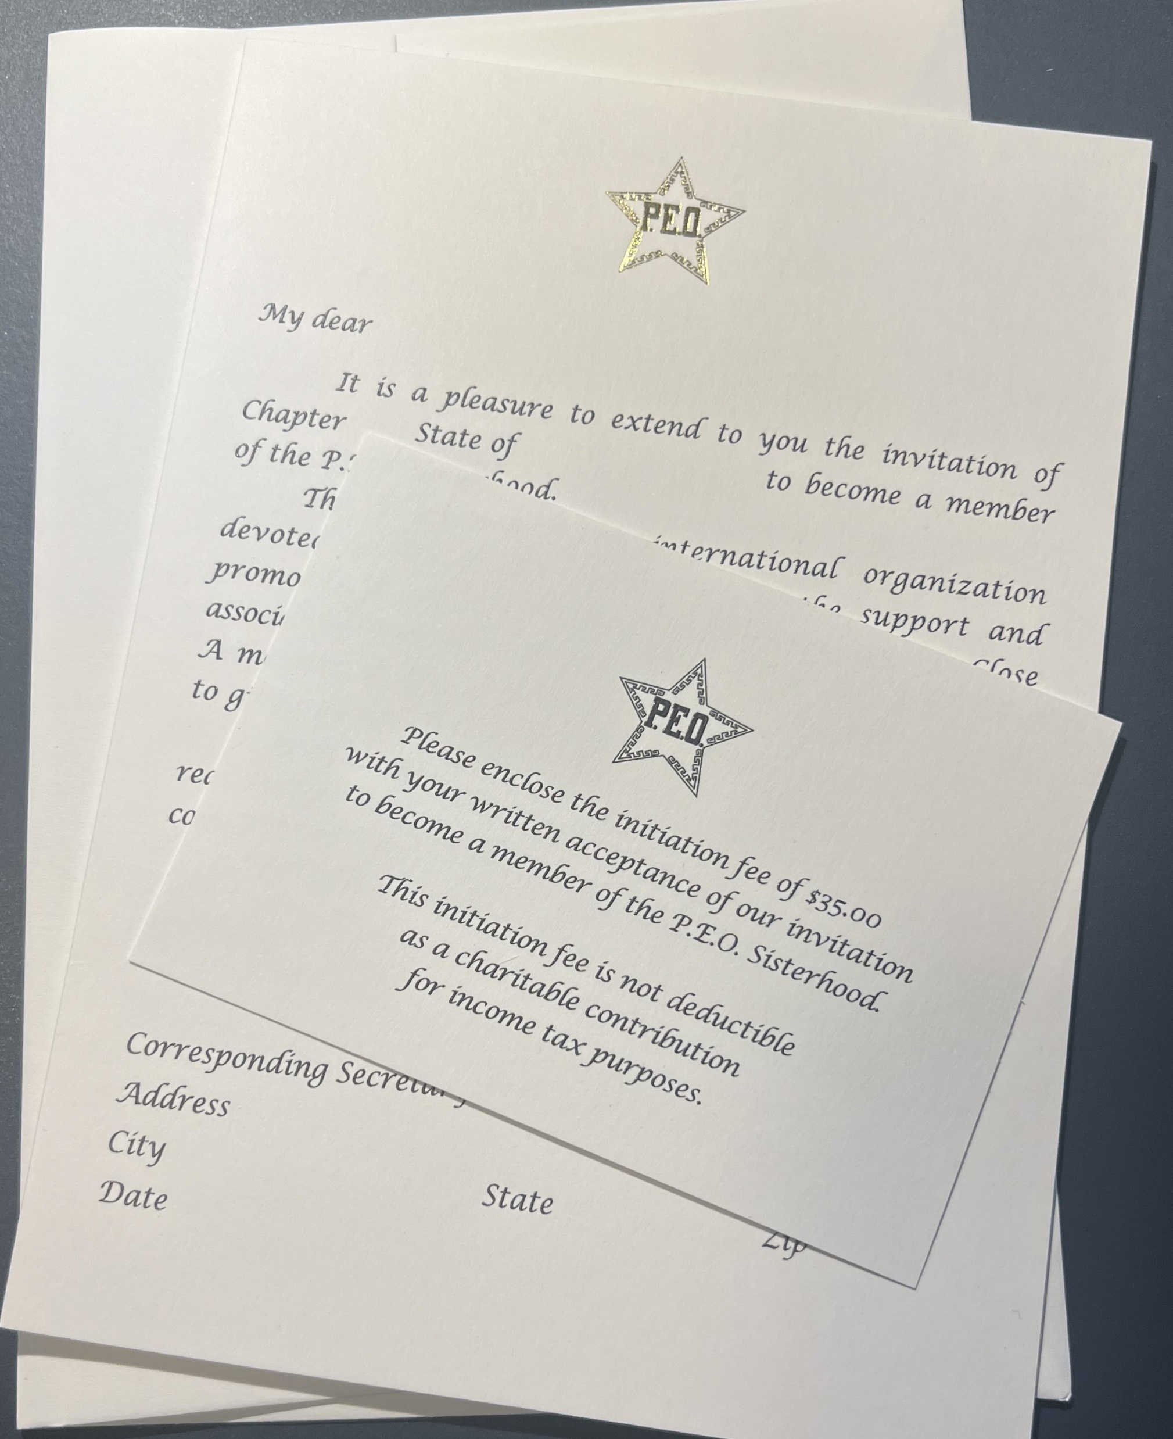
INVITATION: What Are Your Touchpoints?

Slide 12
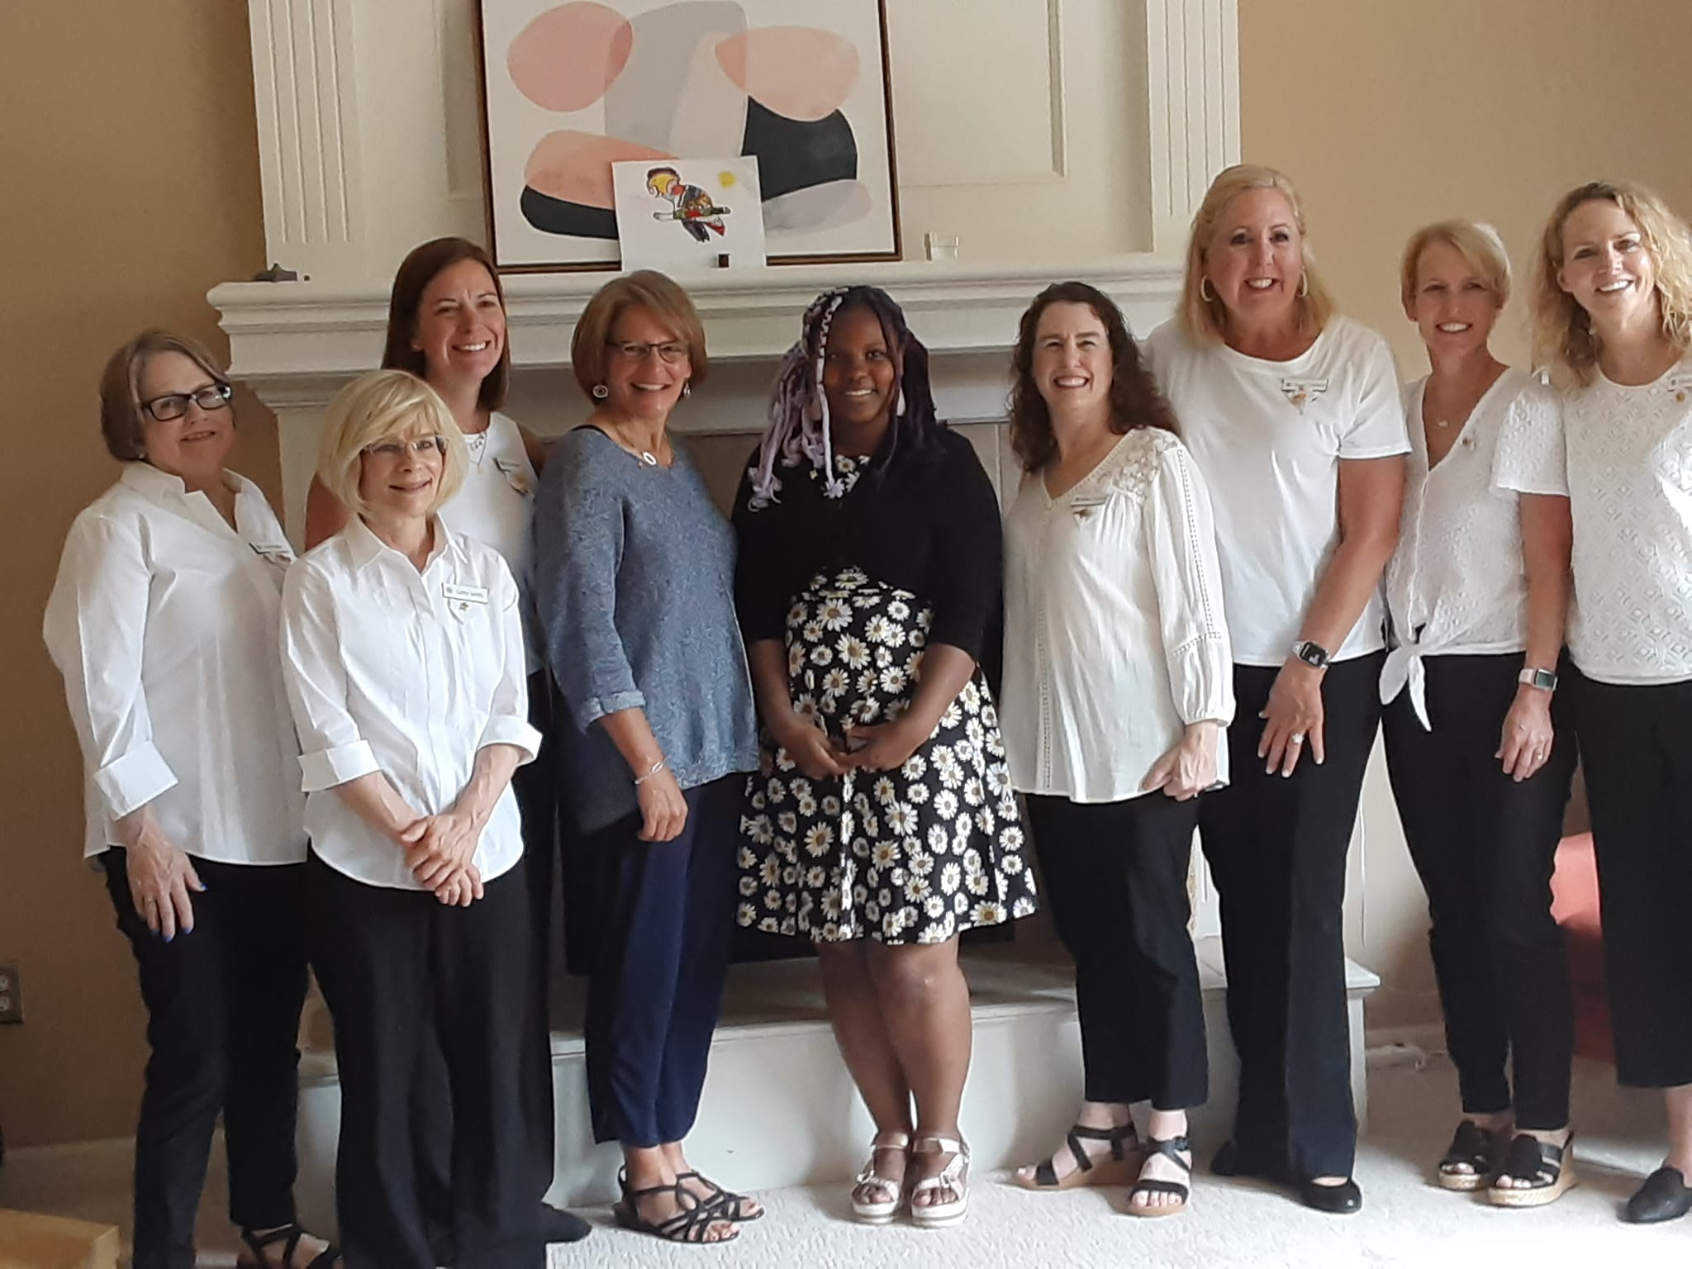
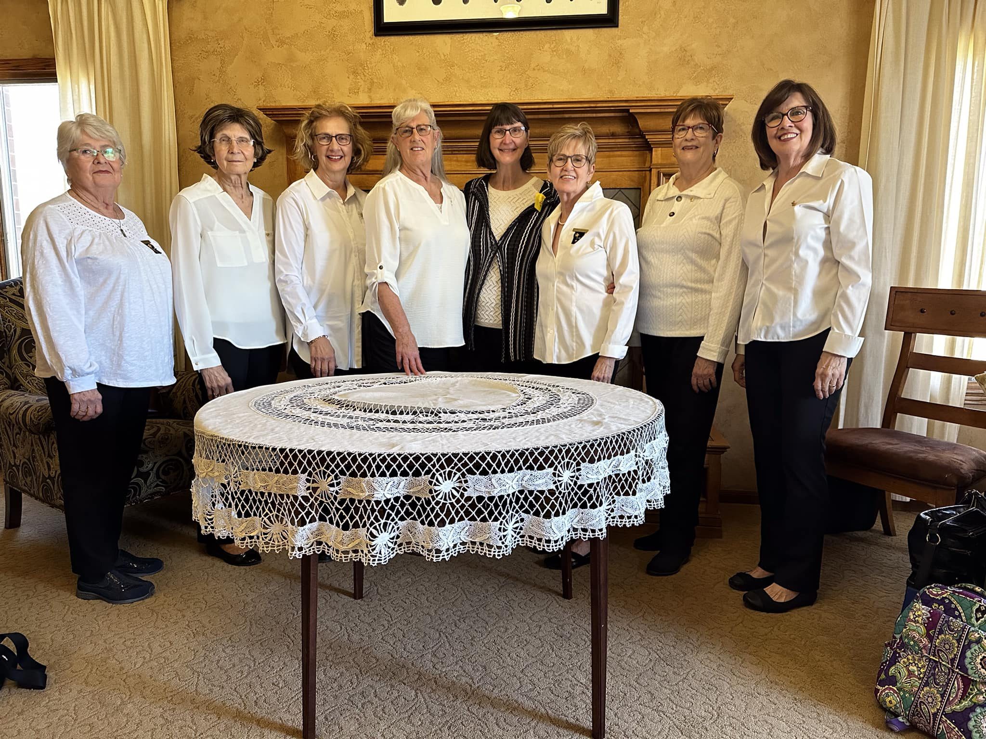
INITIATION: What Are Your Touchpoints?

Slide 13
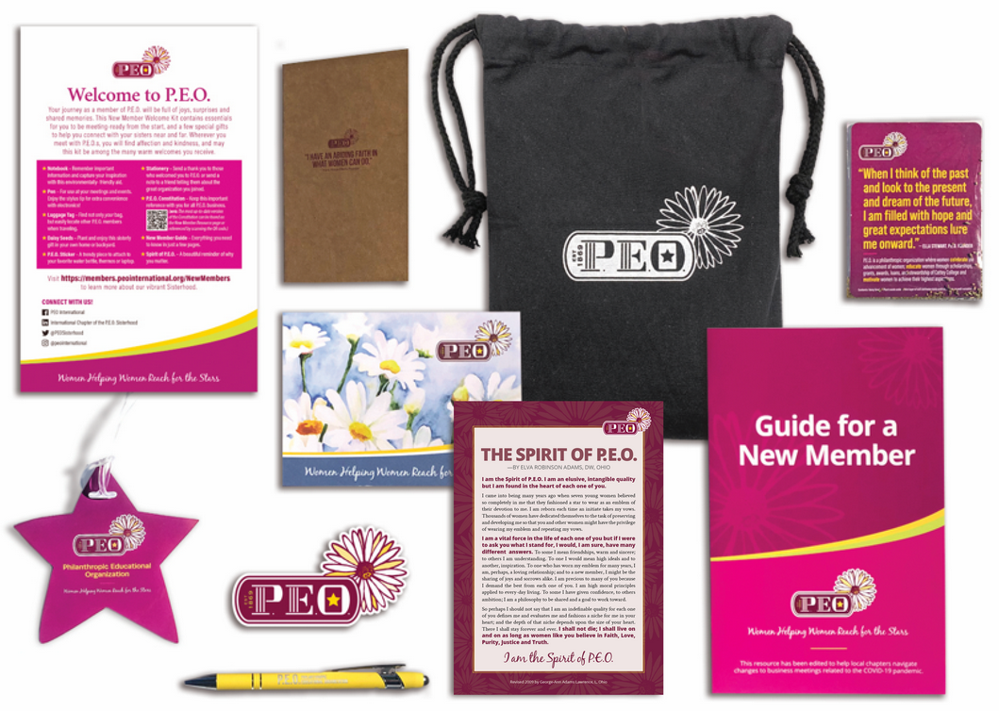
ONBOARDING: What Are Your Touchpoints?

Slide 14
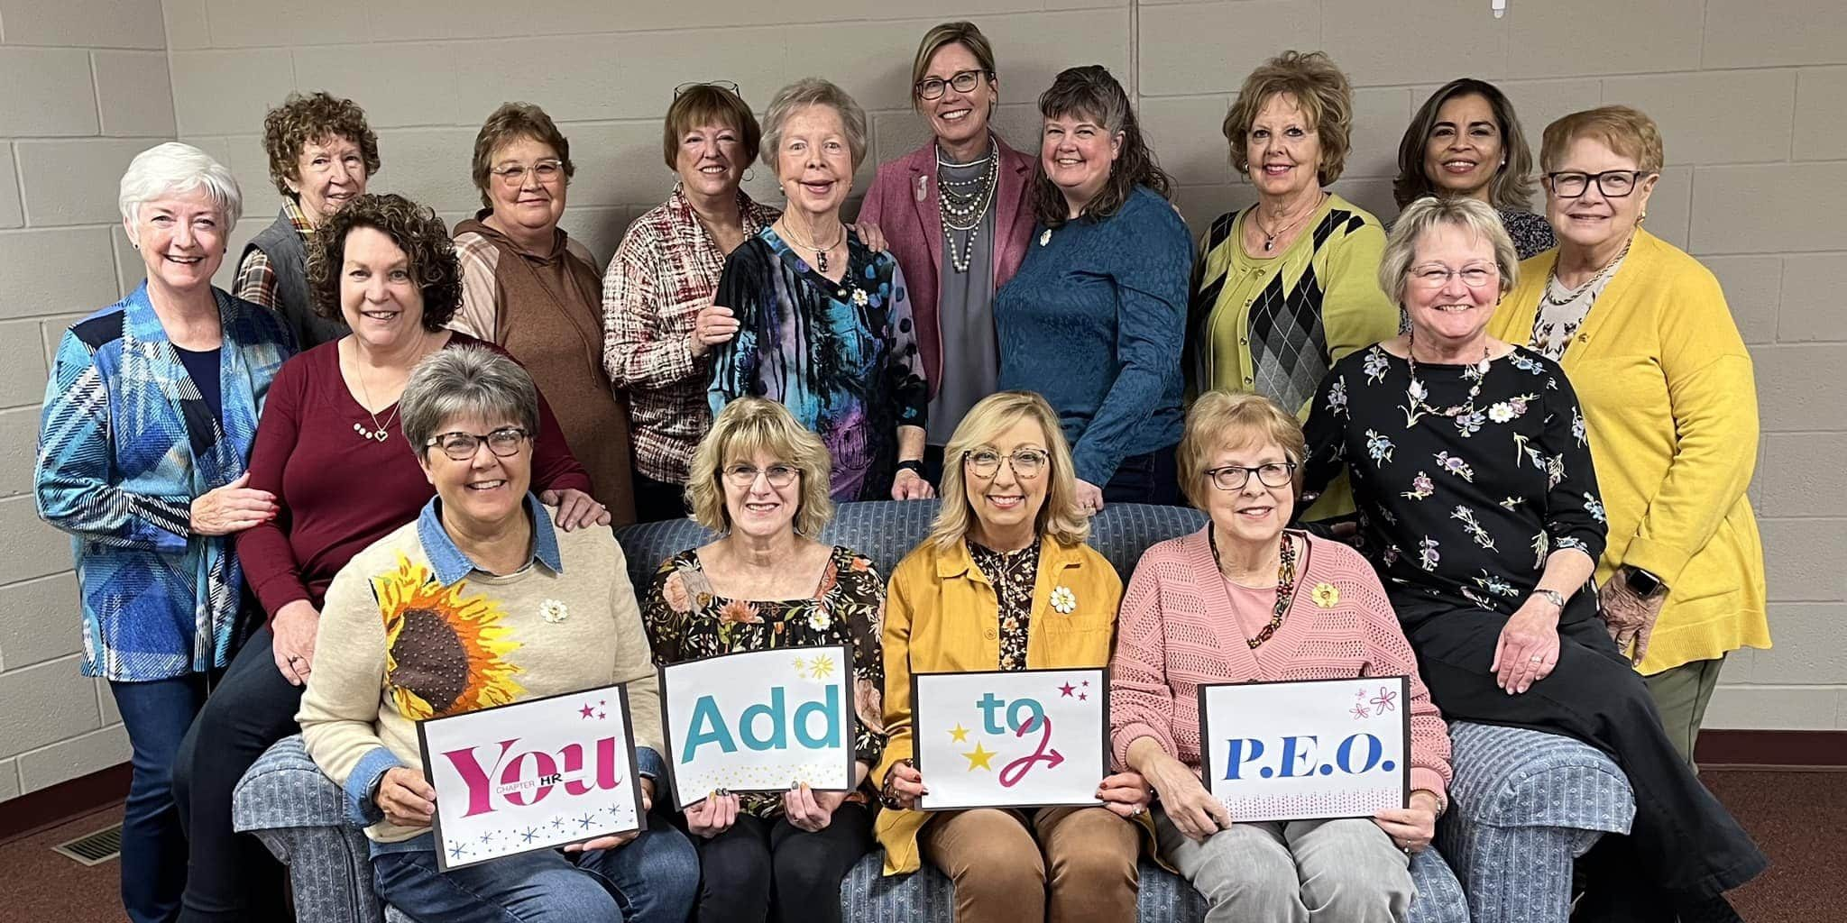
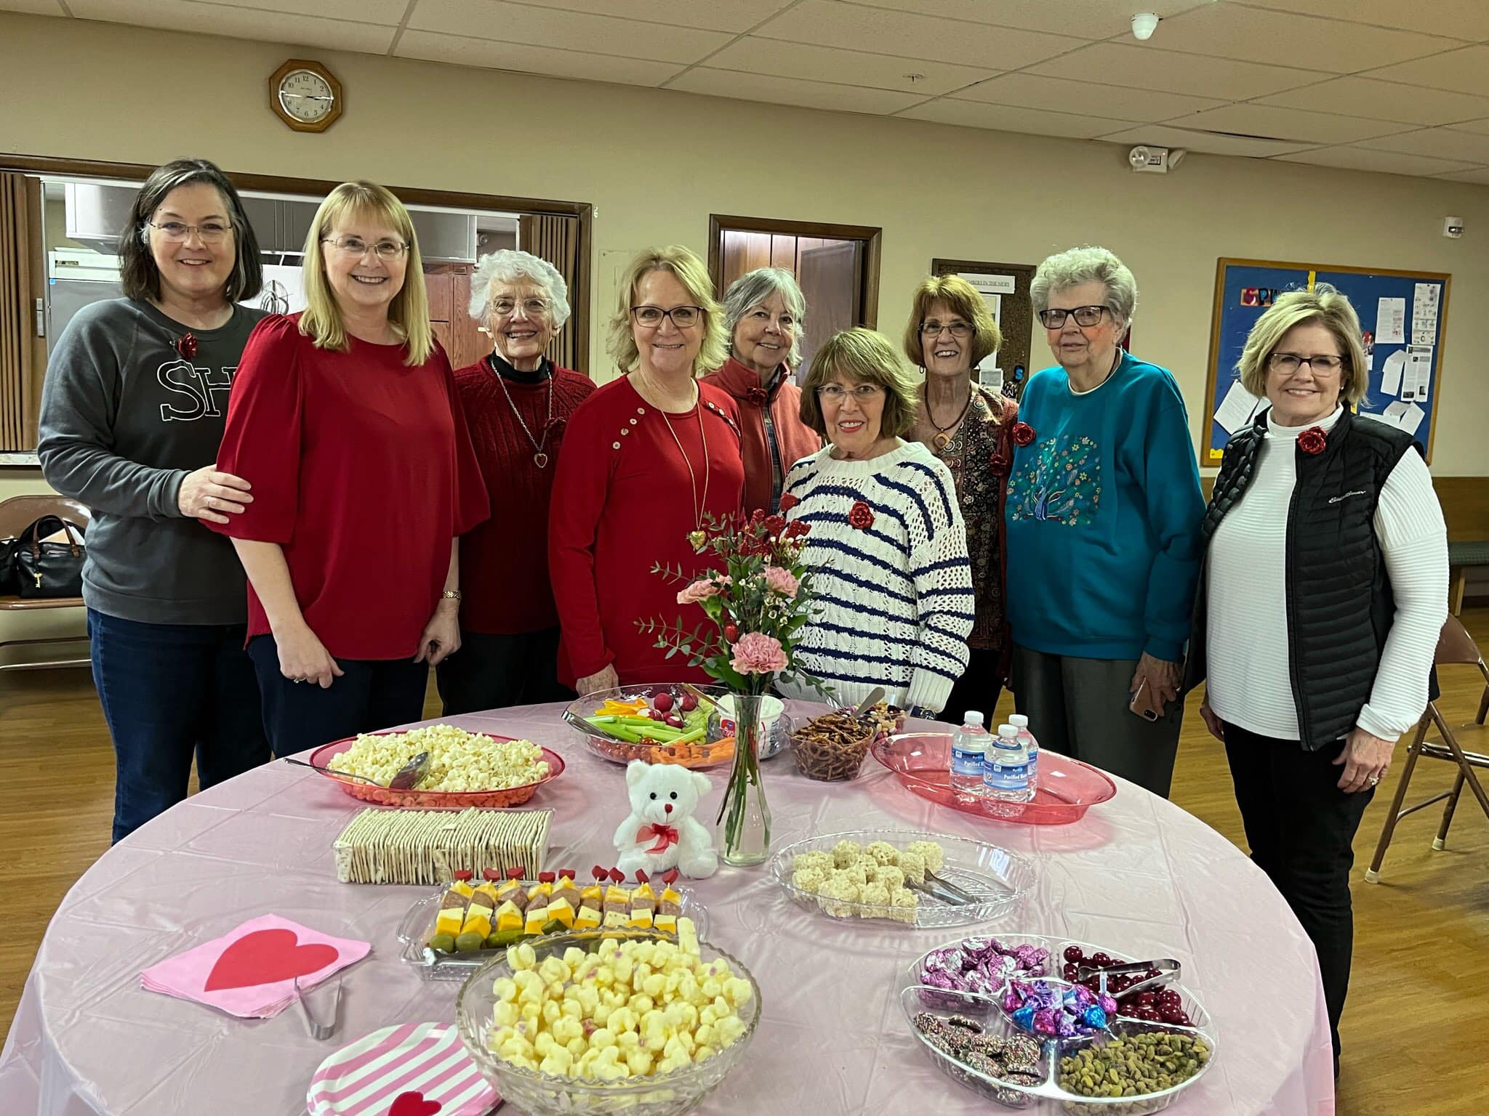
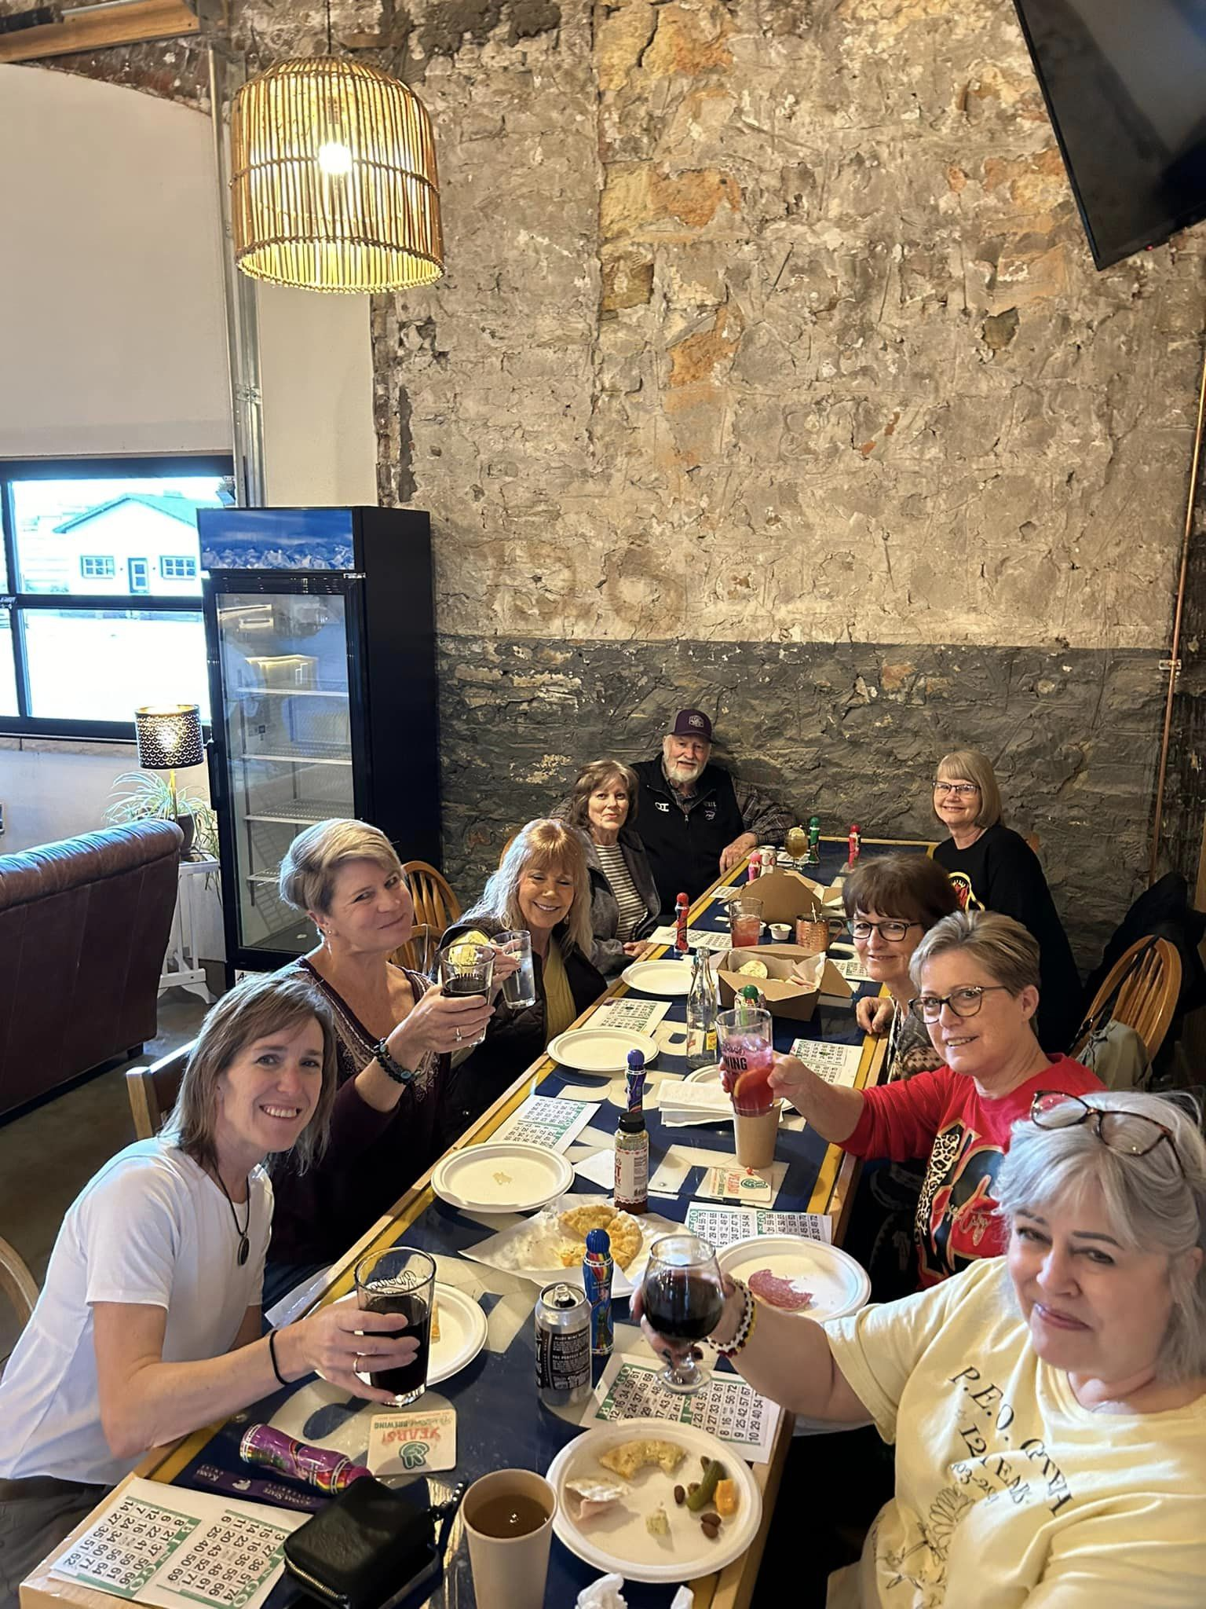
GROWTH: What Are Your Touchpoints?

Slide 15
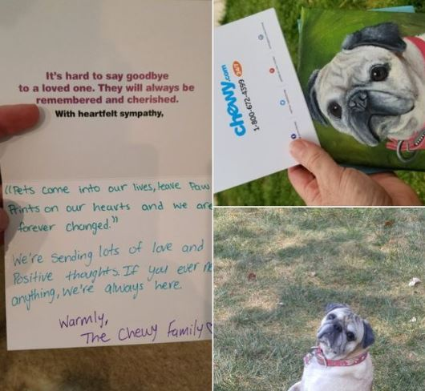
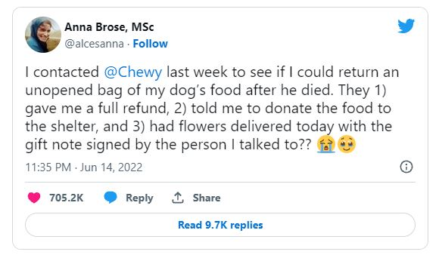
#2 Experiences Can Be Shaped

Slide 16
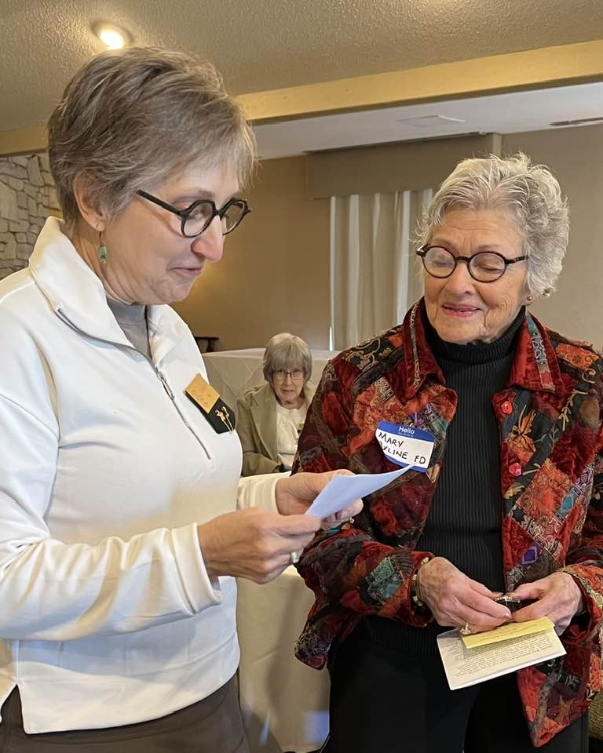
Elements of the Experience
Emotion
Connection
Authenticity

Slide 17
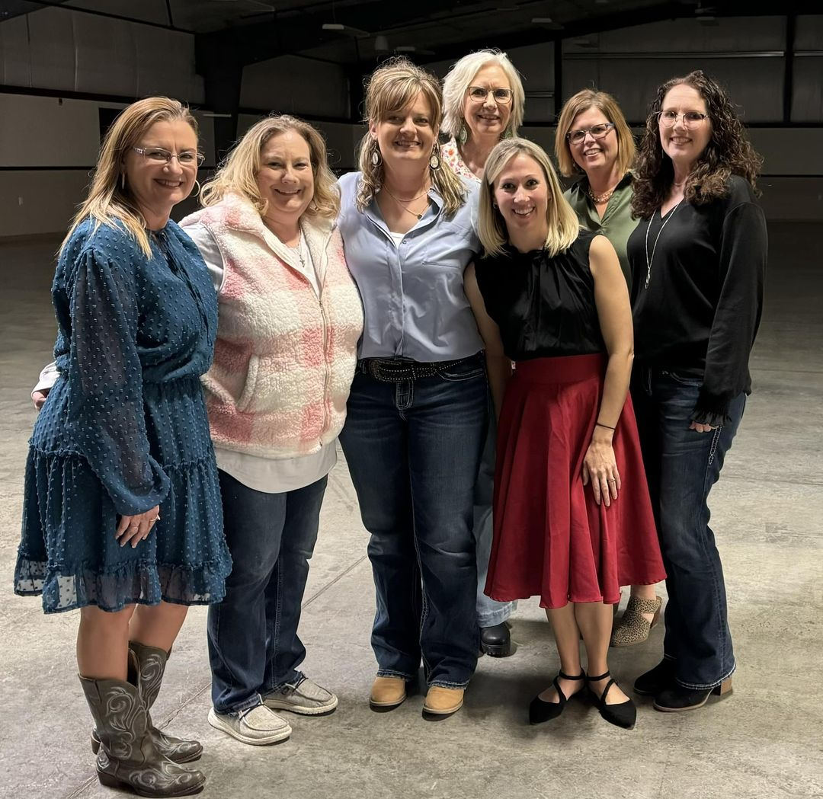
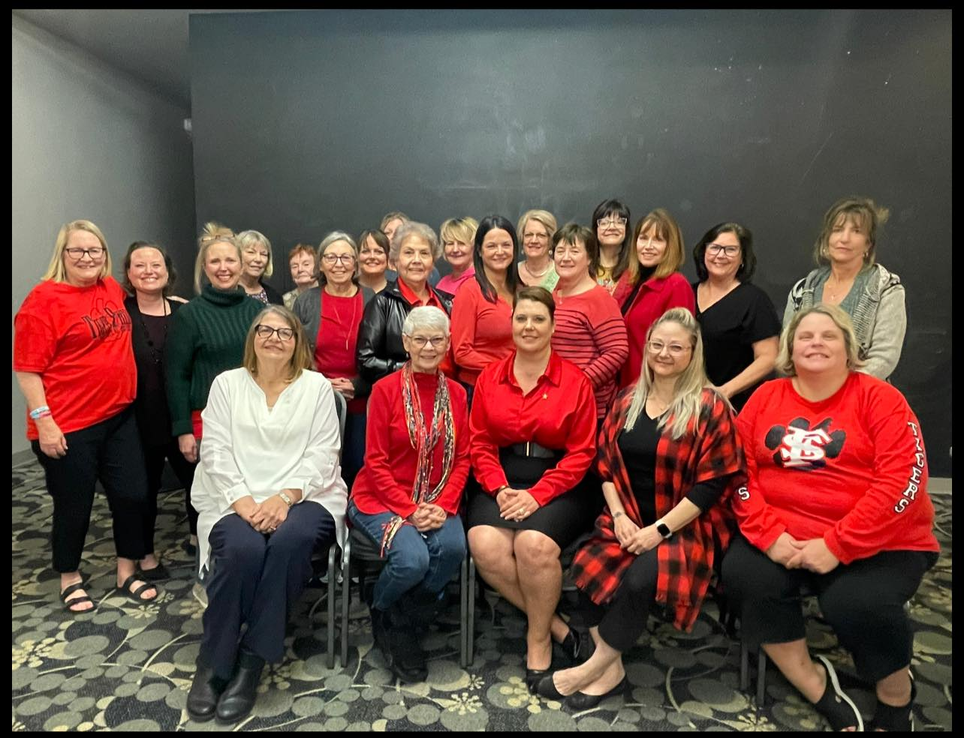
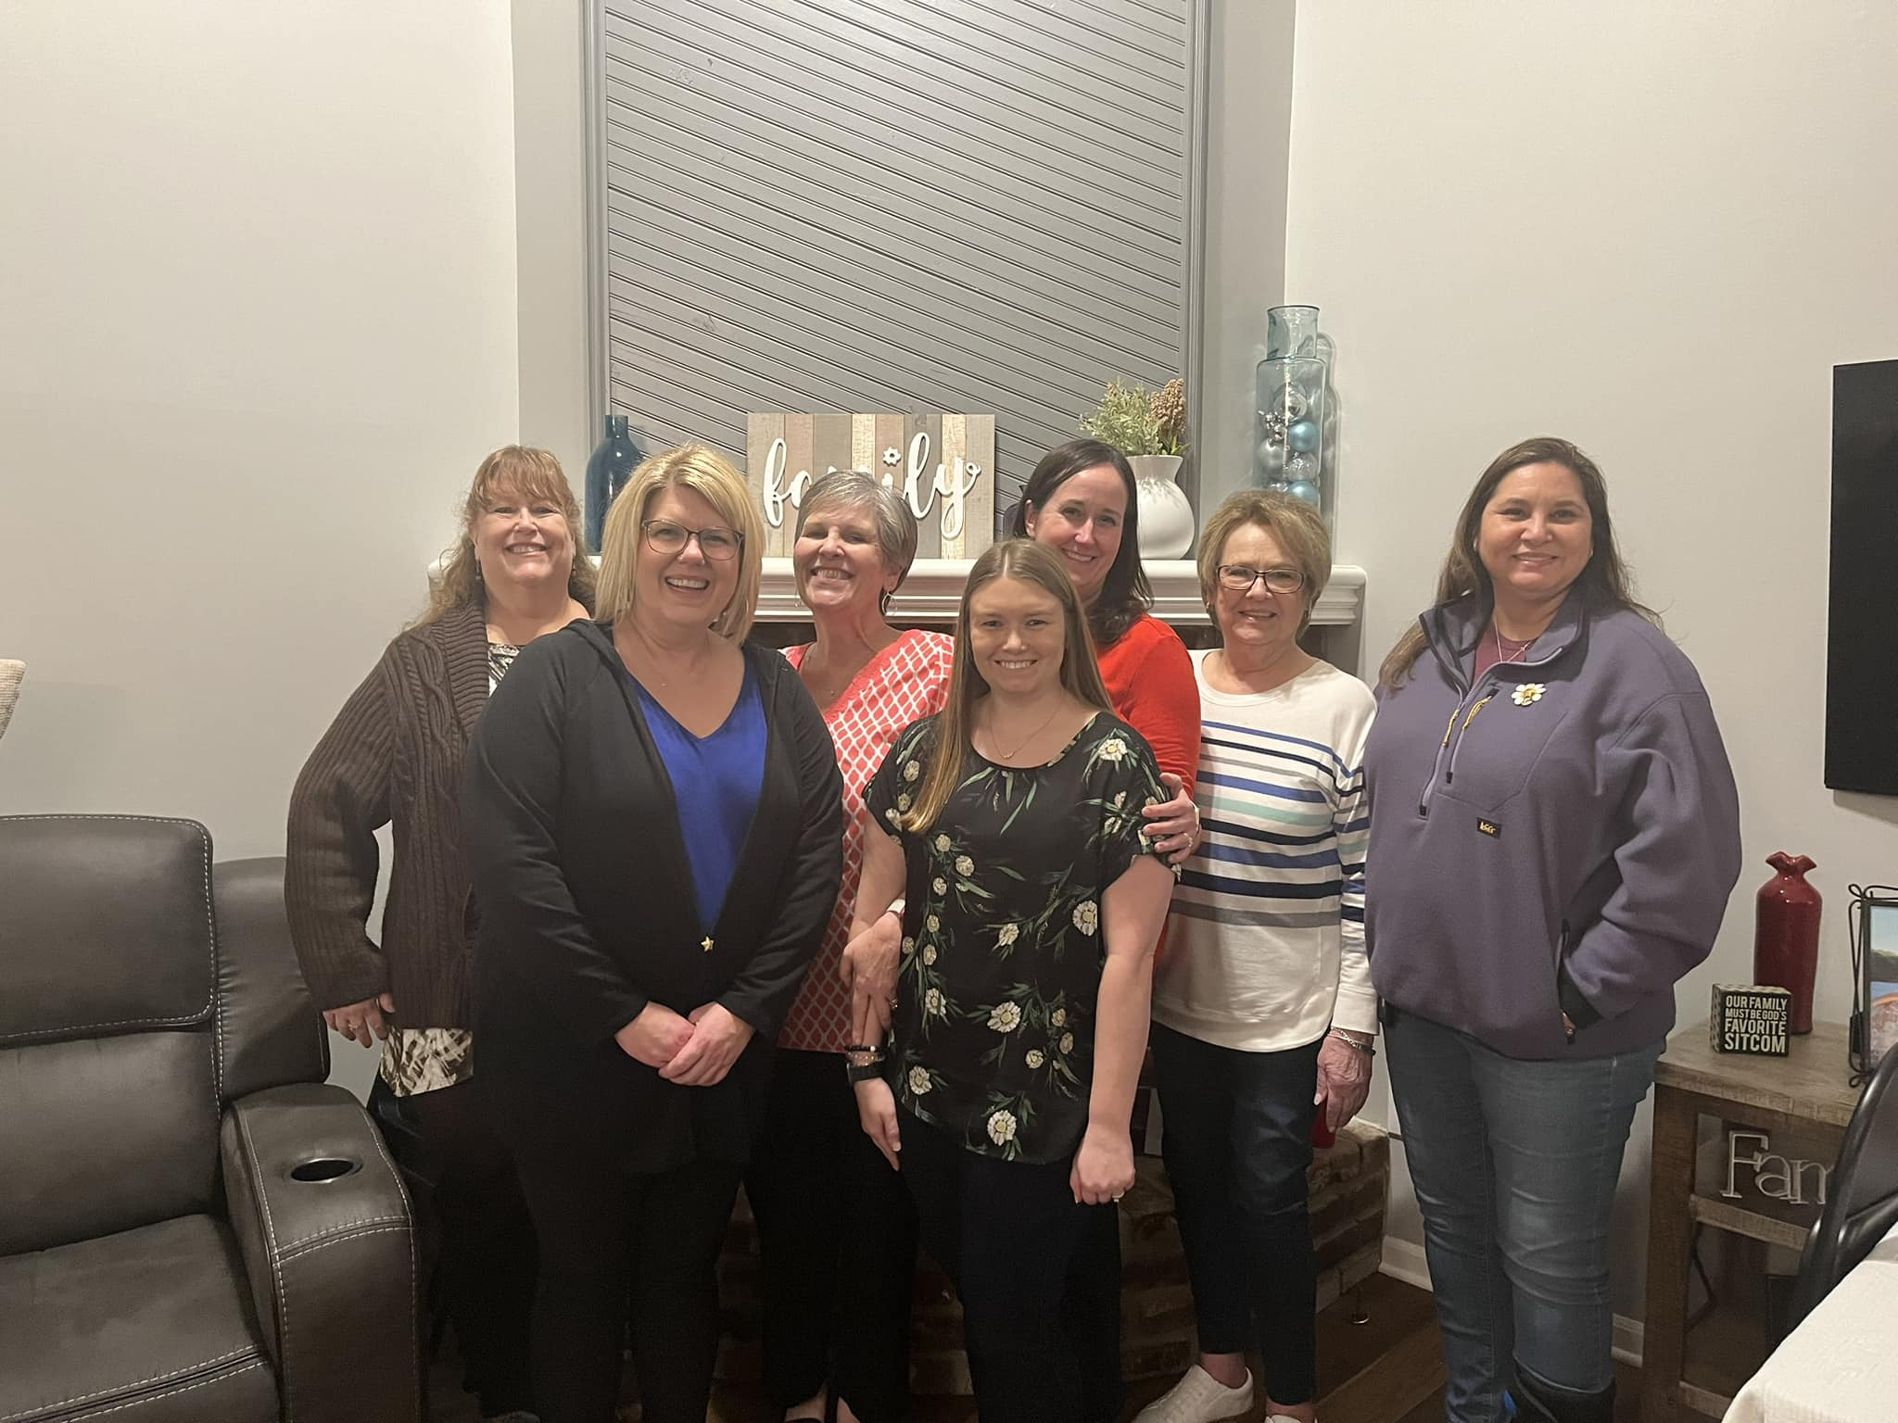
#3 Everyone Needs to Belong

Slide 18
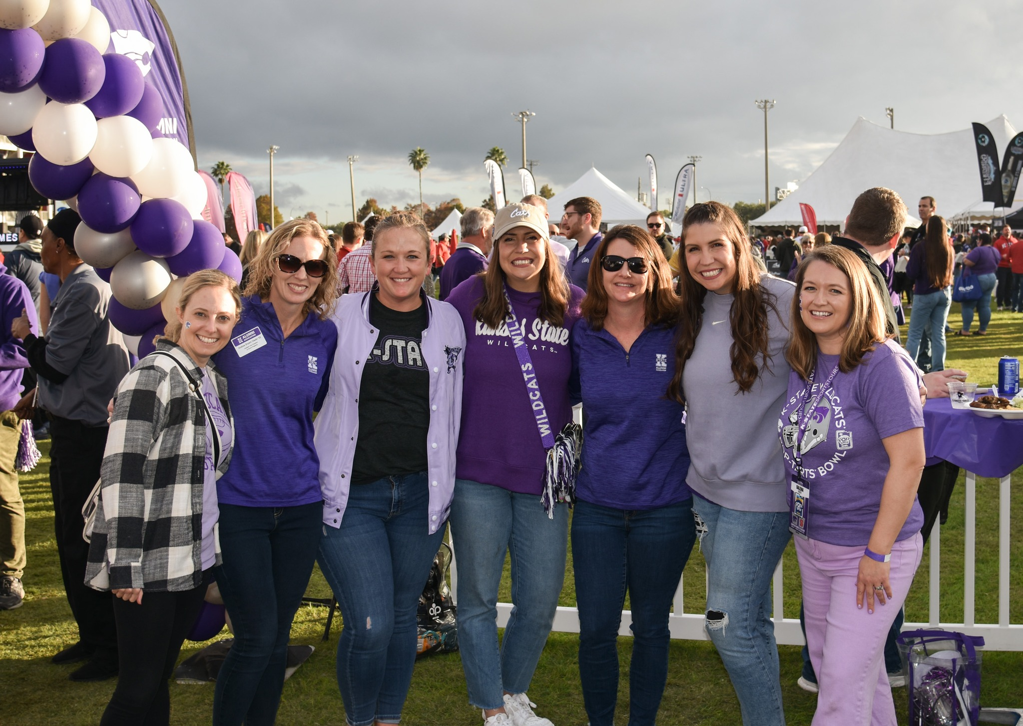
Personalize and Customize
Include names where appropriate
Encourage relationship-building activities
Get ideas from the Every Sister is a VIP resource
A member should feel individual and special.

Slide 19
The Framework
Talk about each part.
Identify the touchpoints.
Shape the experience with:
Emotion
Connection
Authenticity
Create belonging with personalization.

