Slide 1
P.E.O. Project Sing: A Journey to Find the Project that’s Just Right!
Kansas State Chapter Convention Seminar – June 2024
Written by 2023-2024 KSC International Project Chairs
Louise Hicks, HE, Overland Park, chair of IPS and PSA
Stacee Jennings, IN, Olathe, chair of PCE
Pat Jones, CJ, Pittsburg, chair of ELF and STAR

Slide 2
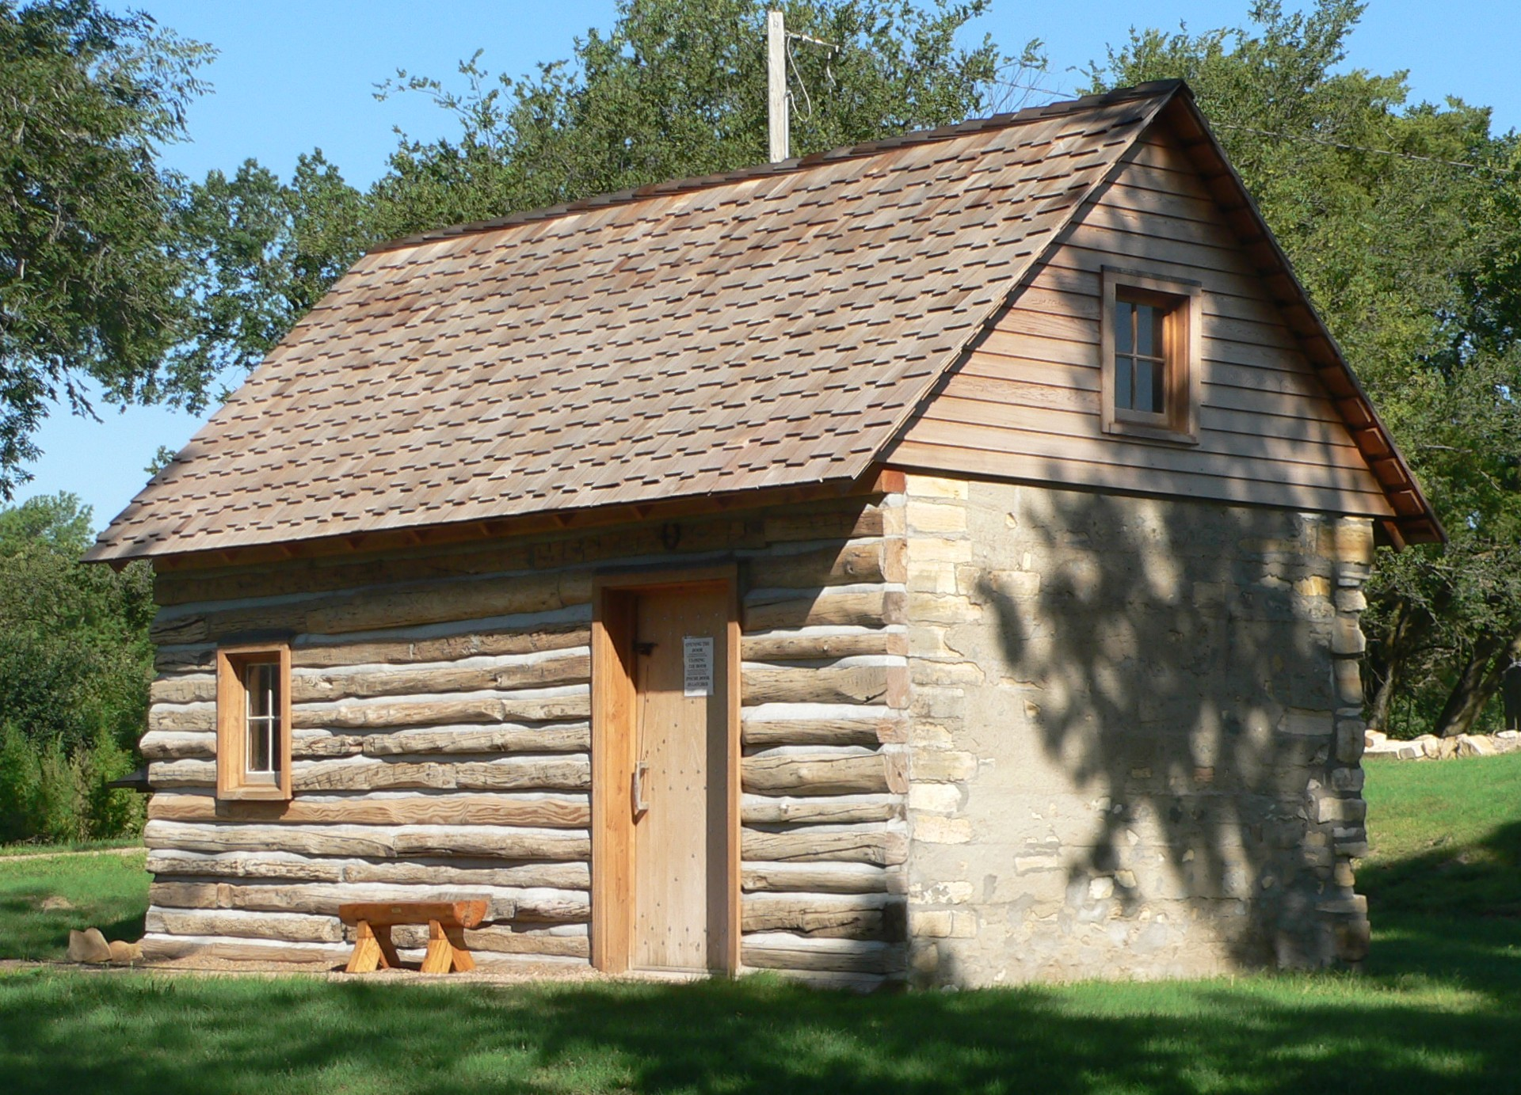
There once was a woman at home, on the range, who wanted to go back to school, she had more to learn.
She needed funds and didn’t know where to turn!
As is wont to happen during a Midwest spring, a tornado of thoughts woke her at night.
The alarm in her head gave her quite a fright.
As she tossed and turned, she remembered the options her P.E.O. friend had given for her to choose.
But which one was right? She needed to know so she could finally snooze!

Slide 3
Without any more thought, she jumped out of bed and walked to the bathroom, she needed to pee…
She opened the door and instead of the toilet, what did she see?
There ahead of her, right before her eyes was a friendly white witch and Me! Her scarecrow guide!
Where were we? Standing on a yellow brick road, 4 feet wide….

Slide 4
Let’s focus on a project
A project of P. E. O.
Supporting other women as a chapter, helps us grow (and glow!)
If ever we hope to fulfill a dream
And help our candidates be seen
Be seen, be seen, be seen, be seen, be seeeen…
Knowledge and promptness must be our theme.
Let’s focus on a project, a project of P.E.O.!

Slide 5
And we were off!
{Name} the good witch was on a mission to assist {Applicant’s Name} in finding the funding that was just right for her and I was there to help!

Slide 6
We came across a serene forest lit up by beautiful stars! {Applicant Name} asked {Name} the Good Witch where they were, and she told her they were in the land of the P.E.O. STAR Scholarship.
“Here,” she said, “young women in their final year of high school, who have at least a 3.0 GPA on a 4-point scale, and exhibit excellence in leadership, academics, and other activities, can earn $2,500 for college!”

Slide 7
If I was young and motivated
Worked hard and innovative
The Star scholarship could be mine
I would need to be a leader,
Engaged in life beyond just readin’
If I want to get the Star
I must apply in mid September
With the he-elp of my Chapter
And be legal in the states (or Canada)
With this money I can pay for
Books, supplies, or tuition,
And I’ll know before it’s May
Oh, I, would need to be
Recommended by a chapter
My GPA can’t be under
3.0
And I must use it the next year
If I was young and motivated
Worked hard and innovative
The Star scholarship could be mine
I would need to be a leader,
Engaged in life beyond just readin’
If I want to get the Star

Slide 8
{Applicant Name} thought the STAR Scholarship was a great opportunity, but it didn’t fit her needs, so on we went on our journey to find the project that was just right for her!
As we exited the forest of the stars we entered a peaceful valley with doves, diamonds and crystals hanging from the sky and rainbows glittering everywhere you looked.
{Applicant Name} turned to {White Witch} and asked, “where are we now?”
And {White Witch} replied, “the land of the International Peace Scholarship Fund. Here a woman from outside the US or Canada, seeking an advanced degree, who will then return to another country to utilize her degree and make a positive impact and foster global peace, can be awarded up to $12,500 towards her education!”

Slide 9
When peace is what you’re hopin’
To bring back into your home and
You need your degree
If your school is in the US
Or Canada then IPS
Could help you meet your needs
Not just money I’d be getting
But support from all the sisters
In the chapters around me
IPS will encourage
As well as build a village
It’s about community
When we support internationally
Women everywhere
The world becomes a better place
For all
And P.E.O. is meeting their goal!
When peace is what you’re hopin’
To bring back into your home and
You need your degree
If your school is in the US
Or Canada then IPS
Could help you meet your needs

Slide 10
{Applicant Name} was overwhelmed by the International Peace Scholarship Fund but realized that since she was not from another country it was not the project for her. The journey continued!
We followed the yellow brick road into a beautiful town and found a library with more books than you could ever imagine! “Where are we now?” {Applicant Name} asked, thinking that they may have found the perfect spot!
“This is the town for the Program for Continuing Education!” {White Witch} replied. “Here, women who had to leave their education or have not engaged in higher education for 2 or more years can apply for a need-based grant to continue their education! They can be awarded up to $4000 towards educational needs!”

Slide 11
I could pay for my tuition,
Equipment, transportation,
my books and my supplies.
And my thoughts would be focused,
On the learning, not the money
If I went with PCE
It says I must be recommended,
And for 2 years have not attended,
I fit that profile
As long as you are legal
In the US and Canada
You should go with PCE
If I am enrolled
In an accredited institution
Have 18 months or less to go
And a job or growth is waitin’ at my door
I could pay for my tuition,
Equipment, transportation,
my books and my supplies.
And my thoughts would be focused,
On the learning, not the money
If I went with PCE

Slide 12
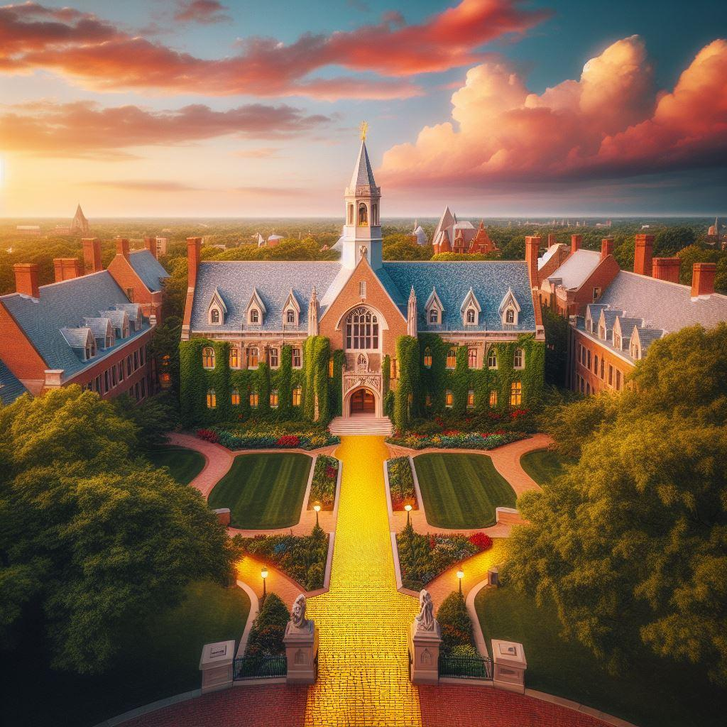
{Applicant Name} was intrigued by the PCE grant but realized that it wouldn’t work for her since she already had a master’s degree. So, we kept following the yellow brick road, hoping to find the project that was just right for her.
We came across a beautiful university town with large ivy-covered buildings as far as the eye could see. “This might be it!” {Applicant Name} exclaimed, thinking that a college town might have just the kind of project she needed!
“This is the town of the Scholar Award,” said {White Witch}. “This is where the brightest and most dedicated students come to earn their doctoral degrees. The women who earn the P.E.O. Scholar Award are given an award of $25,000 that will provide partial support for a year’s study.”

Slide 13
If you’re sma-art and determined
To make weighty contributions
In your field of study
Then the PSA could be the one
That helps you make a difference
For so-ci-ety
You’d need a nomination,
An accredited institution,
Pursue a doctoral degree
You’d be a leader and a model
Helping others to become the
Very best they can be
Fine Arts, Science, or the Law
Practically any field at all
Must be from the U.S. or
Canada
And get good grades, on all your work.
If you’re sma-art and determined
To make weighty contributions
In your field of study
Then the PSA could be the one
That helps you make a difference
For so-ci-ety

Slide 14
Although the Scholar Award sounded amazing, {Applicant Name} recognized that she was not getting her doctorate, so this project was once again not the right fit for her. As they continued, {Applicant Name} counted down the projects and realized that they only had one project left. She hoped this one would fit her needs.
Ahead, in the distance, {Applicant Name} could see an emerald building that looked very much like a bank in the center of a town. She looked to {White Witch} and said, “Where are we now? Have we come to the final project?”
“Yes,” said {White Witch}. “We have finally reached the Emerald City, home to the Educational Loan Fund. Here women can apply for a 2% low and simple interest loan for up to $25,000 depending on their degree program starting on July 1st 2024!. This allows many women to focus on their studies without having to pay off the loan until after graduation. The best part is that woman can get a scholarship or grant from one of the other projects and still apply for the ELF loan!”

Slide 15
When your thoughts are busy brewin'
While thinking of pursuin'
Advanced degrees and such.
Oh, the bills ya can’t delay’em
And you think “How will I pay’em?”
E-du-CATIONAL Loan Fund!
If your chapter finds a woman
In need and then presumin'
She meets requirements.
There’s a loan we’ll present her
And the interest’s 2% fer
E-du-CATIONAL Loan Fund!
With a diploma or GED
And someone to cosign for her
To be legal in the States or
Canad“er”
And then, submit, and wait and see
When your thoughts are busy brewin'
While thinking of pursuin'
Advanced degrees and such.
Oh, the bills ya can’t delay’em
And you think “How will I pay’em?”
E-du-CATIONAL Loan Fund!

Slide 16
{Applicant Name} had finally found the P.E.O. project that was right for her! Educational Loan Fund fit all her needs and would be the best choice for her going forward! “I can’t wait to discuss this with my chapter and get started!” she told {White Witch}. “Now that I know which project is right for me, I better get back home and get some sleep… How do I do that?”
{White Witch} knew the answer! “All you have to do is think of your Home on the Range and sing this song…”

Slide 17
'Oh give us a goal
To-o help women grow,
With vital P.E.O. funds,
Where they reach for the stars And become all they are,
As they find all the best in their dreams.
Our newest award
For a young high school STAR
Who excels in her work and her play.
She enrolls in the fall
In accredited halls
Where she studies to brighten her day.
PCE is the way
To recharge them each day
If li-fe should pau-se their ED
They can go back to class
And complete their drills
As they build their sell-a-ble skills.
When a woman wants more
Be a ‘DOC’ is her goal
P.E.O. help depends where she’s from
IPS if away;
PSA Here??? Ok!
Honored women will love P.E.O.
With a vow to repay
A loan is their way
To continue to en-hance their path.
Online or in class
ELF is up to the task
To help women march on really fast.
Chorus
Find wo-men with goals
Who strive and steadily grow
Education’s the way
To enhance life each day
P.E.O. helps them reach for the stars.

Slide 18
Scholarship! Loans! Grants! Awards! Oh my!
P.E.O. Project Sing: A Journey to Find the Project That’s Just Right!
P.E.O. STAR Scholarship
One-time Award
$2,500
Minimum GPA 3.0
International Peace
Scholarship
Must return to home country
$12,500
Used for Graduate Degree
Not a citizen of U.S. or Canada
P.E.O. Scholar Award
Used for Doctoral Degree Only
$25,000
Merit based
Enrolled full time
Educational Loan Fund
2% low interest
Max $20,000 loan
Must Have Diploma or GED
Can be awarded ELF and another project
Program for Continuing Education
24-month continuous break from education
$4,000 max grant
Need based
Cannot have a Master’s Degree yet

