Slide 1
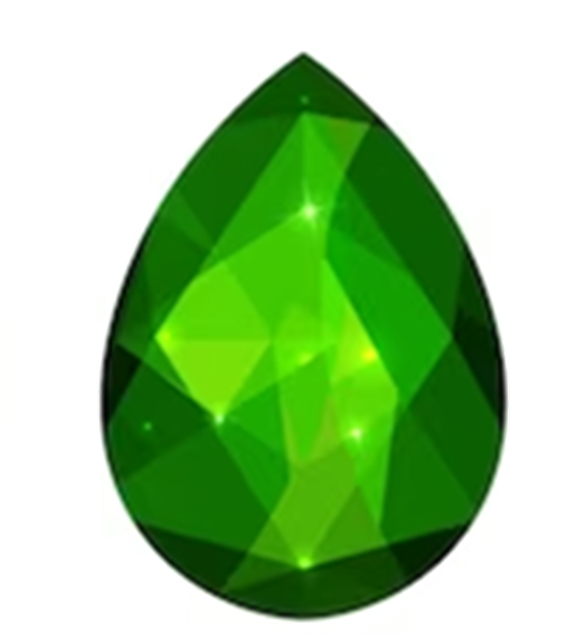
A Tiara of
Sparkling Diamonds
Anniversary Chapter Luncheon
Saturday, June 8, 2024

Slide 2
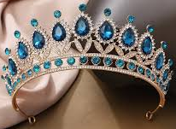
1924-2024
Chapters: CH, CI, CJ, CK, CL, CM, CN, CO
1949-2024
Chapter: FO

Slide 3
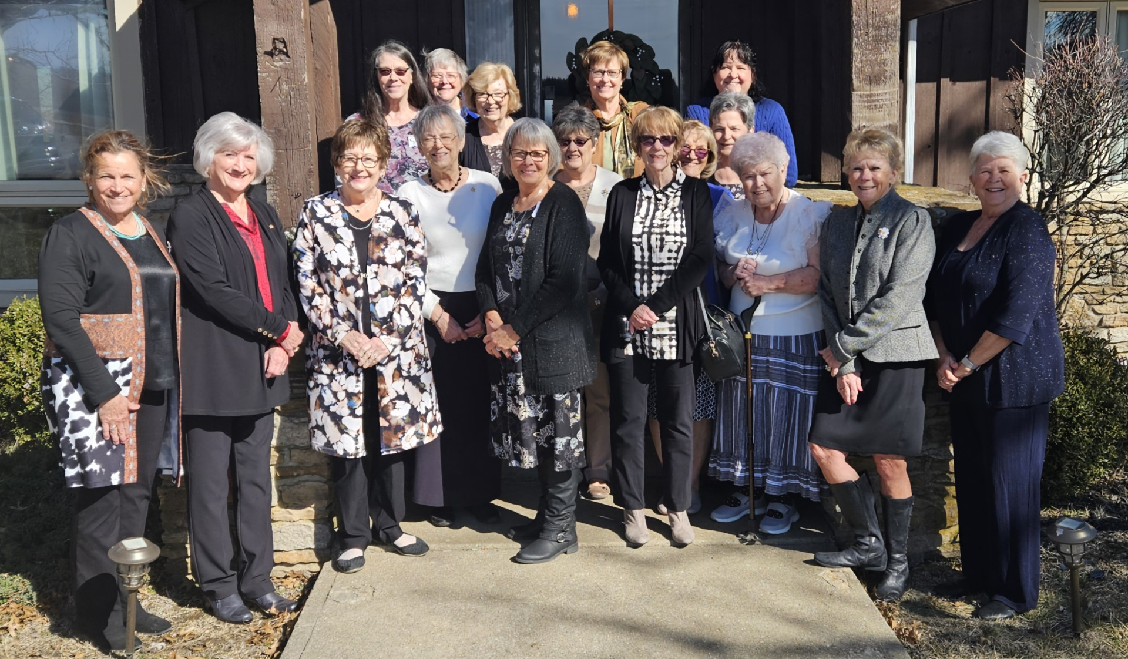
CHAPTER CH
YATES CENTER
Organized February 16, 1924
2024

Slide 4
*The first scholarship was given in 1930 in the amount of a $5 gold piece.
*Activities include monetary and toiletry gifts to Cottey College, gift bags to nursing home residents and other gifts from year to year as needed.
*In 2016, they successfully sponsored a local single mother for a PCE Grant.
*They enjoy close relationships with each sister, sharing fun times and concerns.

Slide 5
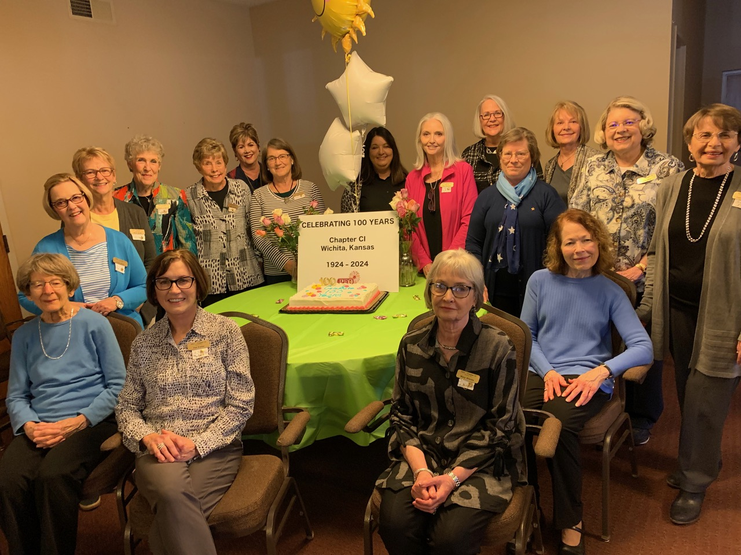
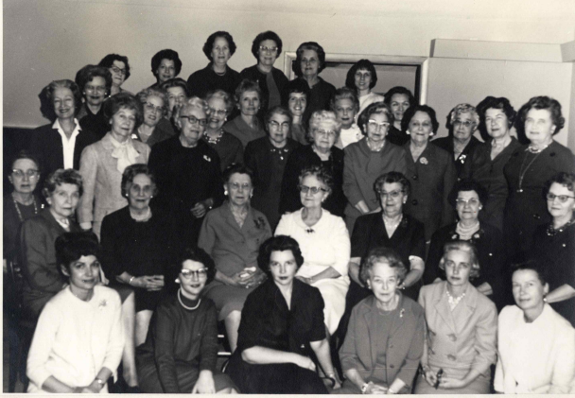
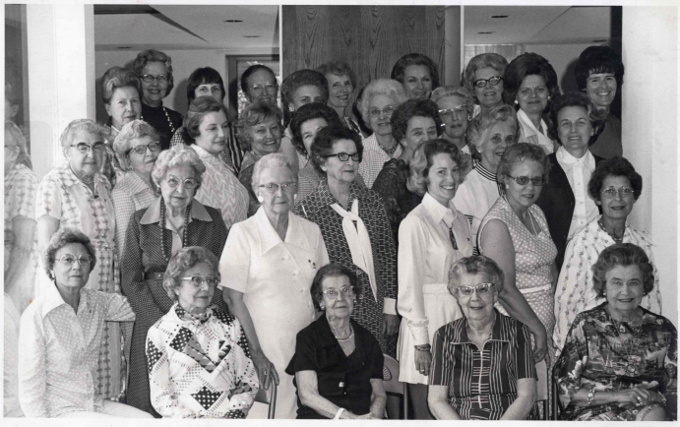
CHAPTER CI
WICHITA
Organized March 8, 1924
50th Anniversary 1974
100th Anniversary
March 8, 2024

Slide 6
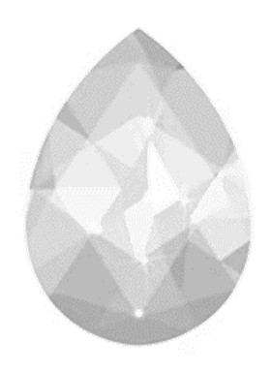
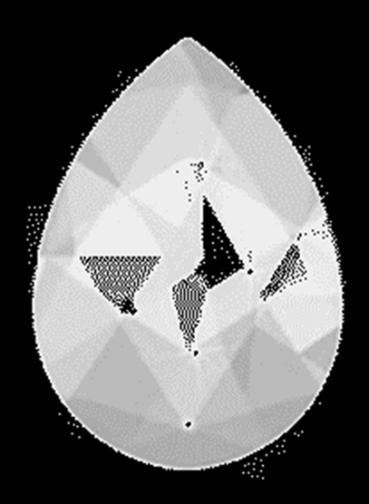
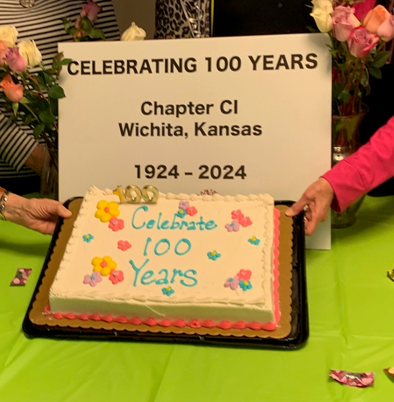
*Although the roads were snowy and icy, 13 charter sisters were initiated into Chapter CI - the 14th was quarantined with diphtheria.
*Three sisters from the 50th Anniversary picture are still in Chapter CI.
*Edith Coe is a published author and was an editor to the book “Our Diamond Heritage: Seventy-Five Years of P.E.O. in Kansas”
*
100th Anniversary party

Slide 7
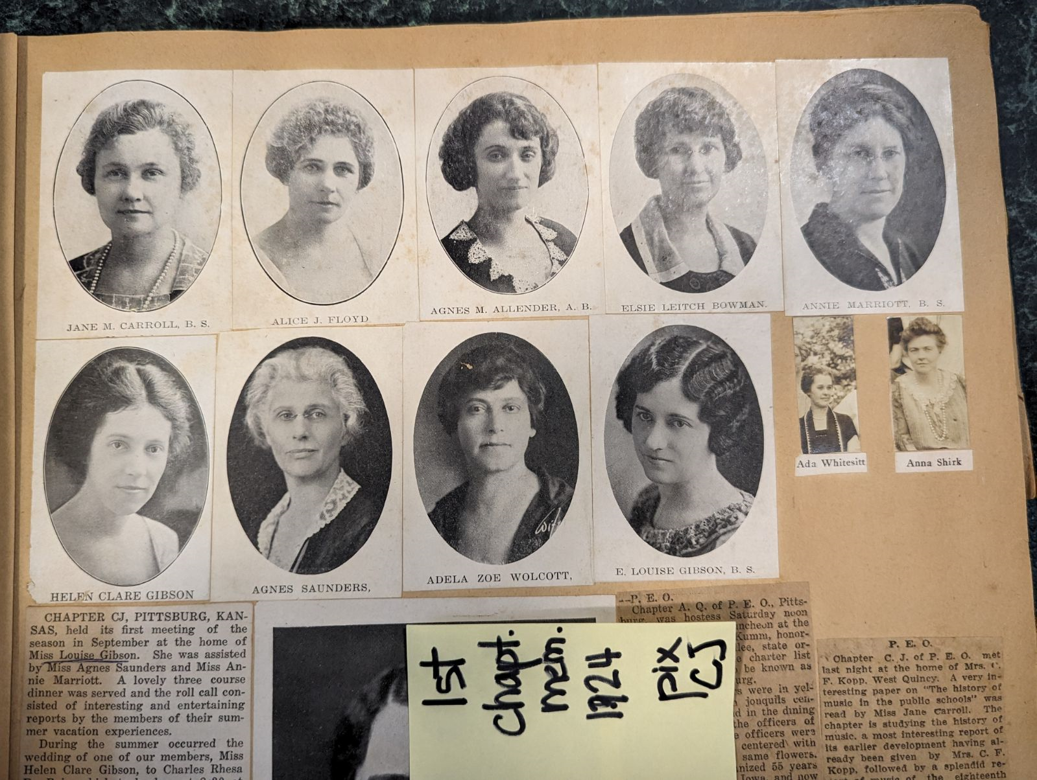
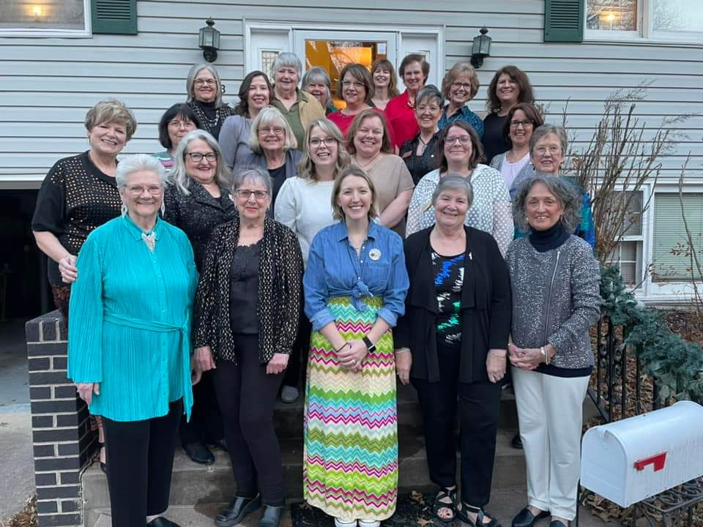
CHAPTER CJ
PITTSBURG
Organized March 15, 1924
1924
2024

Slide 8
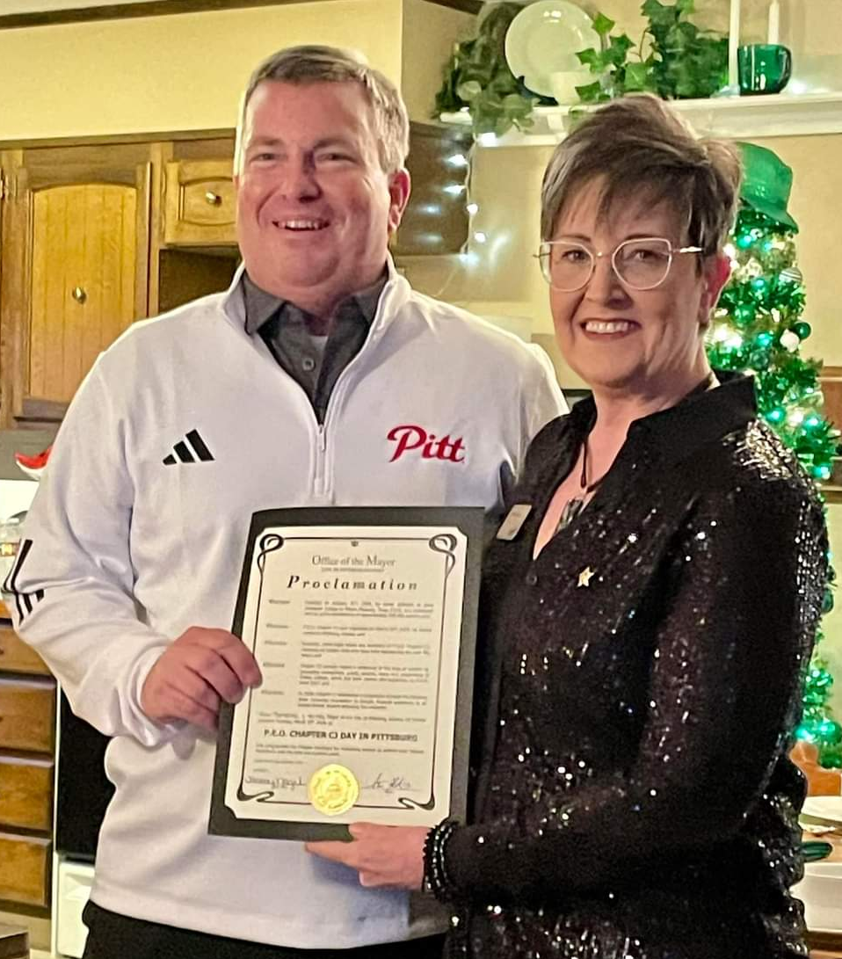
*Chapter CJ once had a newsletter titled; “Chatter of Joy”.
*Was known as the “FUN” chapter.
*Jo Ann Kemp, 1976-1977 president of Kansas State Chapter, was a member of CJ, Pittsburg; she is currently a member of HW, Topeka.
*The Mayor of Pittsburg presented a proclamation that March 15, 2024, shall be recognized as Chapter CJ, P.E.O. Day in the City.
The Mayor along with
President of Chapter CJ, Beth Emmert.

Slide 9
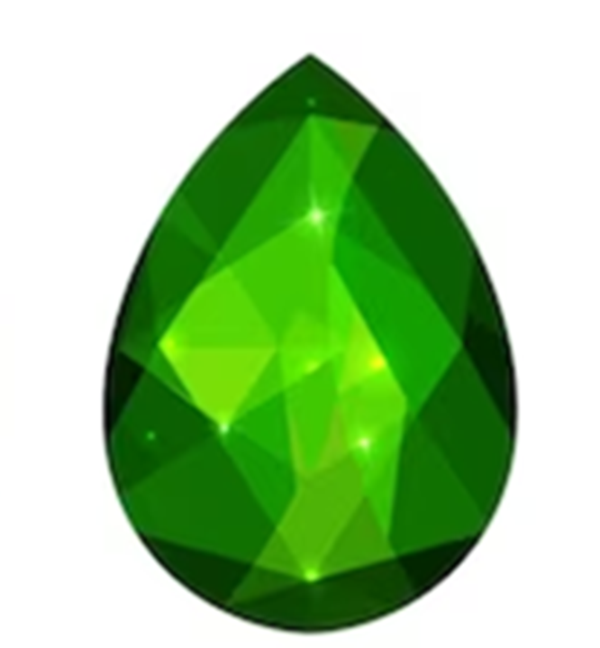
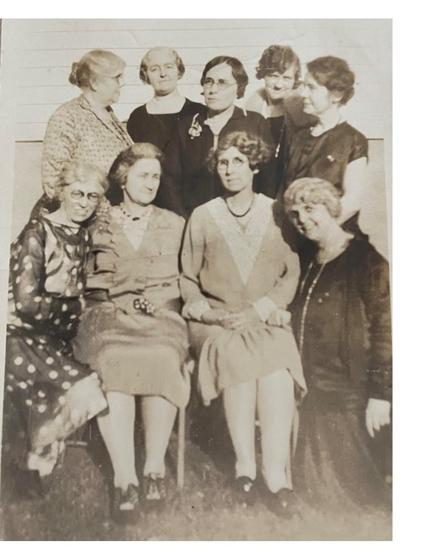
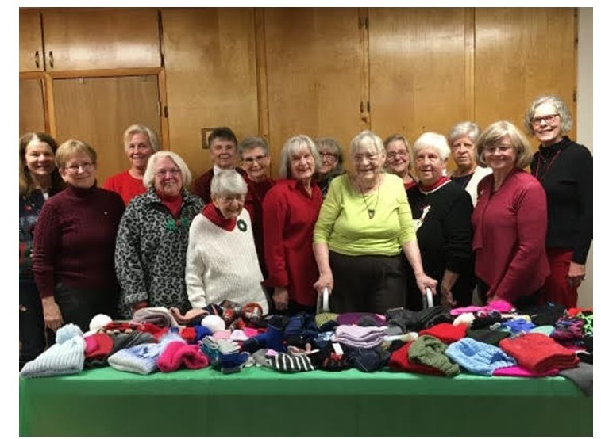
CHAPTER CK
BALDWIN CITY
CK
Organized March 22, 1924
1924
2024

Slide 10
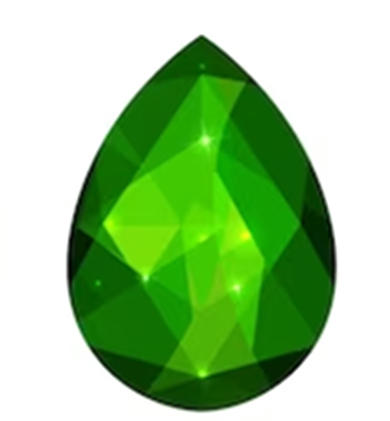
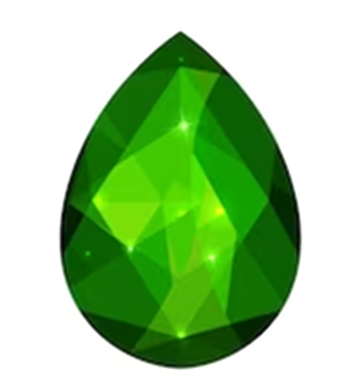
*The first members included four Baker University faculty wives, a pharmacist, a telephone operator, a newspaper editor’s wife, a banker’s wife, four schoolteachers, and a nurse.
*In 2015, their chapter membership included nine sisters who were members for 50 or more years.
*Participated in local projects such as taking treats for employees to local schools, giving mugs of candy to the police department, holding an annual dessert auction, and awarding the Margaret Pierce scholarship in the amount of $600.

Slide 11
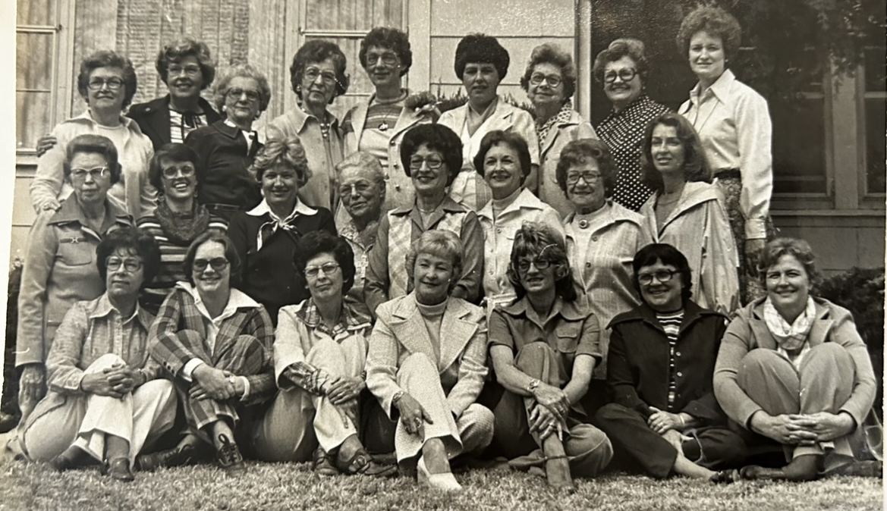
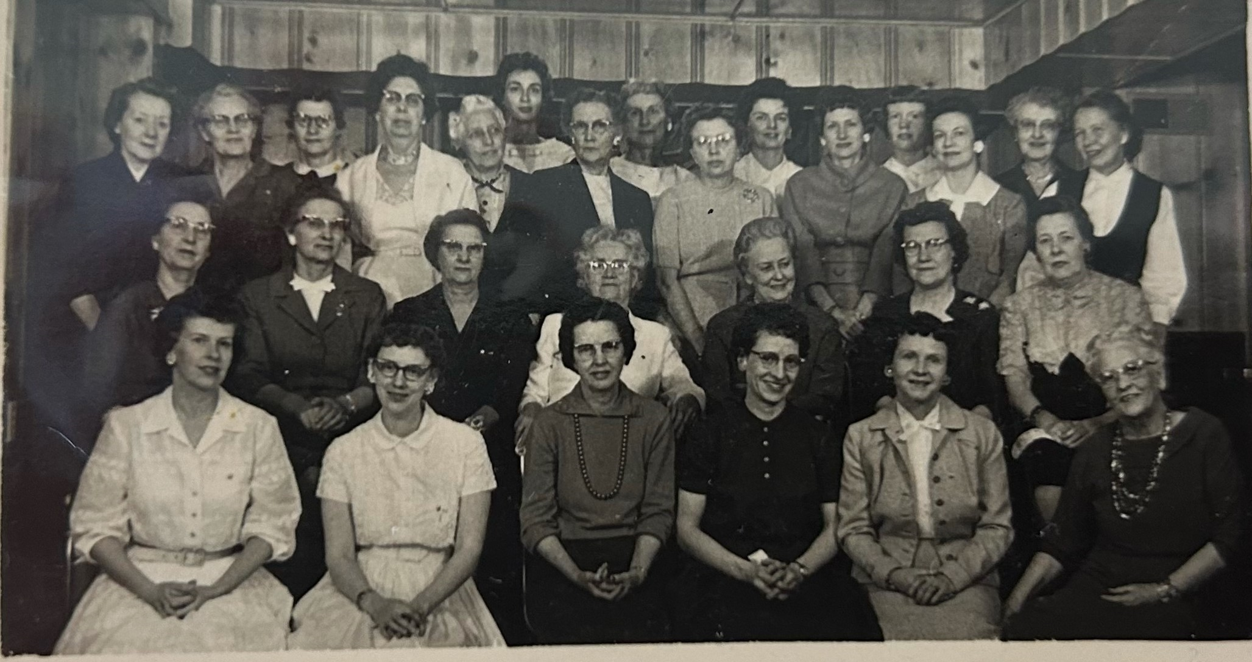
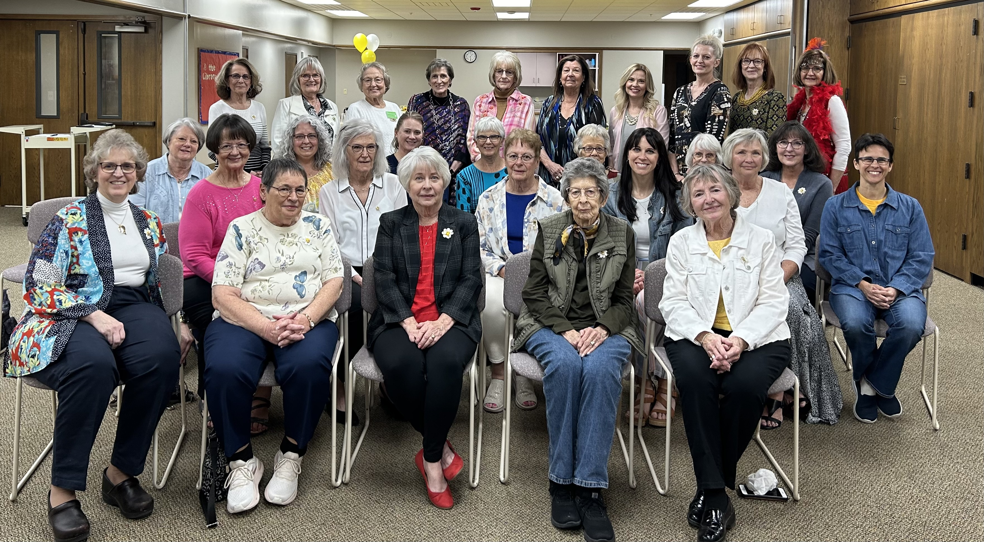
CHAPTER CL CIMARRON
CL
Organized April 5, 1924
1978 at the KSC Convention. Pat McFarland (CL) was installed as KSC Executive Board President.
100th Anniversary
April 6, 2024
1960

Slide 12
*Pat McFarland, 1978-1979 president of Kansas State Chapter, was a member of Chapter CL. Her chapter enjoyed saying: “Yo-ho-ho, Pat is our treasure!”
*During the 1940’s and WWII, sisters assembled Red Cross kits, made surgical dressings and knitted afghans.
*In the 1950’s, the chapter started hosting a Cottey College Tea for local high school girls.
* Chapter CL is proud to have eight Cottey College graduates

Slide 13
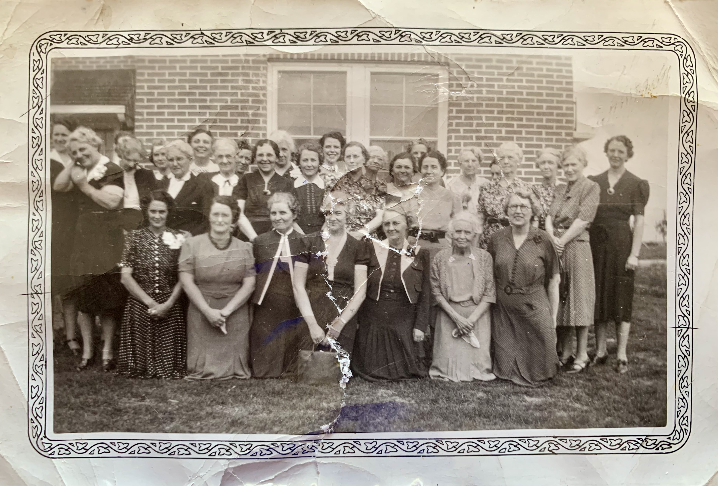
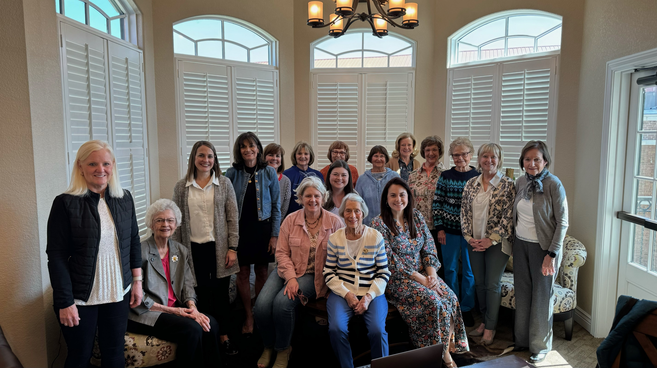
CHAPTER CM
HUTCHINSON
CM
Organized October 4, 1924
Late 1930’s
2024

Slide 14
*Anticipates the future, enjoys the present and treasures the past!
*Wrote a musical called: “Kansasalot” - it expressed the thoughts of a new initiate.
*Greatest achievement has been the sharing of ideas and hopes and a deepening of love and understanding of our sisters.

Slide 15
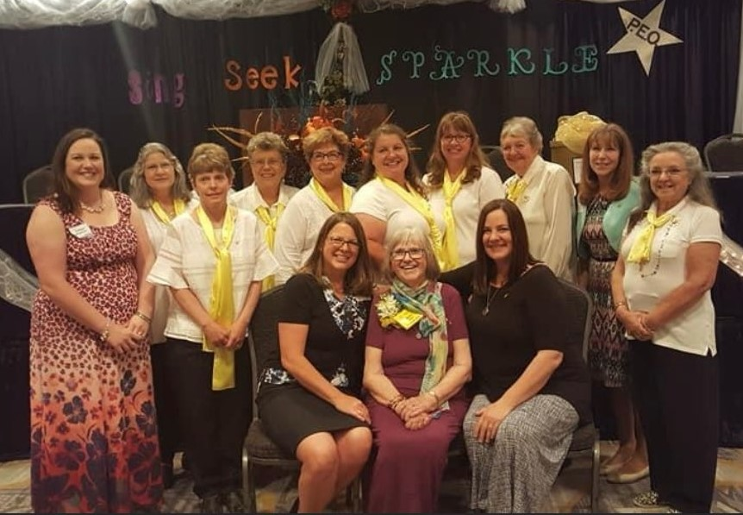
CHAPTER CN
MANKATO
CN
Organized October 15, 1924
June 2018

Slide 16
*The Sisters of CN made gifts for Cottey College students, delivered food baskets to the needy, supported the USO, volunteered in the Red Cross, organized March of Dimes events, sponsored deserving women for P.E.O. projects.
*Chapter CN has empowered women in their community, initiating 171 members, many of which represent multiple generations of the same family.
*Chapter CN is best described by a quote written by their President for their 50th anniversary. Rosalie Menhusen wrote, “The love and consideration of the P.E.O. Sisterhood is rewarding and of great value to its members.”

Slide 17
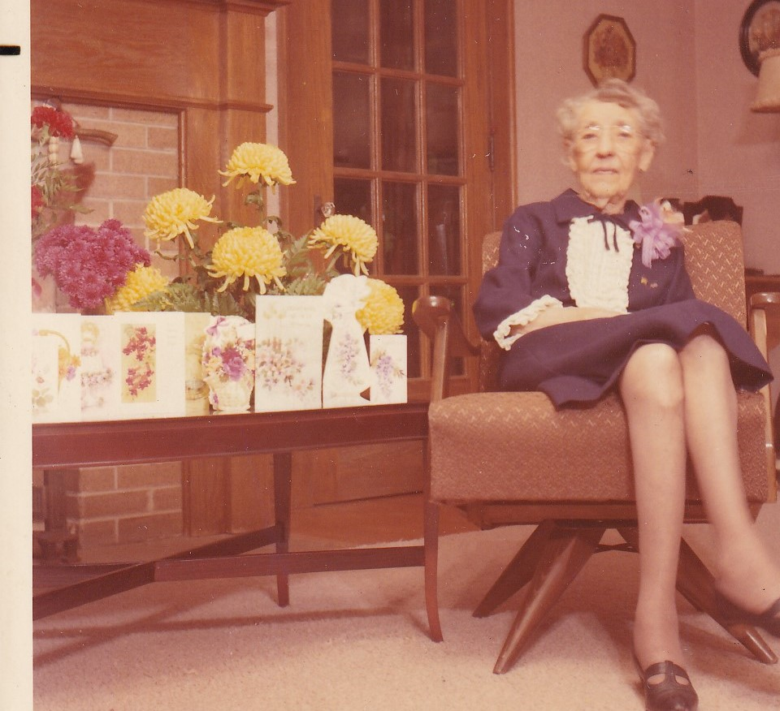
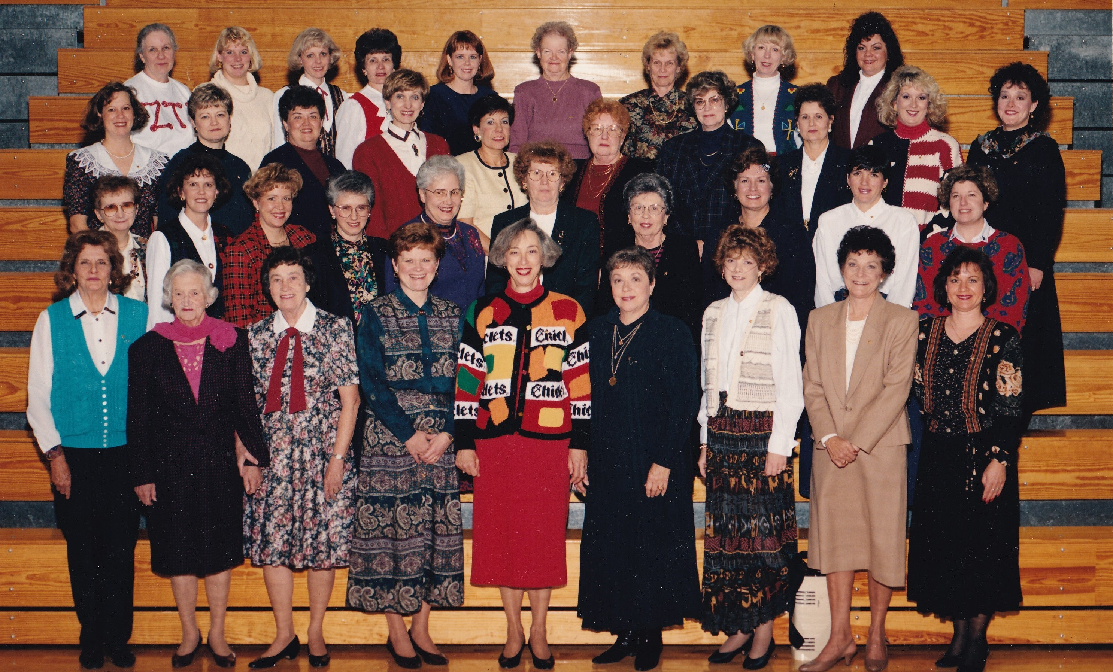
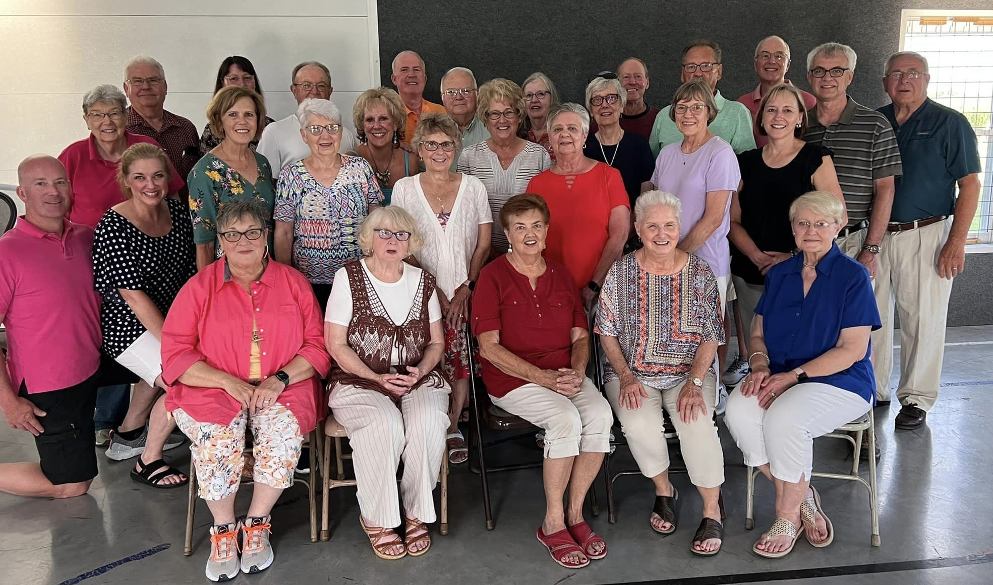
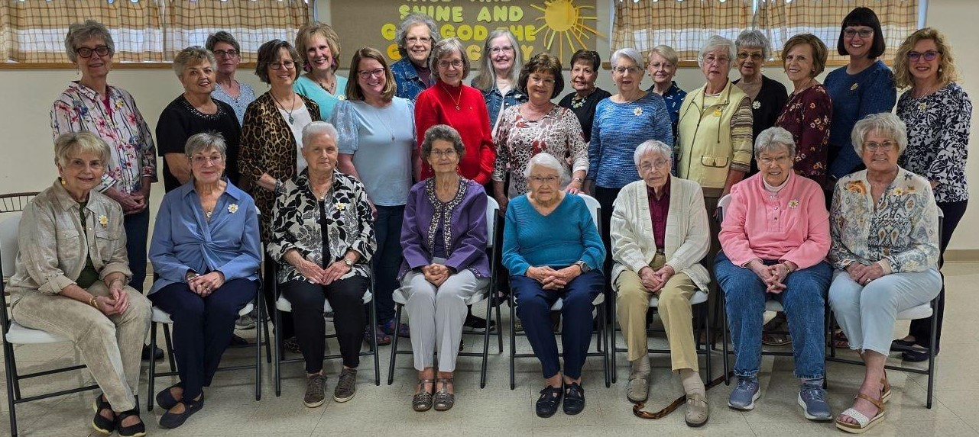
CHAPTER CO
BURLINGTON
CO
Organized
November 18, 1924
Eva Kennedy:95th Birthday:
1969 Charter Member
2024
1995
Chapter CO Sisters
with their B.I.L.s

Slide 18
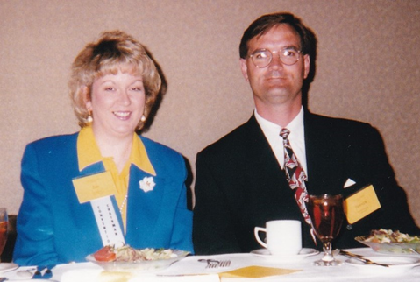
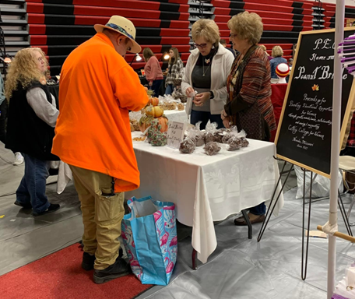
*“We bond with our sisters at events we all enjoy.”
*Activities that the chapter enjoy include a traveling birthday basket, a booth at arts and crafts fair, and holding an annual pancake feed.
*Proud to have initiated Jan Guevel, who is now serves on the KSC Executive Board.
Jan and her B.I.L. Patrick
Convention 1999
*Known for their famous Peanut Brittle

Slide 19
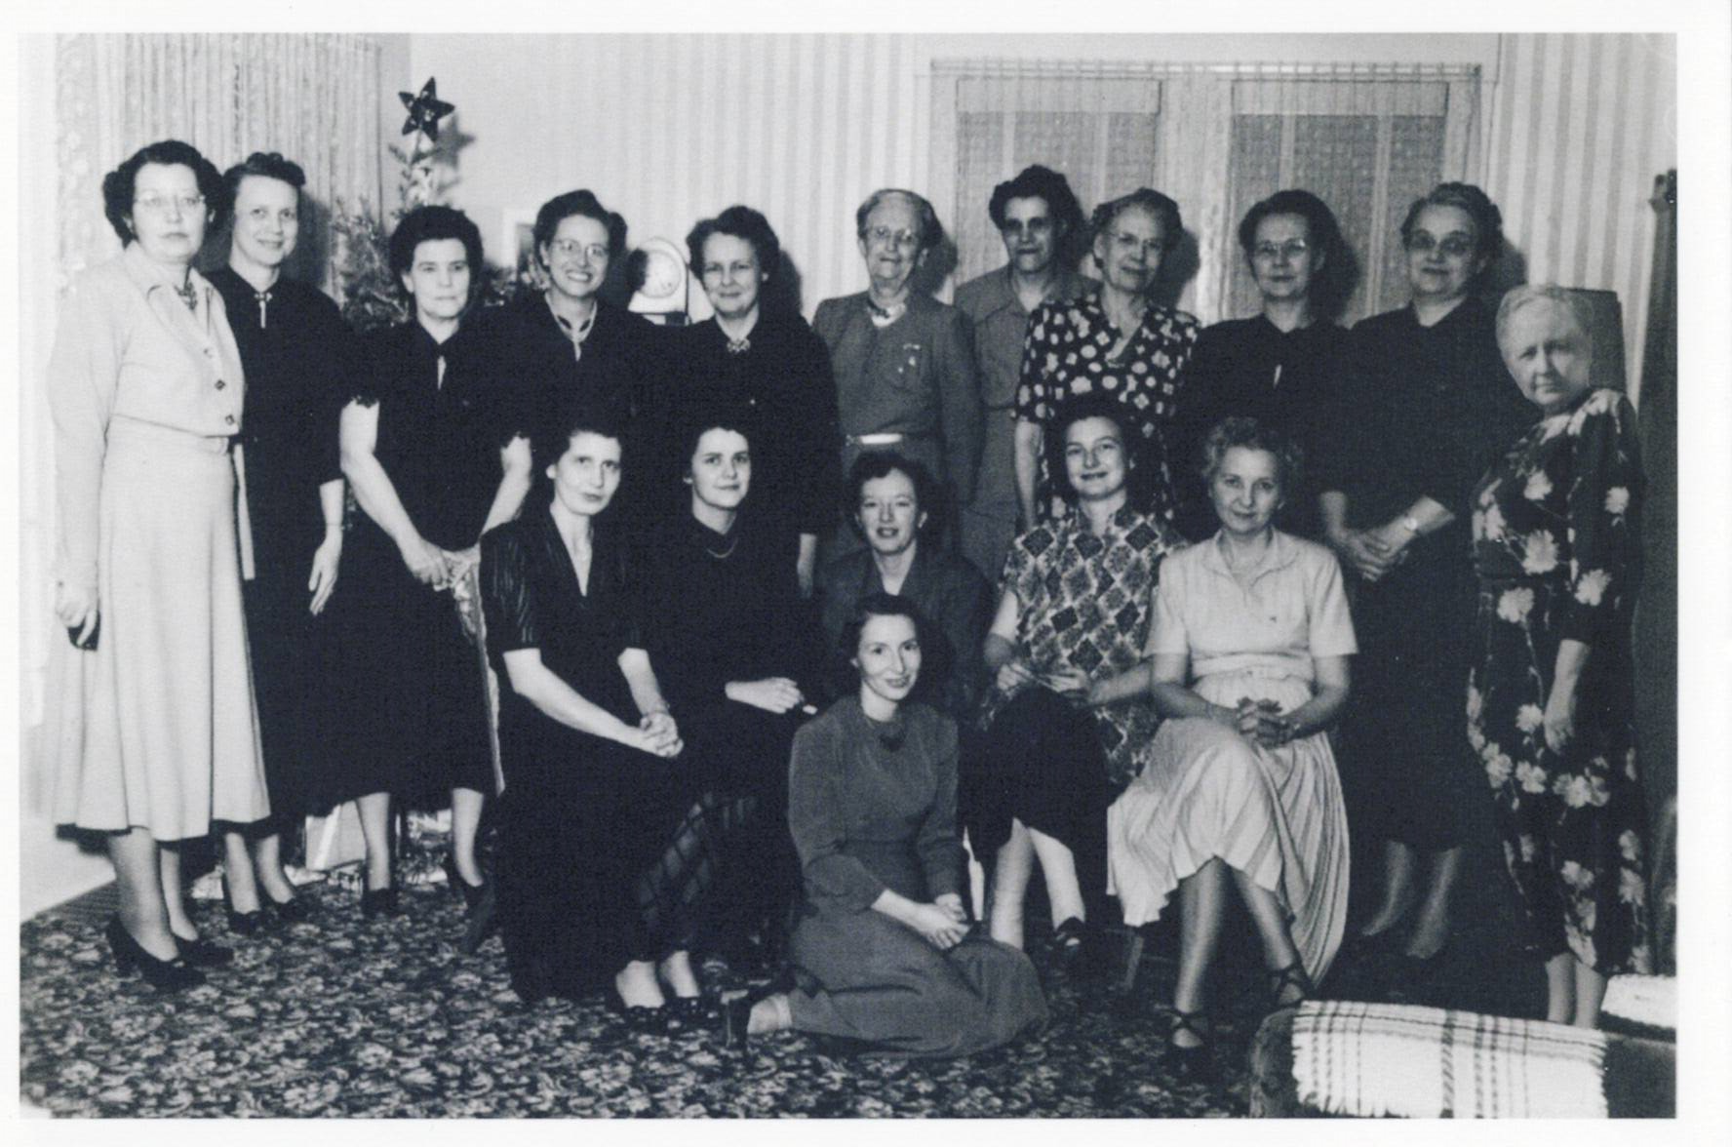
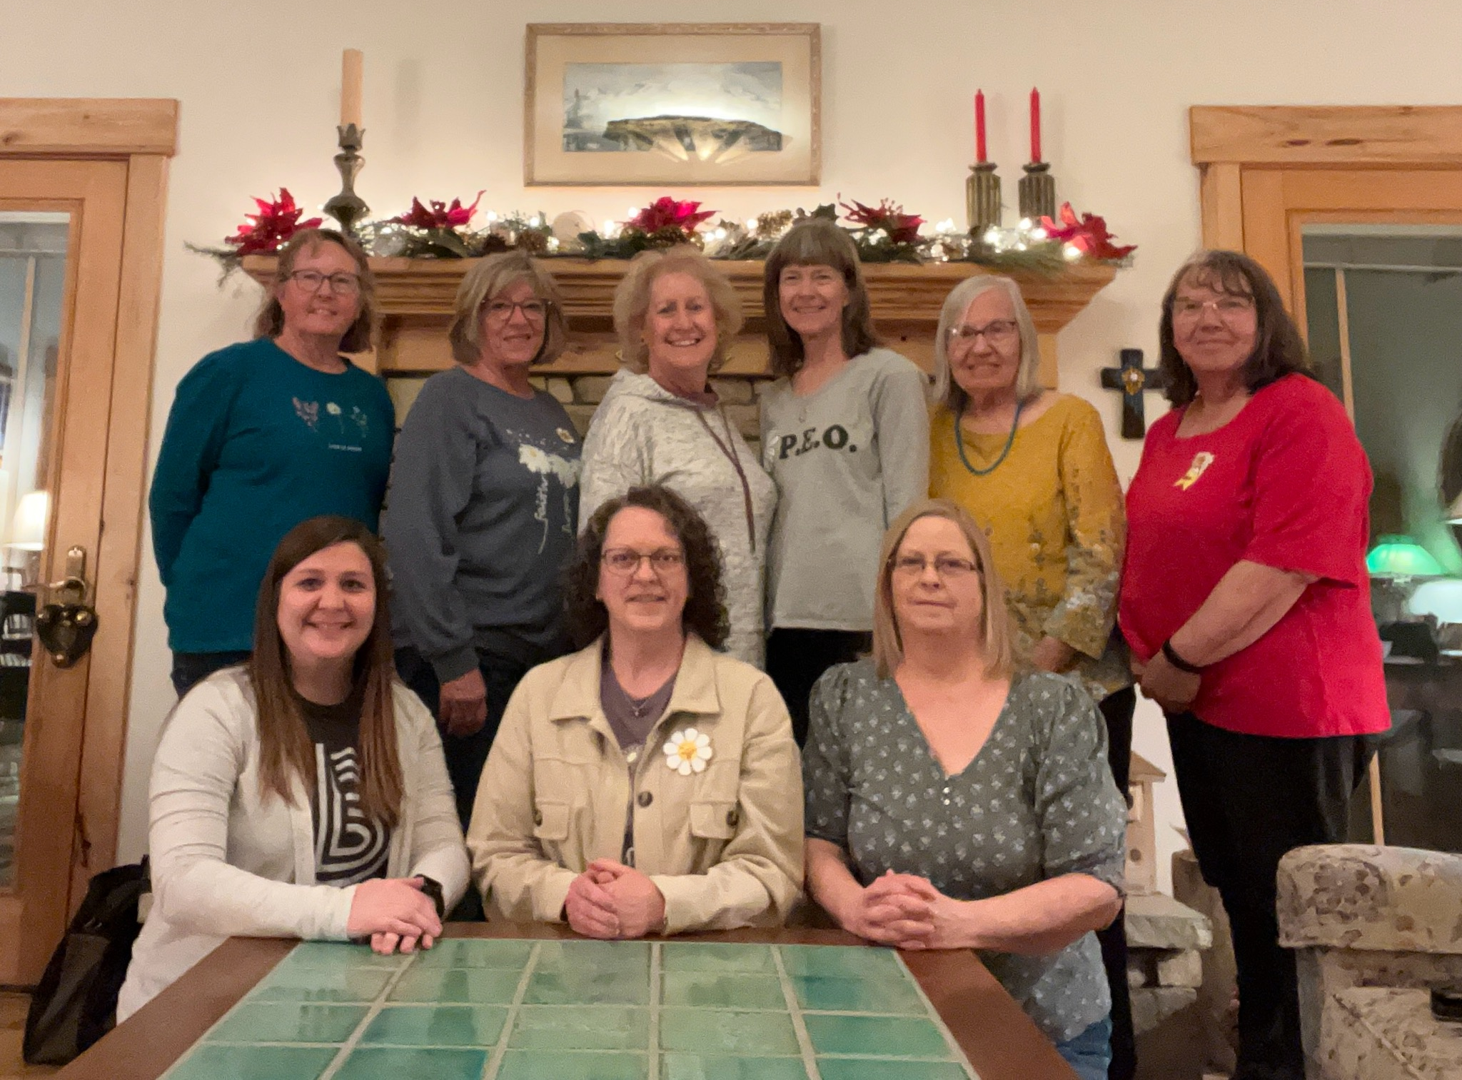
CHAPTER FO
ELLIS
FO
Organized April 7, 1949
December 1949
March 2024

Slide 20
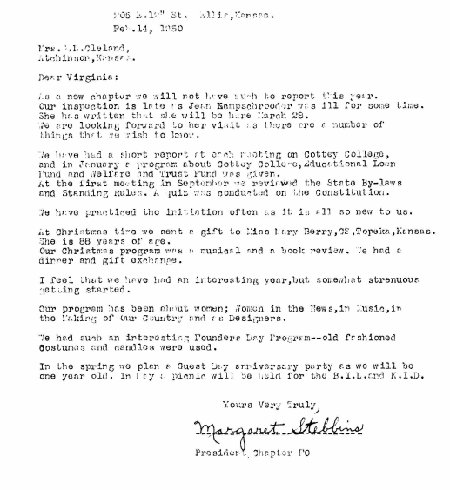
*In 1999, they recognized and celebrated FIVE Golden Girls, in addition to celebrating 50 years as a chapter.
*“P.E.O. is a journey – both for the chapter and for the individuals.”
*Over the last 75 years, they have shared the gift of P.E.O. with over a hundred other women.
*Chapter FO’s first President Letter.

Slide 21
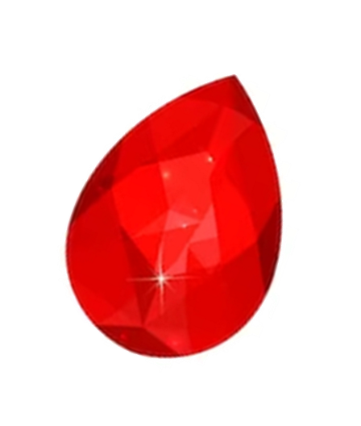
1924 –
2024
1949
2024
Happy Anniversary to our Sparkling Jewels of Kansas!!

